Slide 1
AM CVN stars -an update
Jan-Erik Solheim
Institute ofTheoreticalPhysics
University of Oslo

Slide 2
AM CVn stars:
Hydrogen deficient Semi-detached shortperiods interactingbinaries
D.J. Kustererwith BINSIM tool by R. Hynes

Slide 3
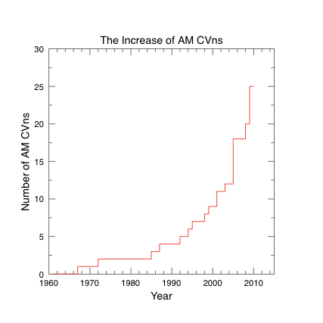

Slide 4
DISTRIBUTION OF AM CVNs
Only 3 objectsbelowgalacticequatoroutof 25

Slide 5
AM CVns of various kinds
Direct impact | P(min) | Mag | Spectrum | Mass transfer
HM CNc | 5.36 Direct | 21 | X-rays, faint emm, pol | 10⁻⁷
ES Cet | 10.3 Direct | 17 | emission | 5x10⁻⁷
AM CVn | 17.1 Disc-large | 14 | Absorption | 7x10⁻⁹
V803Cen | 26.6 Disc-variable | 13-17 | Emission/Absorption | 0.6-1.6x10^{´9}
SDSS J0926+36 | 28.3 Disc variable | 19- | EclipsingEmm/Abs | 10⁻¹¹
SDSS J1240-01 | 37.5 Disc var. | 18-20 | Emmission/Absorption
GP Com | 46.5 Disc small | 16 | Emission | < 4x10^{´12}
V396 Hya | 65.1 Disc small | 18 | Emission | 10⁻¹³

Slide 6
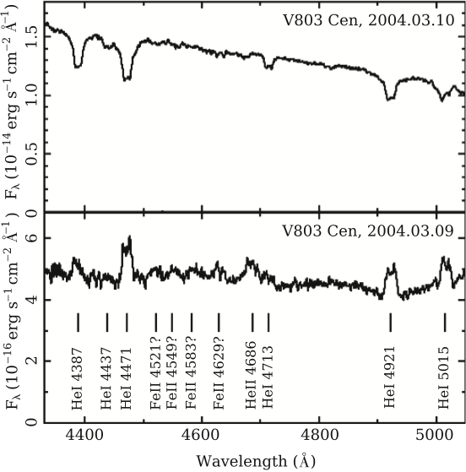

Slide 7
Completenessofspectroscopicfollow up in the SDSS
DB cooling
DA cooling
15 AM CVn stars arefound in the SDSS so far (11 new)
Roeloefs et al. 2005, 2007

Slide 9
The twoultrashort-period AM CVNsX-raydetected dP/dt< 0
V307 Vul: P = 9.48 min, HM Cnc: P= 5.36
kT= 67 eVkT= 65 eV
(Wood 2009)

Slide 10
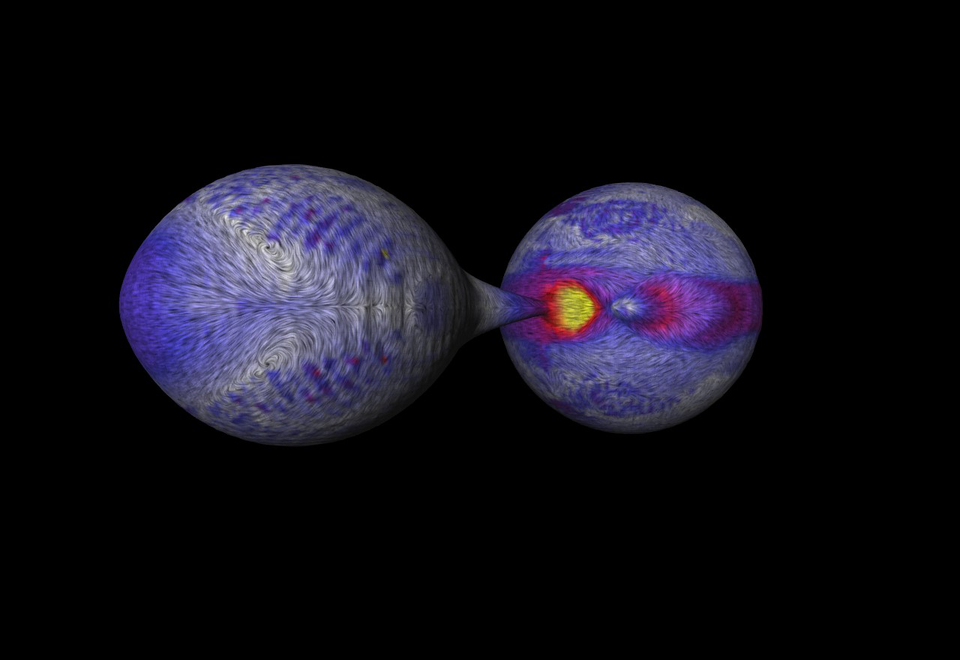
DirectInpactDetails

Slide 11
Electric star model (No accretion)
Wu 2009

Slide 12
L .Yungelson (2010)

Slide 13
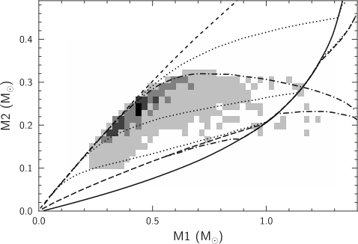
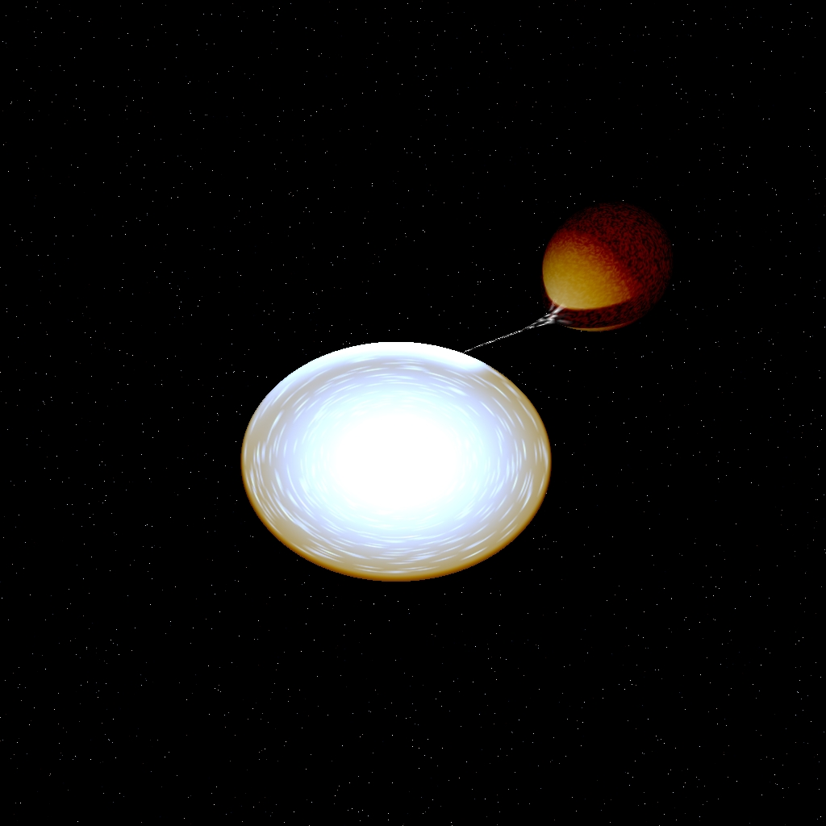
Birth rates and criteria for stable mass transfer
ALWAYS UNSTABLE
(Merger)
ALWAYS STABLE (Disc)
Dotted lines arestability limits for long (bottom) and short (top) shortsyncronisation time simes ( Nelemans et al 2001, Marsh et al 2004)

Slide 14
Helium star donors birthrates: optimistic and pessimistic
(Nelemans et al 2001)

Slide 15
AM CVnevolution: Radius and Mass transfer rates
M_{1,i} = 0.3 M_{o} , M_{2,i}= 0.2M_{o}, Ψ_{c,i}=100, P_{orb,i}=6.5 min
(Deloye et al . 2007)

Slide 16
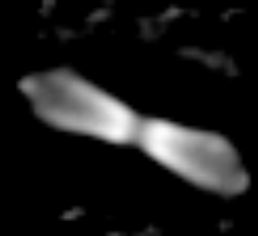
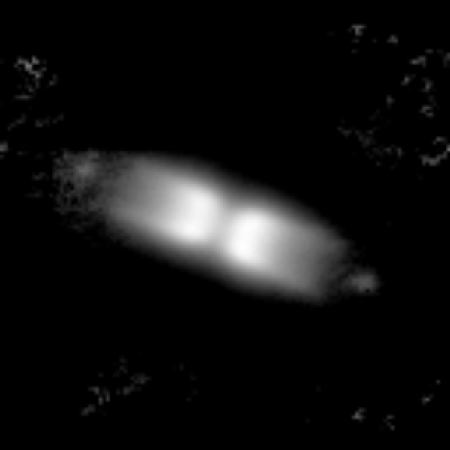
Helium nova: V455 Puppisexpanding bipolar cone
March 2005
March 2007
1.6x1.6”
Decmber 2005
3.5x3.5”
Expansion: knots 0.220” /yr, cone: 0.14”/yr
Adaptive optics in Ks-bandwith VLT/CONICA
P .Woudt (2008)

Slide 17
Mass transfer for AM CVnswith helium WD donors
Dashedcurves show degreesofdegenerarcyofdonor
(Deloye et al. 2007)

Slide 18
Mass transfer, Accretor Temp, M_{V}
No pulsating AM CVnsareyetfound.
Bildsten et al. 2005

Slide 19
Evolutionofabinary system -dependingon initial periodafter CE event for helium star donors
(Yungelson 2008)

Slide 20
Evolutionof Helium star donors
Top, solid: Leastevolved He star donor
Bottom, solid: Most evolvedHe-star donor
Dash-dot line: Leastdegenerate helium whitedwarf donor
Yungelson, 2008

Slide 21
Mass-radiusrelations for AM CVn stars Roche-lobefilling donor
Top solid: Helium star donor
Bottom solid: Cold WD

Slide 22
Donor M-R Relationscomparedwithobservations

Slide 23
Abundance ratio X_{N}/X_{c}
For WD-donorshighratiosareexpected - nuclearprocessesstopped
For He-star donors, helium burning continues and C maydominate
Dotted line: Helium star donors with P(CE)=20, 80, 120 min
(Nelemans et al. 2010)

Slide 24
Conclusions Suggested Birth Channels
Name | P(min) | elements | Donor ?
HM CNc | 5.36 | He/H≈0.4 | WD or H
CP Eri | 28.4 | He/H≈4x10³ | evolved CV?
AM CVn | 17.1 | N, C, | Helium star
HP Lib | 18.4 | N, C, O | Helium star
GPCom | 46.5 | N/C>10, no Si | WD, halo
V396 Hya | 65.1 | N/C≥10, no Si | WD, halo
J1240 | 37.4 | N/C >1 | Helium star
J0804 | 44.5 | N/C>10 | Helium star
J0902 | 48.3 | He,Fe, Si no CNO
V406 Hya | 34.0 | He,Fe, Si,Ca, Na no CNO

Slide 25
Conclusions
Numberof AM CVnincreased pga surveys and dedicatedsearches – willcontinue and find more
The variety is increasing: ultrashort P, eclipsing, magnetic , halo objects, Periodchange (decreasing) , superhumpers, he-nova (V455 Puppis), sub-luminous supernova type Ib (SN2005E) or SN .Ia
Missing: Pulsating AM CVns; Remains: WD + substellarcompanion
Improvedtheory: stellar models, binaryevolution, theaccrtionprocess, spectralmodels, theCE-phase
Large telescopes for time-resolvedspectra;X-rays and UV detections, Dopplertomography, spikes and S-waves, Hubble astrometry, eclipsingobject … newkinematicmassdeterminations…
Missing: Good UV spectroscopy
Futurelowfrequencycalibrators for LISA-experiment, understandingof GR radiation

Slide 26
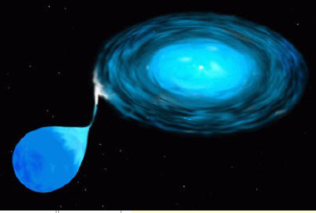
THE END
MORE: PASP, Oct 2010

