Slide 1
Two Planetary Nuclei with Recent Mass-Loss Events: V605 Aquilae & Longmore 4
Howard E. Bond
Space Telescope Science Institute
Baltimore, USA

Slide 2
V605 Aquilae
Rose to 10th mag in 1919.
Spectrum during outburst: cool, hydrogen-deficient carbon red giant, T_{eff} = 5000 K
Dropped below detectability in 1923
In 70’s, van den Bergh discovered it is central star of PN Abell 58

Slide 3
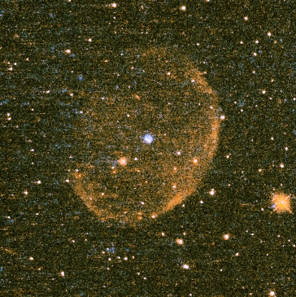
Planetary Nebula Abell 58
HST WFPC2 image of A 58, faint, H-rich PN (major axis 45ʺ) surrounding H-deficient born-again variable star V605 Aql.
Red = [N II]
Blue = [O III]
V605 Aql is inside compact nebula at center.
Pseudo-color image from Hubble Legacy Archive.

Slide 4
The Born-Again V605 Aql
Compact, dusty, H-deficient knot lies at site of 1919 outburst
Present-day spectra show that star is hot again, with high-excitation emission including C IV. Current T_{eff} ~ 95000 K
V605 Aql was a hot WD that underwent a very late thermal pulse, changing it briefly to a 5000 K red giant and back

Slide 5
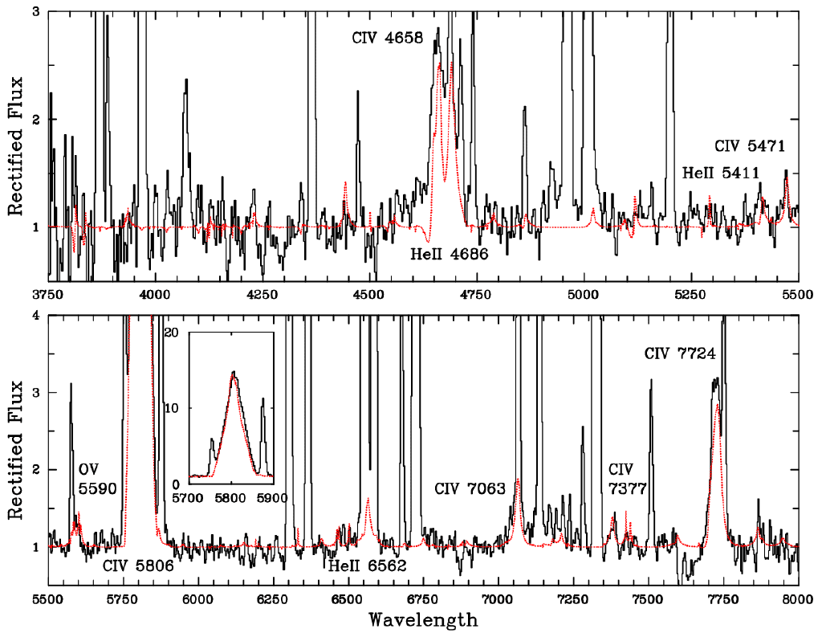
V605 Aql Spectrum 2001
ESO VLT spectrum of V605 Aql in 2001 (black line). Red line is best-fit model atmosphere (T_{eff} = 95,000 K). Sharp emission is from surrounding nebular knot. Note absence of H. Mass-loss rate =1.3 × 10⁻⁷ M/yr. Abundances: He:C:O = 54:40:5. Inset shows full intensity of strongest stellar feature, C IV λ5806. From Clayton et al. (2006)

Slide 6
HST Imaging of V605 Aql
HST has imaged V605 Aql 3 times:
1991 FOC F501N (PI: Bond)
2001 WFPC2/WF F502N, F658N (PI: Hinkle)
2009 WFPC2/PC F502N, F658N; WFPC2/WF F547M (PI: Clayton)
F501N & F502N: [O III]
F658N: [N II]
F547M: C IV emission from star

Slide 7
A Dusty Torus
HST images in [O III] and [N II] show compact nebula of diameter ~1″, bisected by dark band
Suggests dusty torus seen roughly edge-on
No obvious stellar image
Ejection during 1919 born-again event was non-spherical & clumpy

Slide 8
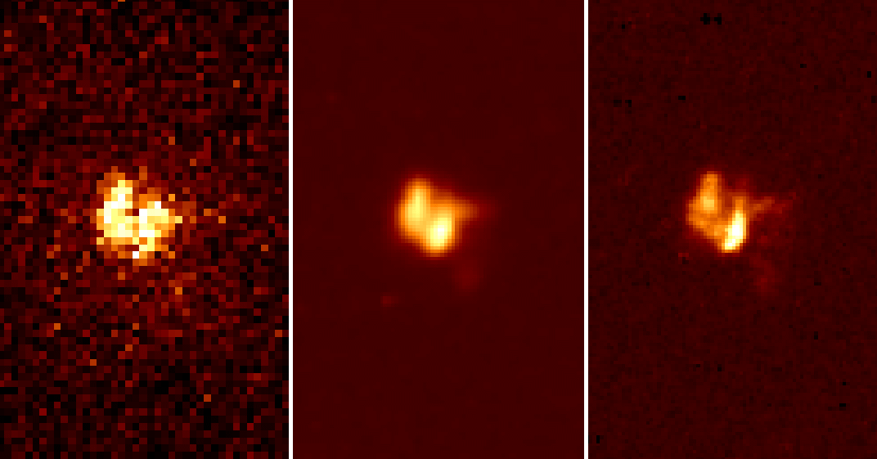
A Dusty Torus: [O III]
1″
1991
2001
2009
HST images of V605 Aql in [O III] 5007 obtained in 1991 (pre-COSTAR FOC), 2001 (WFPC2/WF3), and 2009 (WFPC2/PC). Each panel is 3″.6 wide. Note expansion of nebula from 2001 to 2009.

Slide 9
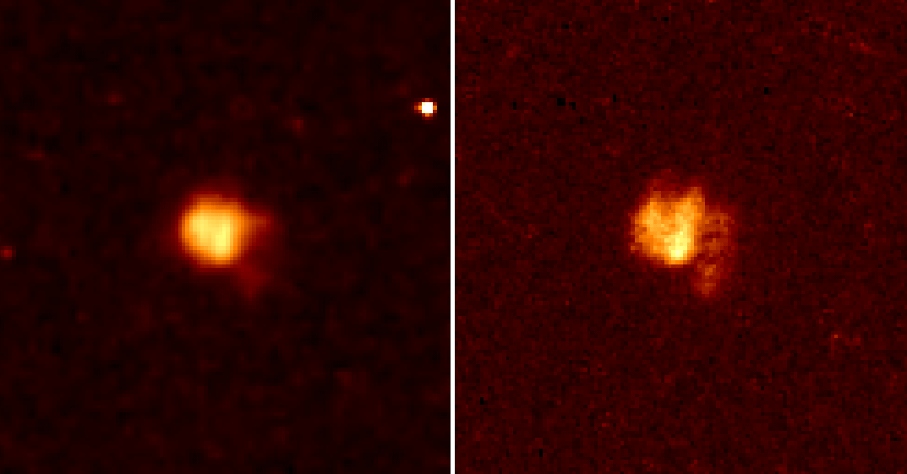
A Dusty Torus: [N II]
1″
2001
2009
HST images of V605 Aql in [N II] 6583 obtained in 2001 (WFPC2/WF3) and 2009 (WFPC2/PC). Each panel is 5″.6 wide. Note expansion of nebula from 2001 to 2009.

Slide 10
Angular Expansion
HST images in [O III] and [N II] clearly show angular expansion from 2001 to 2009
Expansion is ~9%, consistent with expansion starting at the 1919 event

Slide 11
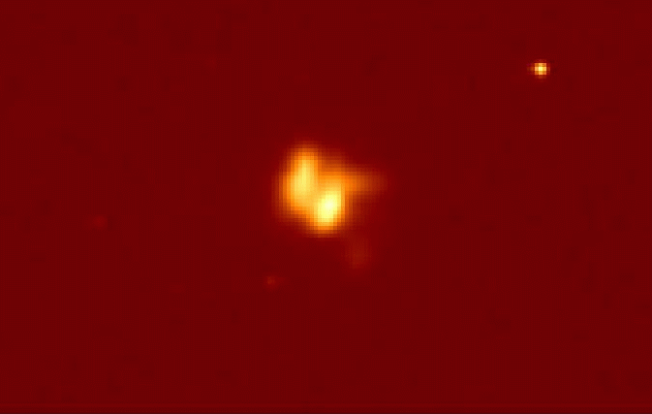
Angular Expansion in [O III] 2001-2009

Slide 12
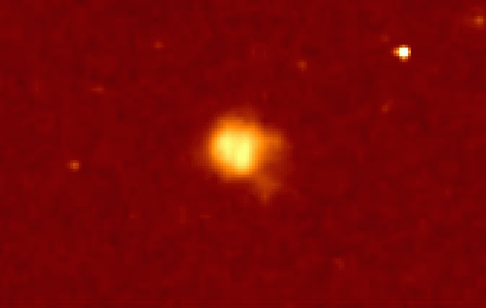
Angular Expansion in [N II] 2001-2009

Slide 13
Direct Detection of Central Star?
Central star is not seen in HST [O III] and [N II] images
Deep image (12,600 sec) in F547M (stellar C IV emission) dominated by slightly non-stellar “hot spot”
We suggest this is central star, seen through substantial dust extinction

Slide 14
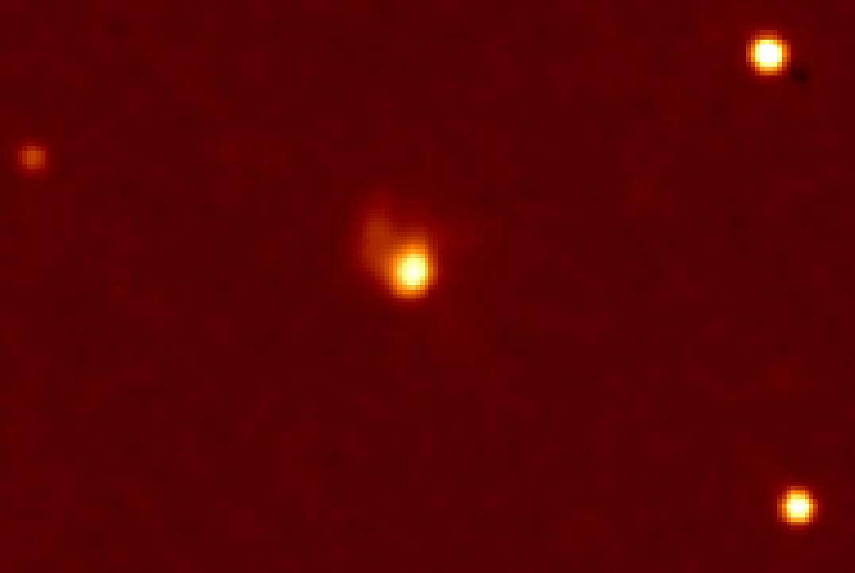
F547M (C IV) Image
HST 2009 image in F547M (WFPC2/PC). Panel is 8″.7 wide. Bandpass is dominated by stellar C IV emission & shows slightly non-stellar bright spot. This is probably the central star, seen through substantial dust extinction.

Slide 15
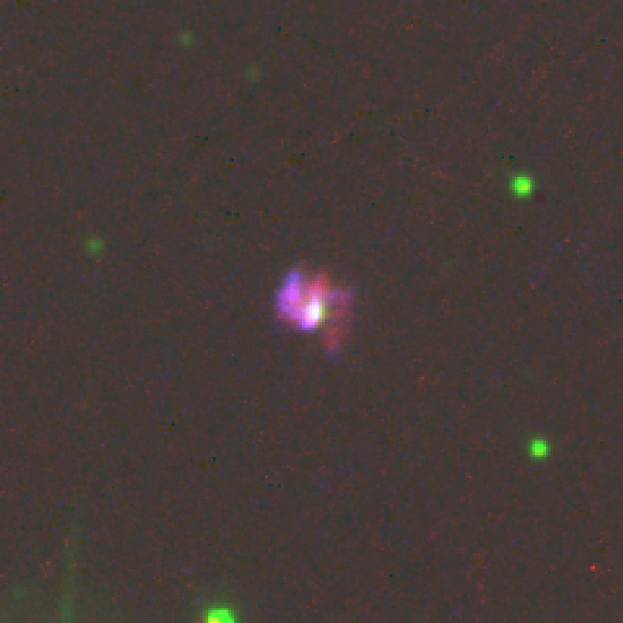
Central Star Lies Near Geometric Center of Nebula
Pseudo-color rendition of HST 2009 images in [O III] (blue), F547M (green), & [N II] (red). The white spot near the center may be the central star, visible through the dusty nebula.

Slide 16
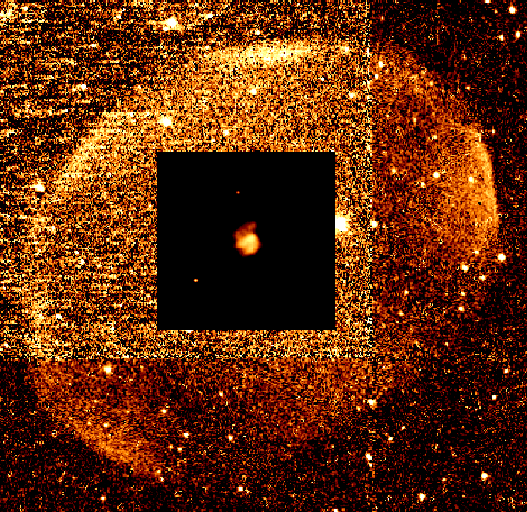
Torus of Compact Nebula is Aligned with Major Axis of Large, Faint PN!

Slide 17
HST V605 Aql Team
Geoff Clayton (PI)
Howard E. Bond
Olivier Chesneau
Orsola De Marco
Karl Gordon
Florian Kerber
William Sparks

Slide 18
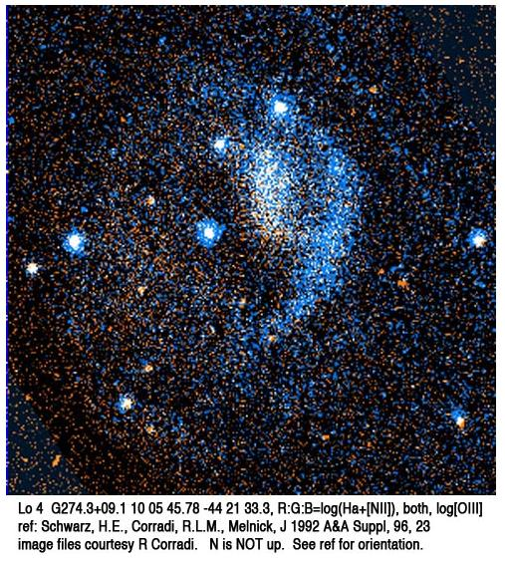
Longmore 4
Faint PN discovered by Longmore (1977), during ESO-SRC sky survey.
Central star (V=16.6) classified as PG 1159 star by Méndez et al. (1985):
Conspicuous C IV and He II absorption, no Balmer absorption. O VI 3811-3834 in emission
H-def spectral type: O VI , O(C), or PG 1159

Slide 19
Pulsations of Lo 4
CCD photometry of Lo 4 nucleus (Bond & Meakes 1990) revealed GW Vir-like non-radial pulsations.
Second known pulsating PNN (after K 1-16)
Strong periodicity near 31 min (1850 sec); at least 9 pulsation modes, with periods of 831 to 2325 sec

Slide 20
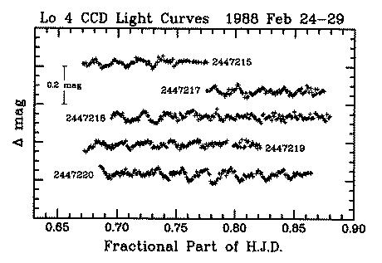
Pulsations of Lo 4
31 min
Bond & Meakes 1990

Slide 21
A Mass-Loss Event in Lo 4
A spectacular transient mass-loss event in Lo 4 was discovered by Werner et al. (1992,1993)
Spectrum changed from PG 1159 to [WCE] ([WC2]-[WC3]) and then back to PG 1159
T_{eff} = 170,000 K, log g = 6 (Werner et al. 2007; see also their poster at this meeting)
During [WC] state: log (dM/dt) = −7.3 (M/yr), v∞ = 4000 km/s

Slide 22
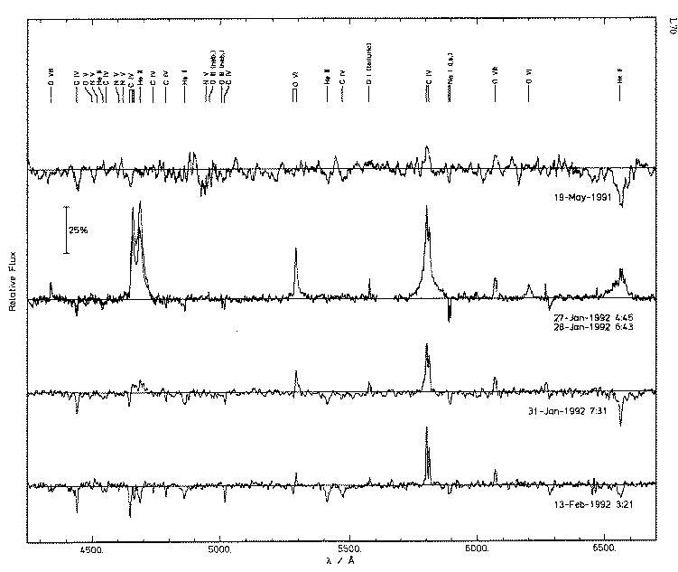
The 1992 Event Werner et al. (1992)
C IV+He II
C IV
O VI
He II

Slide 23
The Werner et al. Mass-Loss Event
Spectrum on 1991 May 19: normal PG 1159
1992 Jan 27 & 28: [WCE]! Emission weaker on 2nd night
1992 Jan 31: [WC] emiss. present but weak
1992 Feb 13: normal PG 1159
A unique phenomenon, never seen before in hot post-AGB stars

Slide 24
Spectroscopic Monitoring of Lo 4
I began spectroscopic monitoring in 2003—
—using service observing with SMARTS Consortium 1.5m telescope at Cerro Tololo
Wavelength coverage 3650-5400 Å
Resolution 4.3 Å
S/N per res. element ~30-40 on good nights
2003 Mar to 2010 May: ~70 usable spectra
Three mass-loss events have been detected!

Slide 25
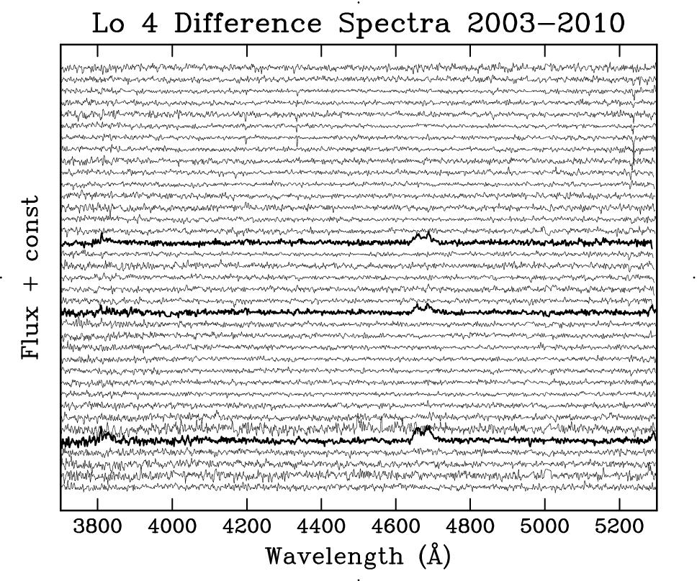
SMARTS Spectra, with Mean Subtracted
2003
2006 Jan 16
2006 Nov 30
2008 Nov 30
2010

Slide 26
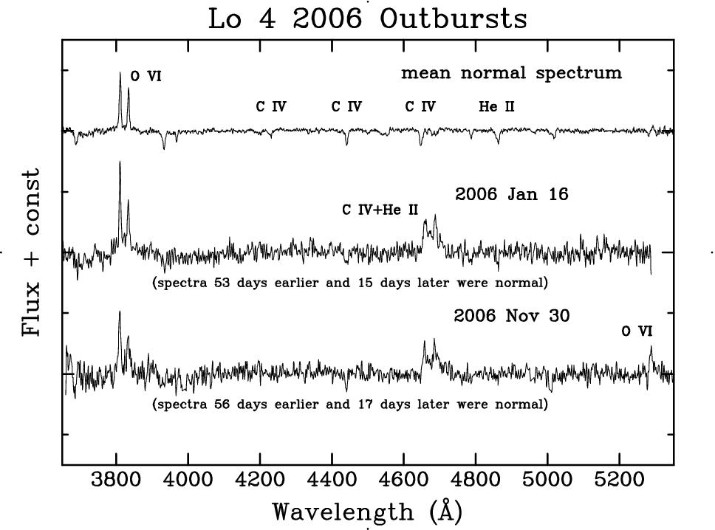
The 2006 Outbursts

Slide 27
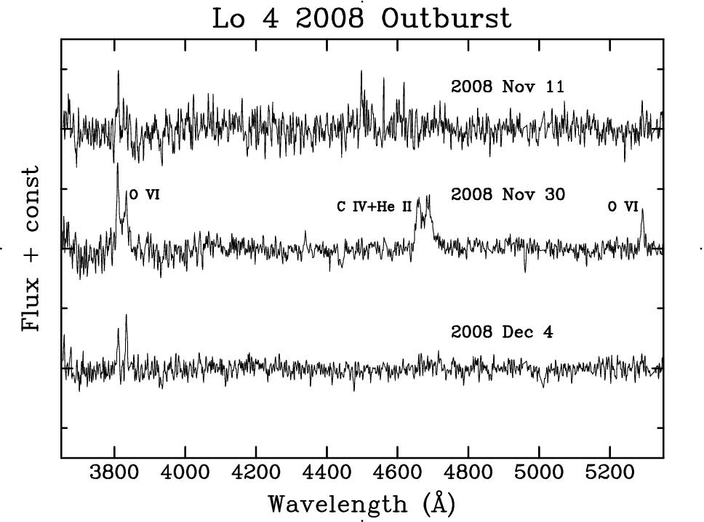
The 2008 Outburst

Slide 28
Central Star of NGC 246
PG 1159 spectrum similar to Lo 4
T_{eff} = 150,000 K, log g = 5.7 (Rauch & Werner 1997; Werner et al. poster) (slightly cooler than Lo 4)
Shows GW Vir-type pulsations similar to Lo 4 (Ciardullo & Bond 1996)
periods of 24-31 min
lower light amplitudes than Lo 4

Slide 29
Central Star of NGC 246
From 2003 to 2010 over 100 spectra obtained with SMARTS 1.5m
No mass-loss events were detected

Slide 30
Constraints on Mechanism
Lo 4’s transient wind is hydrogen-deficient
Thus unrelated to accretion events involving a companion star, debris disk, infalling planets, or other exotic external cause
Short durations of events ⇒ mass loss not driven on evolutionary timescale
The similar, but lower-amplitude, pulsator NGC 246 has not shown such events

Slide 31
Speculations
Córsico et al. (2006) suggest Lo 4 is near red edge of GW Vir instability strip & this may be related to transient events
Lo 4 does lie near the boundary between [WCE] and PG 1159 PNNi—see next slide

Slide 32
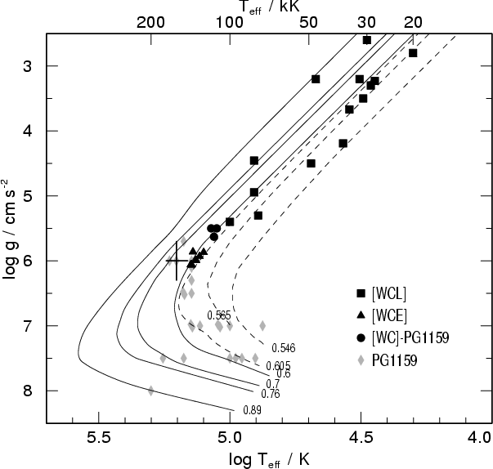
Locations in HR Diagram
Lo 4
NGC 246
Figure from Werner et al. 2004

Slide 33
Speculations, continued
Since Lo 4 lies near boundary between [WCE] and PG 1159 PNNi, it may take only a small perturbation to cause transition to [WCE]
For example, occasionally many pulsation modes will be in phase, giving a temporarily large amplitude—could this trigger an outburst?
If so, outbursts will recur @ beat period

Slide 34
Time-Averaged Mass-Loss Rate
4 mass-loss events seen in ~75 randomly timed spectra
∴ Lo 4 is in “high” state ~5% of time
Time-averaged dM/dt due to outbursts is ~ 0.05 ×10^{−7.3} ~ 2.5 ×10⁻⁹ M/yr
dM/dt during normal PG 1159 state is ~3-30 ×10⁻⁹ (from FUSE data; Werner priv. comm.) ⇒ outbursts have little additional effect on evolution

Slide 35
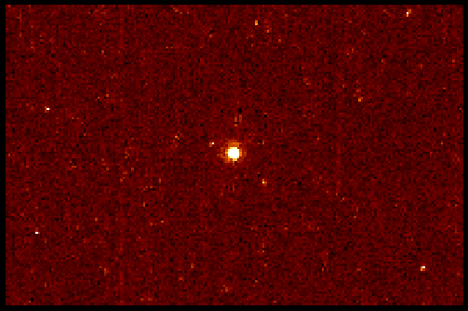
No Ejecta Visible Near Lo 4 in [O III] HST Image
HST/WFPC2 F502N 2200 sec Width 9″ 2007 June PI: K. Werner

Slide 36
Conclusions: V605 Aql
HST images resolve compact dusty nebula at site of 1919 born-again VLTP
Angular expansion consistent with ejection in 1919
Ejection was non-spherical: compact nebula is bisected by dark band
Central star is visible in stellar C IV line
Dark band is parallel to major axis of surrounding ancient PN Abell 58

Slide 37
Conclusions: Lo 4
Lo 4 occasionally transitions from normal PG 1159 spectrum to [WCE]
Supports evolutionary link between PG 1159 & [WCE] types
Events have little impact on evolution
Further observations could test whether outbursts recur periodically (beat period)
Do other PNNi near the [WCE] - PG 1159 transition show similar episodes?

Slide 38
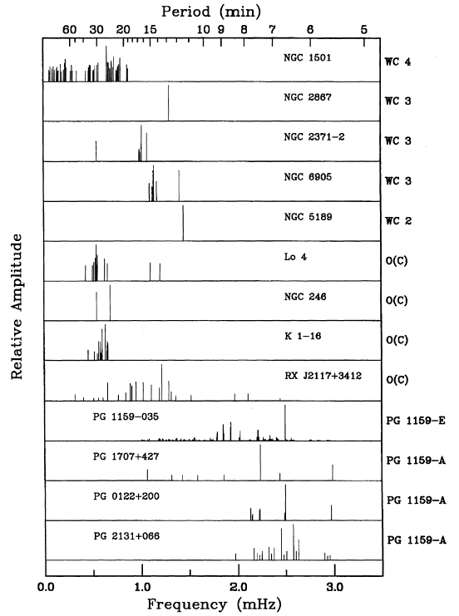
Lo 4 and Other GW Vir Hydrogen-Deficient Pulsating PNNi and WDs
Lo 4
NGC 246
Ciardullo & Bond 1996

Slide 39
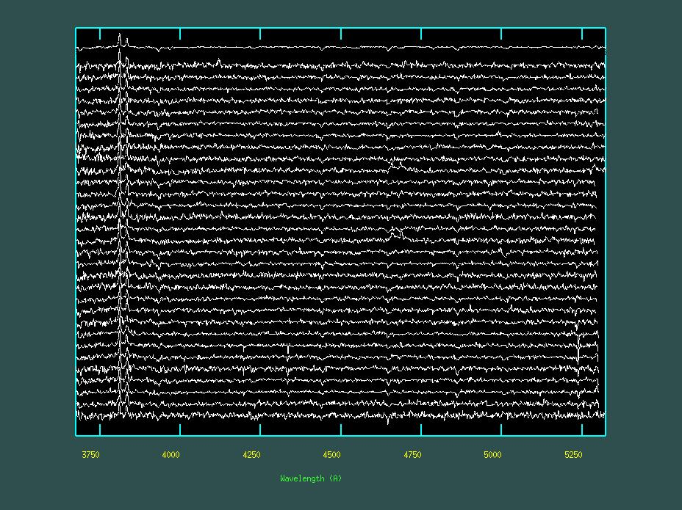
SMARTS 1.5m Spectra
mean sp.
2007
2003

Slide 40
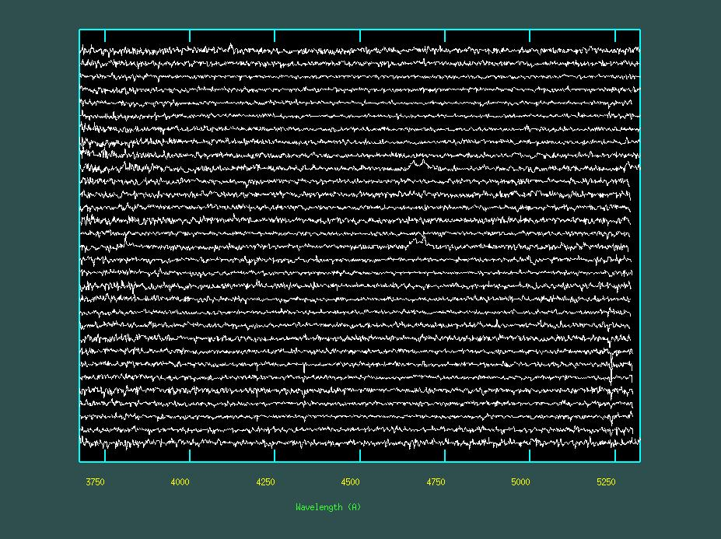
SMARTS Spectra, Mean Subtracted
2007
2006 Nov 30
2006 Jan 16
2003

Slide 41
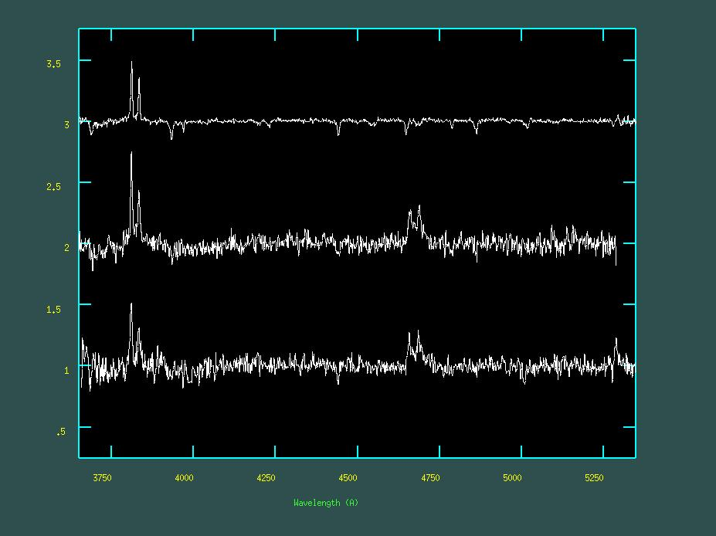
The 2006 Outbursts
O VI
mean normal spectrum
C IV
He II
2006 Jan 16
C IV+He II
(spectrum 53 days earlier was normal)
2006 Nov 30
O VI
(spectrum 56 days earlier was normal)

Slide 42
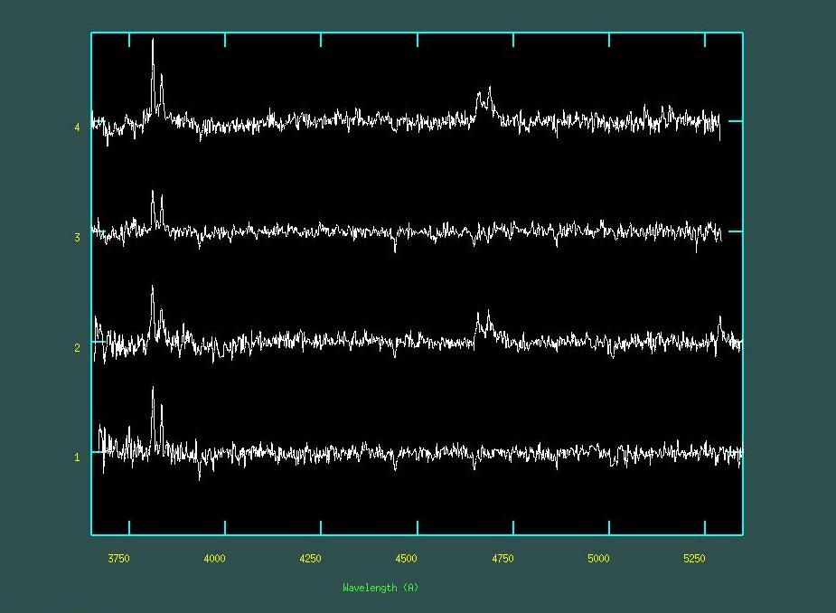
Outburst Decay Timescale
2006 Jan 16
15 days later
2006 Nov 30
17 days later

Slide 43
SMARTS Spectra, with Mean Subtracted
2003
2010

