Slide 1
High Resolution EUV Spectroscopy of Feige 24 Martin Barstow
Department of Physics & Astronomy
www.le.ac.uk

Slide 2
Introduction
Background – EUVE results
J-PEX instrument
Science goals of Feige 24 Observation
Results of 2008 J-PEX flight
Future prospects

Slide 3
Science background
Limitations of ~0.5-1.0Å resolution spectroscopy with EUVE
Detection of photospheric, interstellar or circumstellar He II
The composition and structure of white dwarf atmospheres

Slide 4
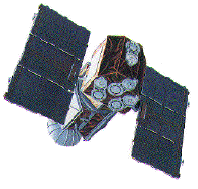
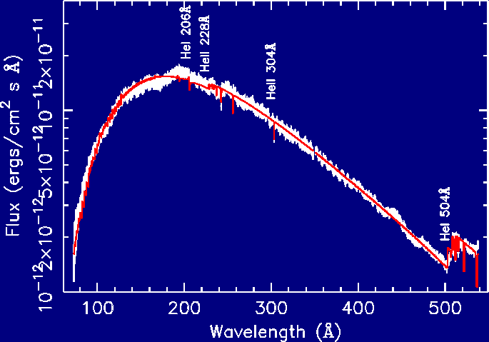
Helium in EUV Spectra
HZ 43

Slide 5
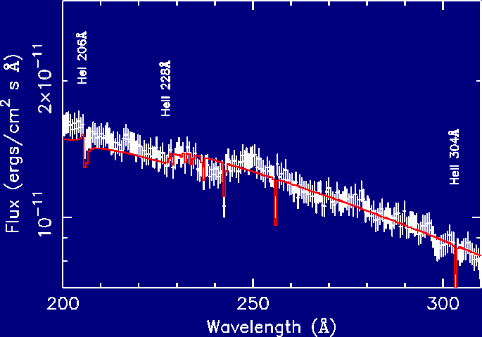
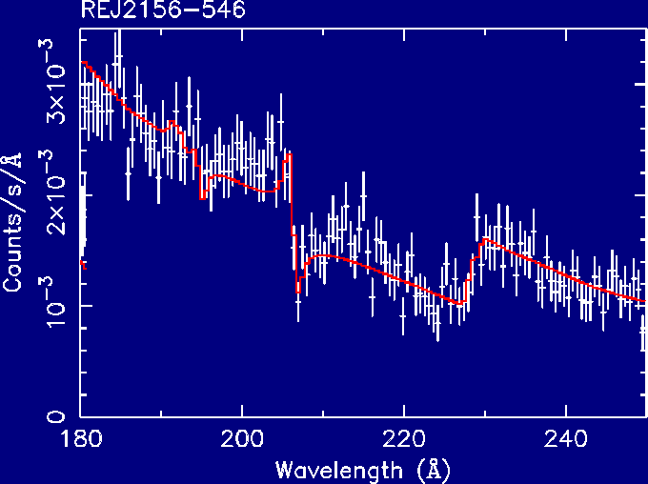
Helium in EUV Spectra
-B2B
Helium I
Helium II

Slide 6
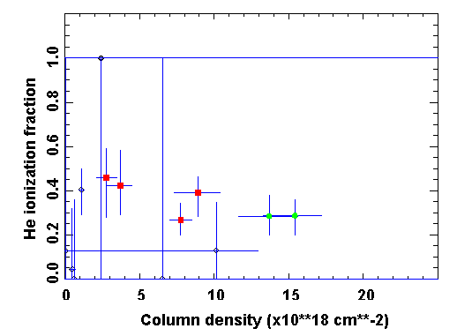
Interstellar Helium

Slide 7
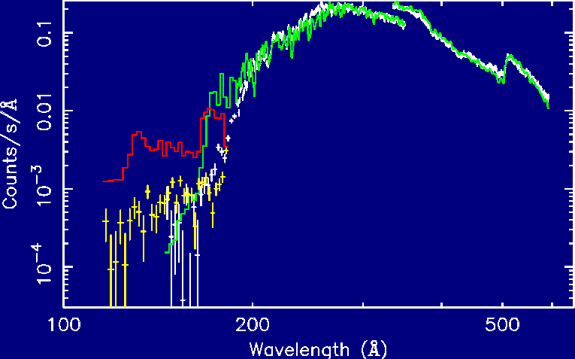
EUVE - Homogeneous Fe Mixture
G191-B2B

Slide 8
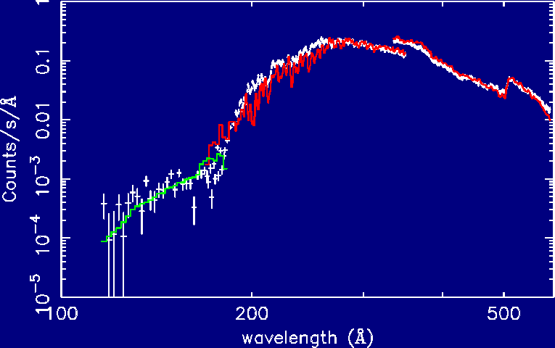
EUVE - Stratified Fe
requires ISM HeII/He~75%
G191-B2B

Slide 9
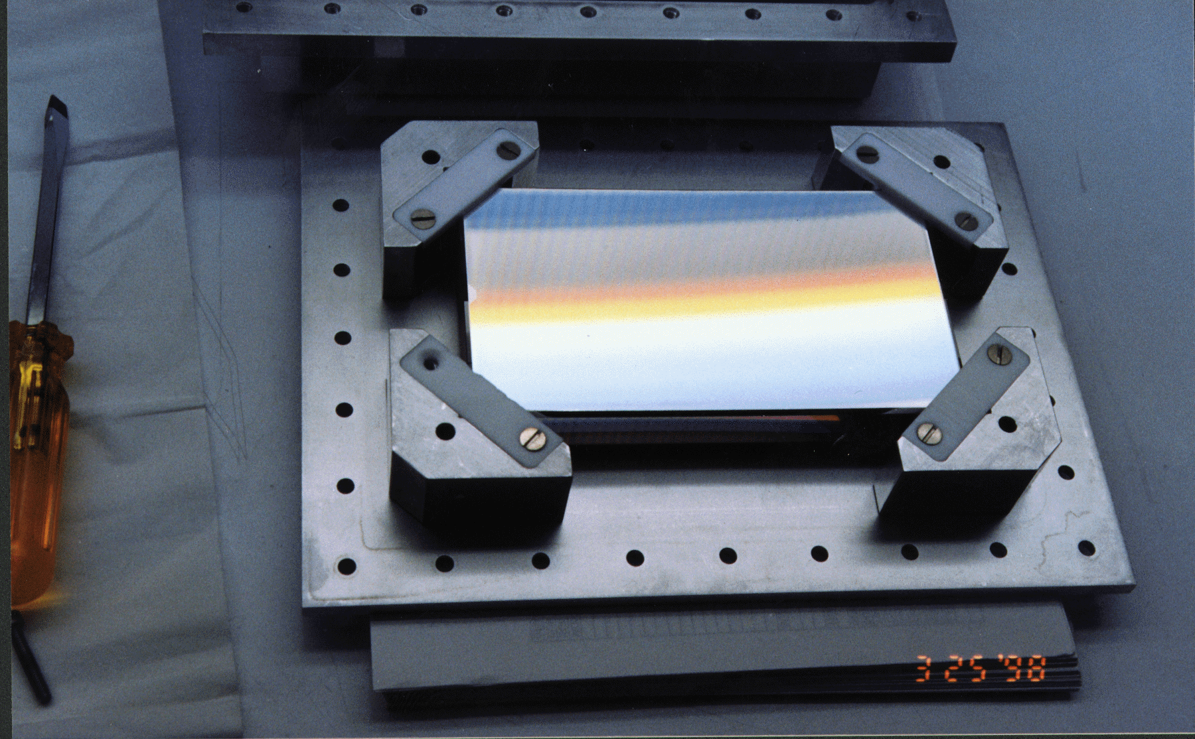
The J-PEX Spectrometer R~6000 (δλ=0.04Å)
Ion etched, blazed grating.
MoSi multilayers for high reflection
Spherical figure, 2.2m focal length

Slide 10
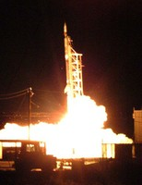
J-PEX
Helium II
Nitrogen IV
Oxygen IV

Slide 11
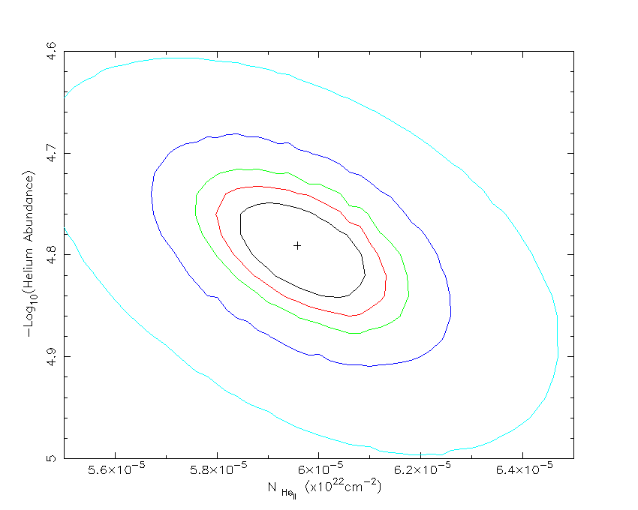
1σ
2σ
3σ
5σ
10σ

Slide 12
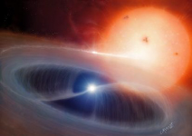
Pre-CV Feige 24
Period = 4.23d
T_{eff}(wd) = 62,000K
K_{wd} ~ 50 km s⁻¹
γ_{total} ~ 70 km s⁻¹
v_{ISM} ~ -10 km s⁻¹

Slide 13
Feige 24 science goals
Search for evidence of photospheric He
Measure H layer mass
Measure the He II interstellar column density
Derive ionization fraction
Search for circumstellar material
Exposure time shorter than planned
Reduced signal to noise

Slide 14
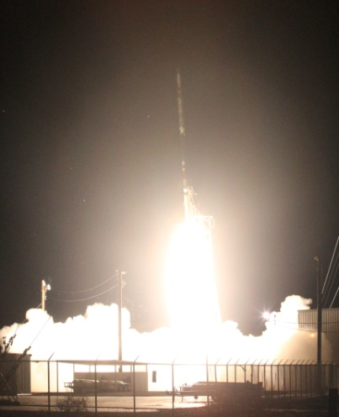
Black Brant 36.207
White Sands Missile
Range
October 21st 2008

Slide 15
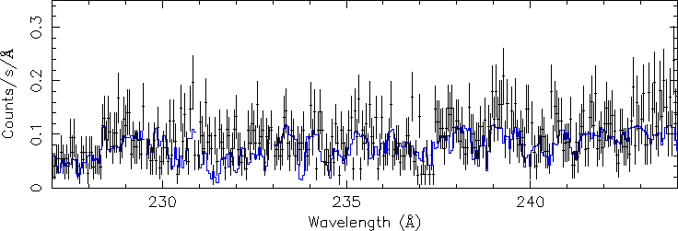
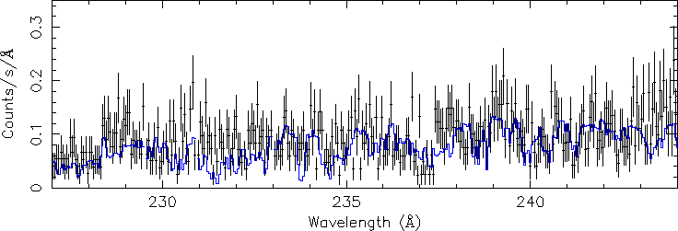
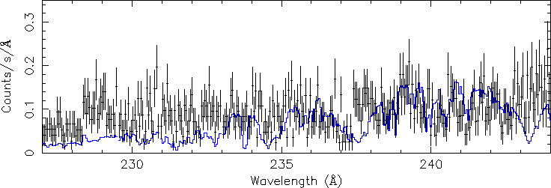
a)
Feige 24; DA+dM
H-layer mass = 10^{-12.92}M
H-layer mass = 10^{-13.5}M
H-layer mass = 10⁻¹⁴M
N_{He II} = 3.9x10¹⁷cm⁻²
N_{He} _{I} = 1.6x10¹⁷cm⁻²
He II/He = 0.72
b)
c)

Slide 16
Conclusion
Achieved primary science goal
Limits on H layer mass
Value of He II interstellar component (He II/He = 0.72)
Need longer exposure times and more observations
Translate J-PEX onto a satellite platform

Slide 17
a)
Feige 24; DA+dM
H-layer mass = 10^{-12.92}M
H-layer mass = 10^{-13.5}M
H-layer mass = 10⁻¹⁴M
N_{He II} = 3.9x10¹⁷cm⁻²
N_{He} _{I} = 1.6x10¹⁷cm⁻²
He II/He = 0.72
b)
c)

Slide 18
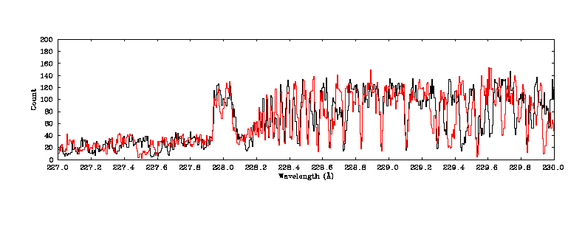
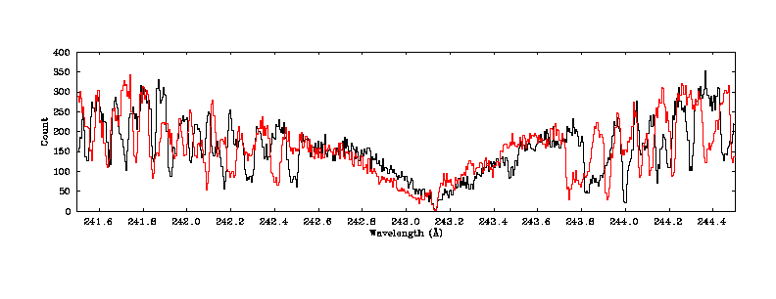
Feige 24 simulation, exposure = 4000s

Slide 19
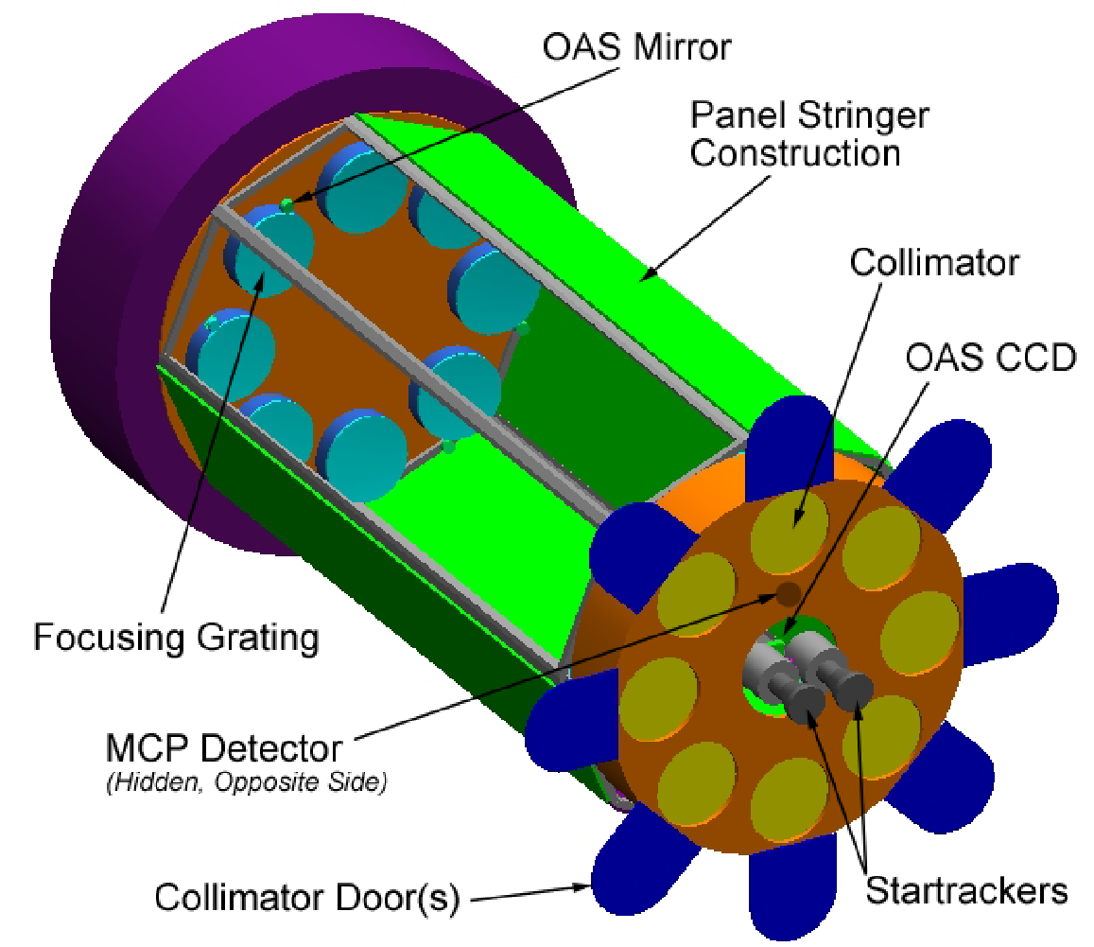
SAGE

Slide 20
EUV spectroscopy flight options
In the USA
Low-cost conversion of rocket payloads to ~6 month duration orbital instruments
Response to forthcoming Explorer call
In Europe
Submission to latest M-class mission call
We need your support... please contact me for involvement (mab@le.ac.uk)

