Slide 1
A Gravitational Redshift Determination of the Mean Mass of White Dwarfs
Ross E. Falcon D. E. Winget M. H. Montgomery Kurtis A. Williams
University of Texas at Austin
17th European White Dwarf Workshop
August 16, 2010

Slide 2
Path of the Presentation
White Dwarfs in Context
Mass and Gravitational Redshift
The “Log g Upturn”
Observations
Velocity Measurements
Results

Slide 3
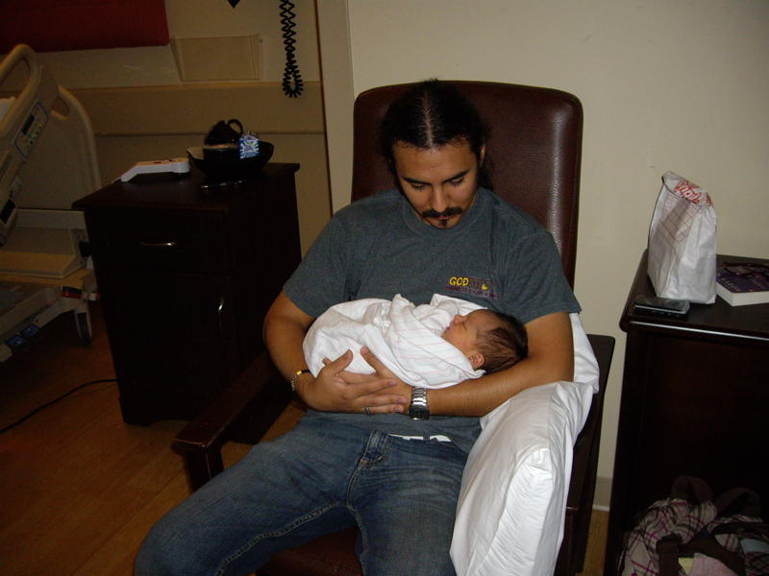
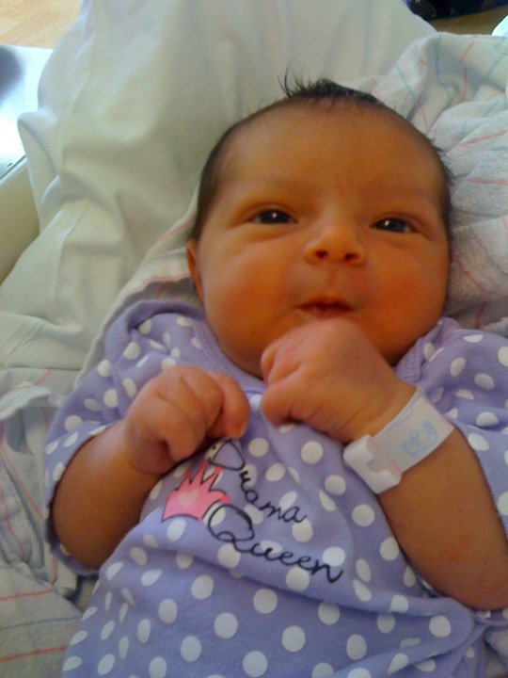
Emma

Slide 4
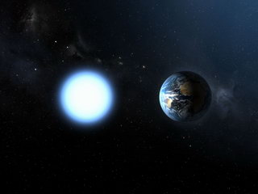
Retired Stars
Most stars (~97%) end up or will end up as white dwarfs (WDs)
WD properties provide crucial information on topics such as:
Cosmochronology
Chemical history of stars in our Galaxy
Formation history of stars
Late stages of stellar evolution
Type Ia supernovae
Image: www.physorg.com

Slide 5
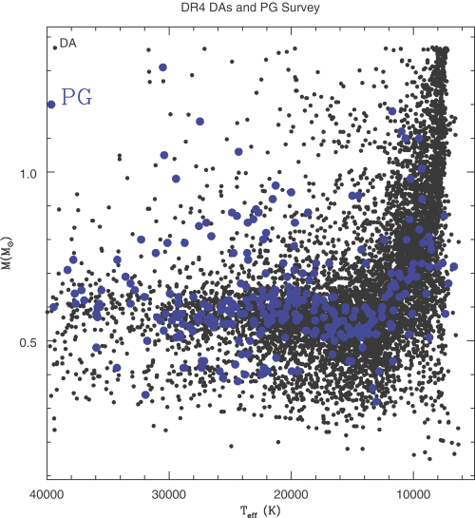
Mass Determination Methods
Atmosphere Model Fitting
w/ photometric colors
w/ parallax and photometric colors
w/ spectroscopy
Astrometry (Orbital Motions)
Pulsational Mode Analysis
Gravitational Redshift (GRS)
Nearby WDs
★
Fails for cool WDs: “log g upturn problem”
Binaries
PG 1159 objects, DAVs, DBVs, DQVs
Common proper motion binaries or cluster WDs, otherwise no way to take out radial velocity

Slide 6
Can We Get Around This Problem? Yes…with a large sample
Main Points of This Work
With a large, high resolution spectroscopic dataset, we can circumvent the radial velocity-GRS degeneracy to measure a mean GRS for WDs in our sample and use that to arrive at a mean mass
Since the GRS method is atmosphere model-independent, we can use it to reliably probe cool WDs and investigate the “log g upturn problem”.

Slide 7
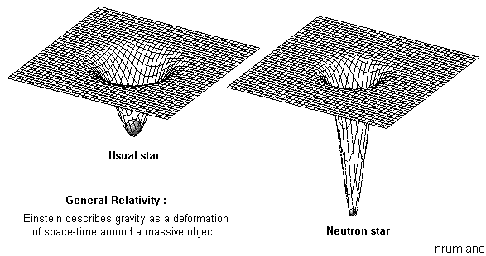
Gravitational Redshift z
A photon loses energy as it climbs out of a gravitational potential well
z = Φ / c² = GM / Rc²
Typical “z”s
Expansion: ~10⁰
Neutron star: ~10⁻¹
WD: ~10⁻⁴
The Sun: ~10⁻⁸

Slide 8
SPY Data
Obtained reduced data from European Southern Observatory (ESO) Science Archive Facility
Spectra taken using UV-Visual Echelle Spectrograph (UVES) with the ESO VLT
Data originally taken for a survey for double degenerate binaries as potential progenitors of Type Ia supernovae (ESO SN Ia Progenitor surveY – SPY; Napiwotzki et al. 2001)
Current largest, homogeneous, high resolution (0.36 Å or ~16 km s⁻¹ at Hα) spectroscopic dataset for WDs

Slide 9
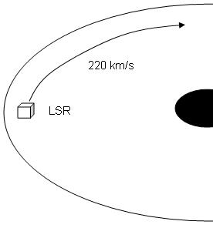
Co-Moving Approximation
For individual WDs, v_{app} = v_{g} + v_{rad}
WDs in our sample are relatively nearby; average distance < 100 pc (Pauli et al. 2006)
Thin disk population
Use v_{app} corrected to the local standard of rest (LSR) and large number of targets (449) to make the approximation: <v_{app}> = <v_{g}>
Notes:
Exclude thick disk and halo objects and assume the rest are from the thin disk. Expect contamination to be at most ~6%.

Slide 10
Measuring Velocities
Pressure effects cause line wings to be asymmetric; must use sharp NLTE line cores
Pressure effects very uncertain for He lines; use H lines
H Balmer lines exist in all DAs
Most (~80%) WDs are DAs
Pressure effects increase with increasing principal quantum number; use Hα (and/or Hβ)
Meaningful centroid measurements demand high resolution; SPY data meets requirements

Slide 11
Balmer Line Core Centroids
Fit Gaussian profiles to Hα (and/or Hβ) line cores
Hi-res SPY data allows us to measure v_{app} at a typical precision of ~1.5 km s⁻¹
WD 1216+036
2001.06.09
Hα: 33.51 +/- 1.10 km s⁻¹
Hβ: 37.93 +/- 1.97 km s⁻¹ v_{app} = 34.57 +/- 2.67 km s⁻¹
2001.06.20
Hα: 33.61 +/- 1.55 km s⁻¹
Hβ: 40.00 +/- 3.03 km s⁻¹ v_{app} = 34.94 +/- 3.66 km s⁻¹
v_{app} = 34.70 +/- 0.25 km s⁻¹

Slide 12
Measurements
449 WDs with measureable Hα line core centroids
372 with Hβ
<v_{app}> = 32.57 +/- 1.17 km s⁻¹

Slide 13
Getting a Mass
z ~ M/R
Weak dependence on T_{eff}

Slide 14
Distribution of spectroscopic T_{eff} of normal DAs from Koester et al. (2009b) (black) and of our sample (purple).
<T_{eff}> = 19400 +/- 300 K
σ(T_{eff}) = 9950 K

Slide 15
Getting a Mass
z ~ M/R
Weak dependence on T_{eff}

Slide 16
Getting a Mass
z ~ M/R
Weak dependence on T_{eff}
Use <T_{eff}>: 19130 +/- 300K

Slide 17
Getting a Mass
z ~ M/R
Weak dependence on T_{eff}
Use <T_{eff}>: 19400 +/- 300K
Convert <v_{app}> to <M/R>
0.647 M_{sun}
+0.013 -0.014
From spectroscopy (Koester et al. 2009b)*: <M> = 0.575 +/- 0.002 M_{sun}

Slide 18
Mini-Samples
DAVs (25)
<v_{app}> = 37.25 +/- 4.34 km s⁻¹
<M> = 0.685 +/- 0.047 M_{sun} using <T_{eff}> = 11510 K
From spectroscopy (Koester et al. 2009b)*: <M> = 0.638 M_{sun}
Helium-Dominated WDs (20)
<v_{app}> = 40.31 +/- 3.76 km s⁻¹
<M> = 0.727 +/- 0.037 M_{sun} using <T_{eff}> = 17220 K
This is larger than for normal DAs
From spectroscopy (Voss et al. 2007): <M> = 0.615 M_{sun}

Slide 19
Previous Studies That Used GRS
Koester (1987): <M>=0.58 M_{sun}
9 WDs in CPM pairs or wide binaries
Wegner & Reid (1991): <M>=0.63 +/- 0.03 M_{sun}
35 in CPM pairs
Reid (1996): <M>=0.583 +/- 0.078 M_{sun}
34 in CPM pairs
Silvestri et al. (2001): <M>=0.68 +/- 0.04 M_{sun}
41 in CPM pairs
Our work uses the GRS method to determine a mean mass of 461 WDs that are kinematically different

Slide 20
Our mean mass is significantly higher than that for all previous spectroscopic studies…
Except one: we agree very well with Tremblay & Bergeron (2009)
Use improved calculations for Stark broadening of H lines

Slide 21
Dynamics
Use nearby WDs so we need not worry about systematics from kinematic structure of Galaxy
Velocity dispersion with varying height above the disk is modest (Kuijken & Gilmore 1989)
Negligible change due to differential Galactic rotation (Fich et al. 1989)
Use kinematical LSR described by Standard Solar Motion (Kerr & Lynden-Bell 1986)
No significant difference in <v_{app}> in the U, V or W directions.
We find that our WDs move WRT the LSR as (U,V,W) = (-1.62+/-3.35, +1.84+/-3.43, -1.67+/-3.37) km s⁻¹

Slide 22
The Log g Upturn: A Serious Problem!
Systematic increase in log g for WDs with T_{eff} < 12000K
Appears in all spectroscopic surveys
None show consistency between hot/cool WDs
A real change in the WDs (i.e., a mass increase)? Or a problem with the models used to determine log g?
Plot of T_{eff} vs. log g for targets in Koester et al. (2009b). Also plotted: cooling tracks from evolutionary models

Slide 23
GRS Method Is Consistent Between Temperature Bins
From Koester et al.
<M>^{hot} = 0.563 +/- 0.002 M_{sun}
<M>^{cool} = 0.666 +/- 0.005 M_{sun}
Δ<M> = 0.103 +/- 0.007 M_{sun}
Inconsistent between T_{eff} bins
Our results
<M>^{hot} = 0.640 +/- 0.014 M_{sun}
<M>^{cool} = 0.686 M_{sun}
Δ<M> = 0.046 +/- 0.053 M_{sun}
+0.035 -0.039
Consistent with no change in mean mass

Slide 24
From SDSS (Kepler et al. 2007)
<M>^{hot} = 0.593 +/- 0.016 M_{sun}
<M>^{cool} = 0.789 +/- 0.005 M_{sun}
12000 K ≥ T_{eff} ≥ 8500 K
Δ<M> = 0.196 +/- 0.021 M_{sun}
Inconsistent between T_{eff} bins
Our results rule out a change in mass this large!

Slide 25
DBAs
Voss et al. (2007)
Detect various amounts of hydrogen in most (55%) of the DBs in their sample
Find similar spectroscopic mass distributions
DBAs are not distinct from DBs
What does the GRS method tell us?

Slide 26
20 DBAs
Helium-dominated WDS that show H absorption
<v_{app}> = 40.31 +/- 3.76 km s⁻¹

Slide 27
<M> = 0.707 +0.036 –0.039 M_{sun}
From spectroscopy (Voss et al. 2007): <M> = 0.614 M_{sun}
Notes:
Evolutionary models uses no hydrogen layer.

Slide 28
Conclusions
We demonstrate that the gravitational redshift method works
For 449 non-binary thin disk normal DAs from SPY: <v_{app}> = 32.57 +/- 1.17 km s⁻¹ <M> = 0.649 M_{sun}
Agrees very well with Tremblay & Bergeron (2009)
Our mean mass is much higher than other previous values
Investigate log g upturn problem
<M>^{hot} = 0.640 +/- 0.014 M_{sun} and <M>^{cool} = 0.686 M_{sun}
Consistent with no significant change in mass across temperature bins unlike all spectroscopic studies
For 20 DBAs: <M> = 0.707 +/- 0.037 M_{sun}
+0.013 -0.014
+0.035 -0.039

Slide 29
References
Kepler, S. O., Kleinmann, S. J., Nitta, A., et al. 2007, MNRAS, 375, 1315
Kerr, F.J., & Lynden-Bell, D. 1986, MNRAS, 221, 1023
Koester, D., Voss, B., Napiwotzki, R., et al. 2009b, A&A, 505,441
Koester, D., Kepler, S. O., Kleinmann, S. J., & Nitta, A. 2009a, Journal of Physics Conference Series, 172, 012006
Kuijken, K., & Gilmore, G. 1989, MNRAS, 239, 605
Liebert, J., Bergeron, P., & Holberg, J. B. 2005, ApJS, 156, 47
Napiwotzki, R., Christlieb, N., Drechsel, H., et al. 2001, Astronomische Nachrichten, 322, 411
Pauli, E.-M., Napiwotzki, R., Heber, U., Altmann, M., & Odenkirchen, M. 2006, A&A, 447, 173
Tremblay, P.-E., & Bergeron, P. 2009, 696, 1755
Voss, B., Koester, D, Napiwotzki, R., Christlieb, N., & Reimers, D. 2007, A&A, 470, 1079

