Slide 1
Hot Subdwarf Stars
Uli Heber
Dr. Remeis-Sternwarte & ECAP
University of Erlangen-Nürnberg
Bamberg
The late stages
of stellar evolution:
Some Prblems and Prospects
Tübingen, July 17, 2010

Slide 2
Outline
The early days
The role of hot subdwarfs in astrophysics
Formation of hot subdwarfs
- in binaries
- single stars
White dwarf merger: SN Ia, EHe & sdO stars
Hypervelocity stars
Abundances and rotation of sdO stars
Summary

Slide 3
History: The early 1980ies
The Kiel – St. Andrews Collaboration
( aka „The Glenfiddich“ connection)
Kiel
Kurt Hunger:
Detlef Schönberner
Rolf Kudritzki
Klaus-Peter Simon
Wolf-Rainer Hamann
Uli Heber
St. Andrews
Phil Hill:
Tony Lynas-Gray
Dave Kilkenny
Helen Walker
Simon Jeffery
The American link:
- John Drilling

Slide 4
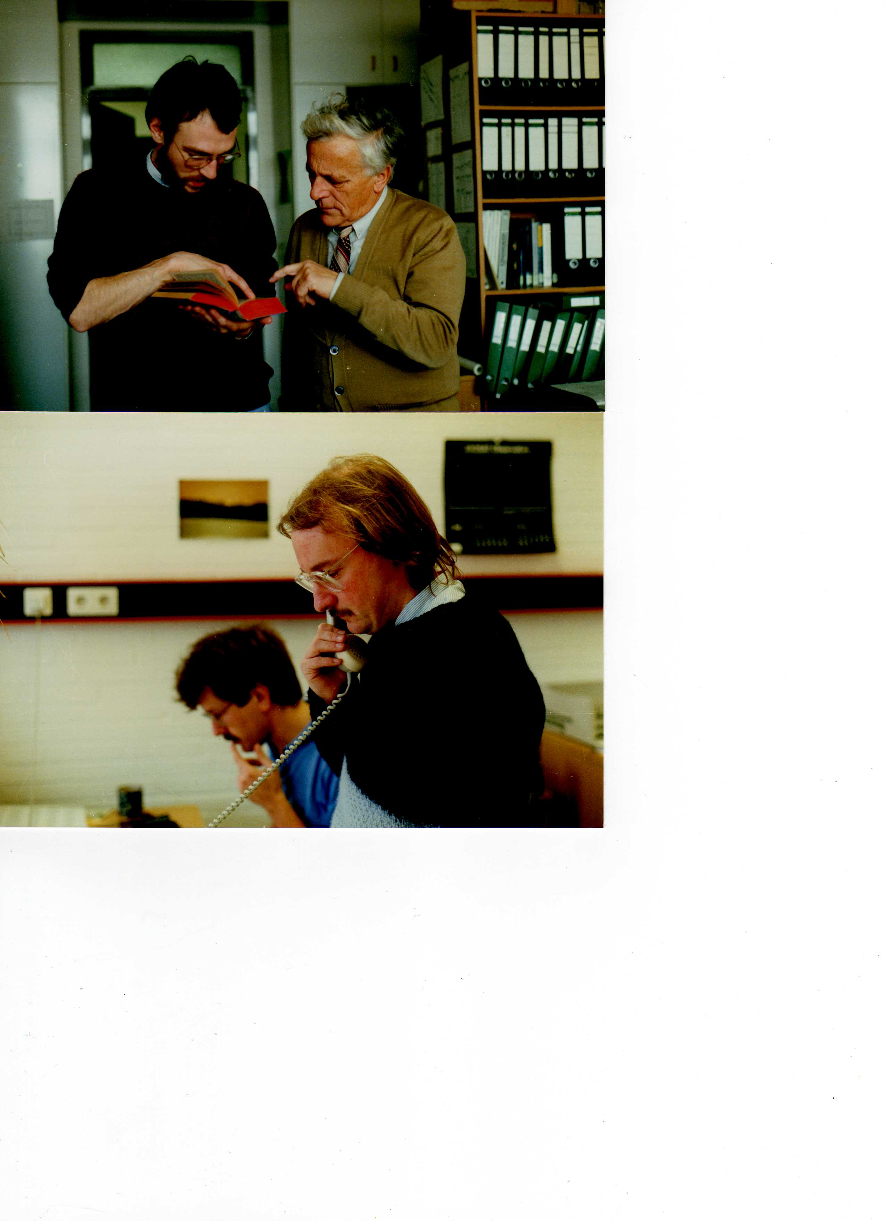
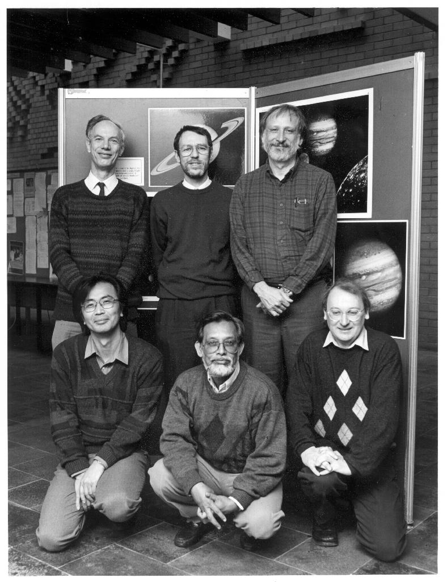
Kurt Hunger
Phil Hill

Slide 5
IAU Colloquium 87 “Hydrogen Deficient Stars and Related Objects”
Mysore, India, 1985
Proceedings, 1986, eds. Hunger, Schönberner, N.K. Rao

Slide 6
Publications Lynas-Gray, Heber et al.
1982-1984
Extreme Helium stars:
4 papers with
- Phil
- Detlef
- Simon
& John Drilling
Hot subdwarf stars:
1 paper on AA Dor with
Rolf
Klaas-Peter

Slide 7
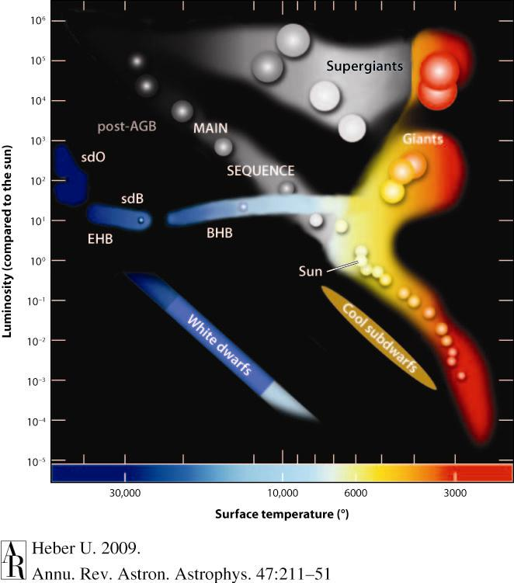
Hot Subdwarf Stars: sdB & sdO
= Extreme Horizontal Branch Stars

Slide 8
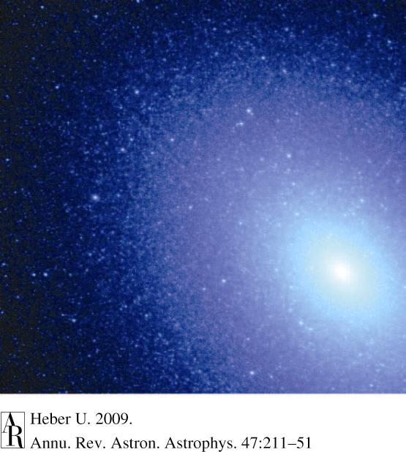
Brown et al.
2008

Slide 9
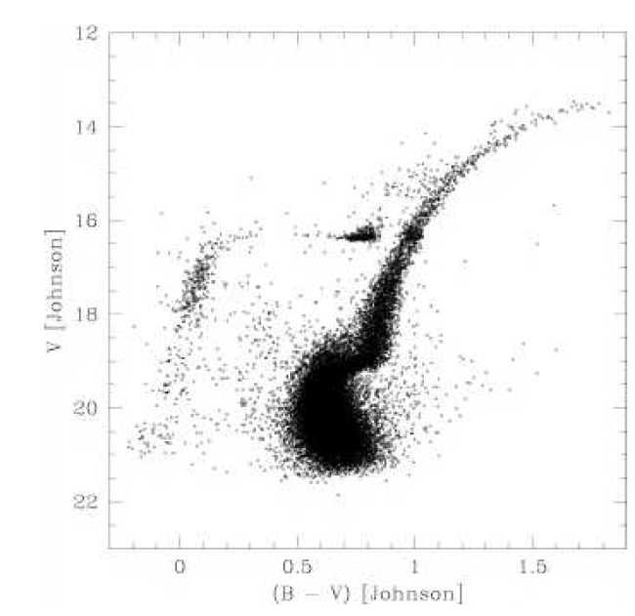
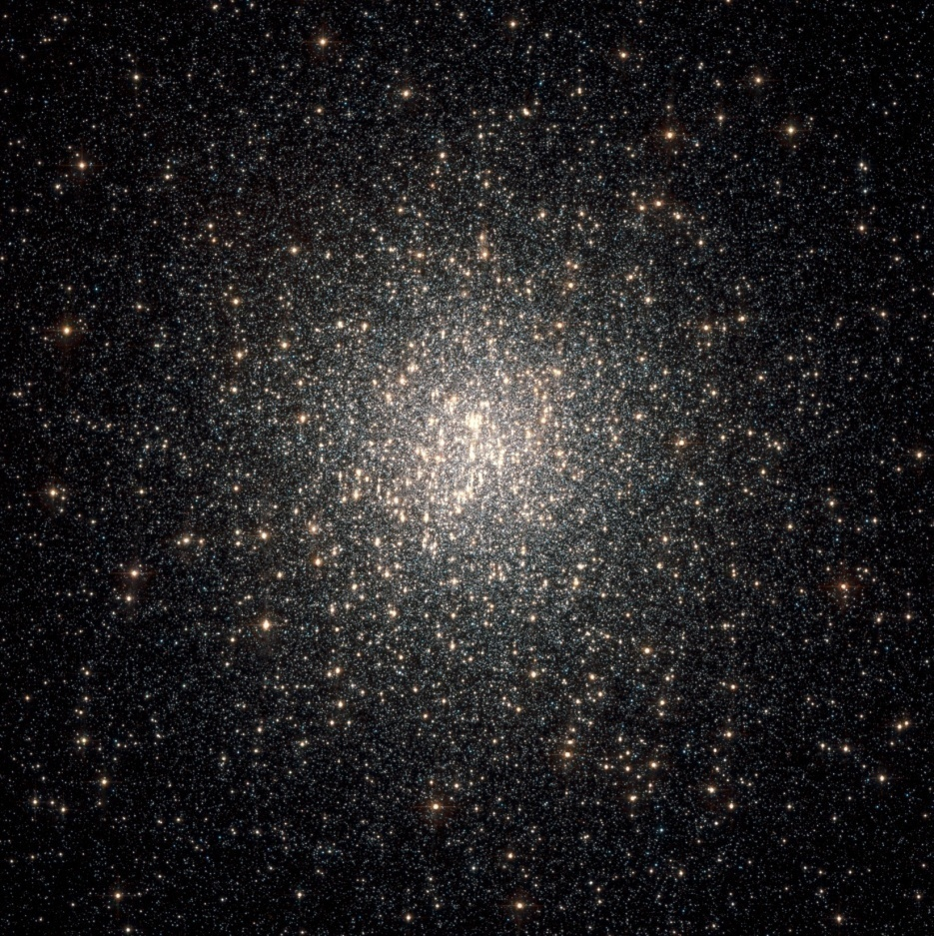
Globular Cluster
NGC 2808
Sosin et al. (2007)
NASA/HST

Slide 10
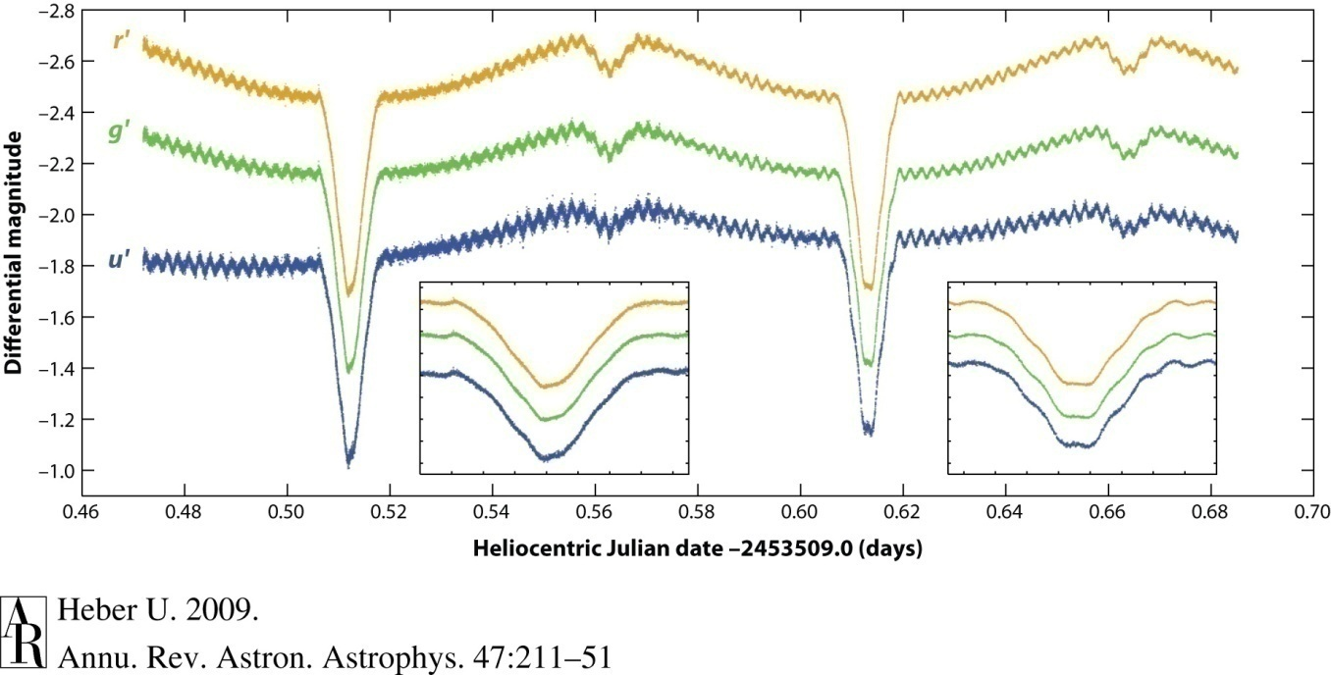
Asteroseismology: Pulsating sdB stars
Vuckovic et al. (2008)
NY Vir: an eclipsing binary with a pulsating sdB star
Rosetta stone for mass determination

Slide 11
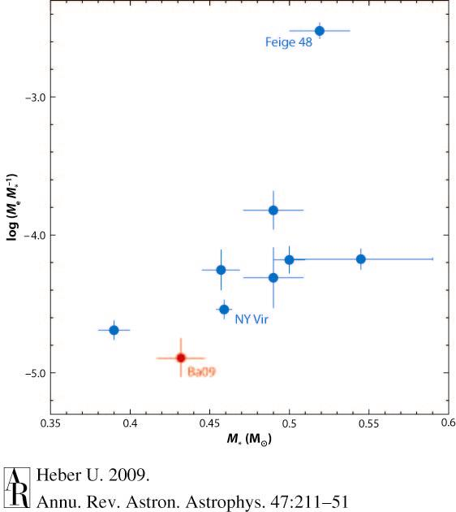
Asteroseismology: Masses of sdB stars
0.46
Randall et al. (2007), van Grootel et al. (2008a,b)
consistent with BPS predictions: 0.46 Msun (Han et al., 2003)

Slide 12
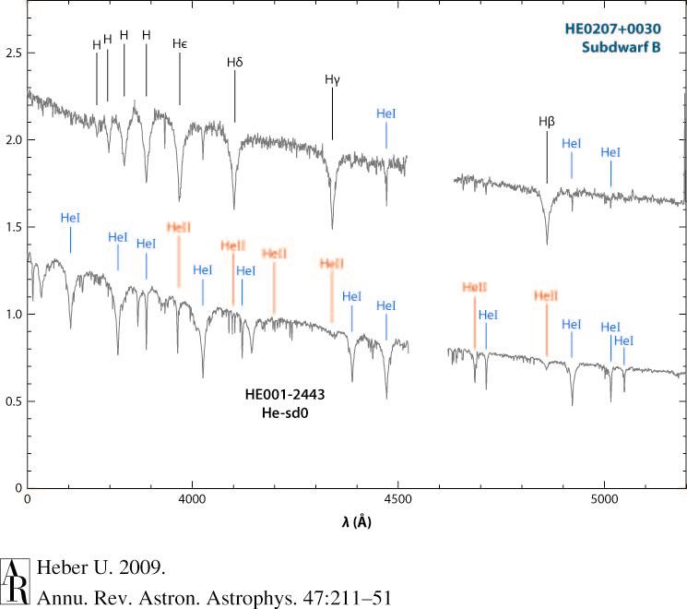
Spectral classification: sdB & sdO
sd B
He sdO

Slide 13
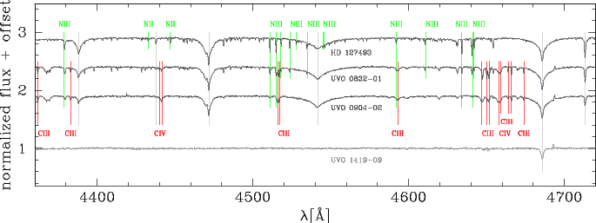
Spectral classification of He-sdO stars – high res.
Nitrogen
Carbon
Stroeer et al. (2007)
HeI
4388Å
HeI
4472Å
HeII
4542Å
HeII
4686Å
HeI
4713Å

Slide 14
Spectral classification, high-res.
Hot subdwarf stars
sdO
He
H
He-sdO
C-
type
CN-
type
N-
type
H-sdO
sdB

Slide 15
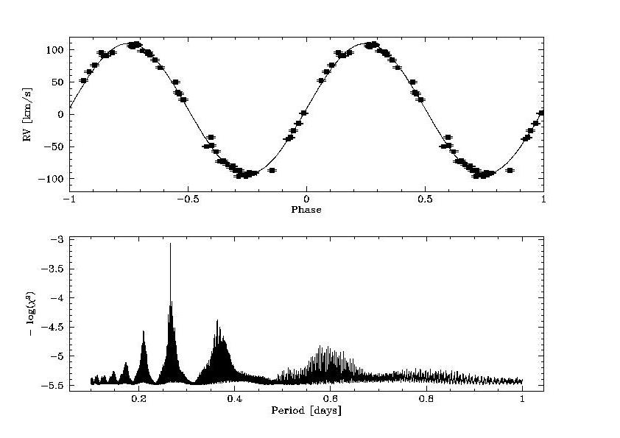
sdBs in binaries
RV curve: mass function
sdB mass?
- BPS: 0.46 Msun
(Han et al. 2003)
- asteroseismology:
0.4 – 0.5 Msun
(Randall et al. 2007,
Van Grotel et al. 2008)
Karl et al. (2005)

Slide 16
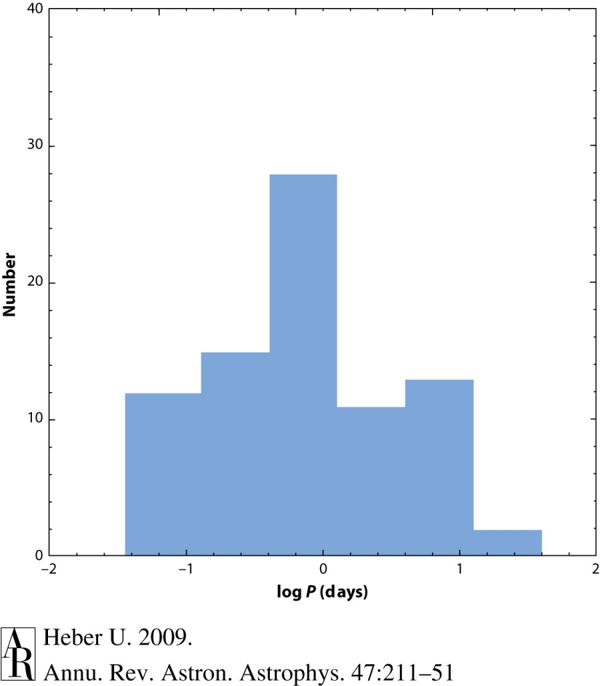
Frequency of close binaries among sdB/sdO stars
0.6 d
RV surveys: SPY, PG, EC:
~50% of sdB stars are in close binaries with periods <30d
He-sdO: much less
But: What´s about the apparently single ones?

Slide 17
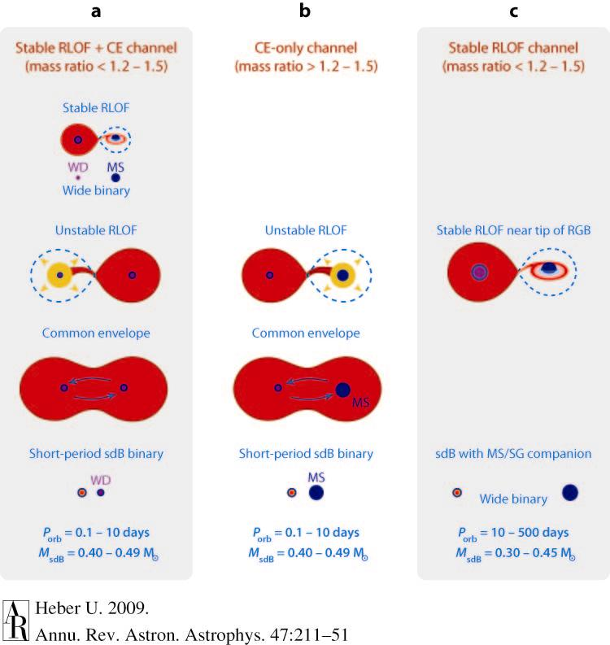
Common envelope ejection
Formation of sds:
Strong mass loss close to helium core flash at tip of RGB
(Mengel et al. 1979)
Common envelope ejection
Close binaries:
MS/WD companions in close orbits (<10d)

Slide 18
Planets and the formation of EHB stars
Substellar companions
discovered by light travel time variations:
- Pulsating sdB star V391 Peg
(Silvotti, Schuh et al. 2008, Nature 449, 189)
Eclipsing Binaries: HW Vir & HS 0705+6700
(Lee et al. 2008, AJ 137, 3181, Qian et al. 2009, )
Soker (1988): Formation of single EHB star
by engulfment & destruction of a planet
in common envelope

Slide 19
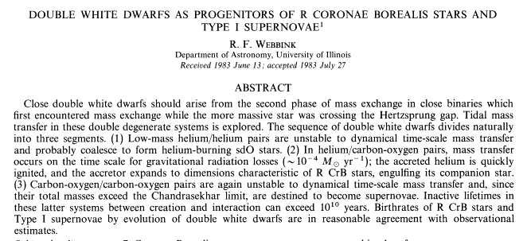
SD-Formation: Merger of two He-White dwarfs

Slide 20
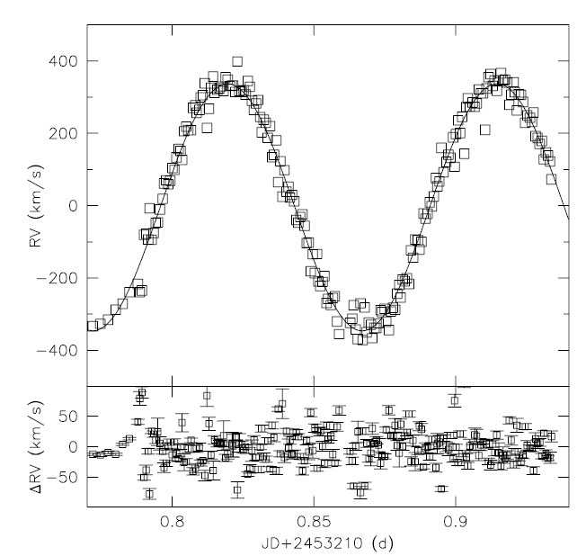
SN Ia Progenitors: double degenerates
KPD1930+2752,
Maxted et al. (2000), Geier et al. (2007)

Slide 21
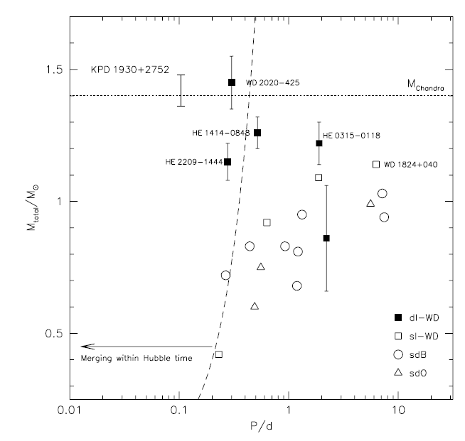
SN Ia Progenitors: double degenerates
Geier et al. (2007)

Slide 22
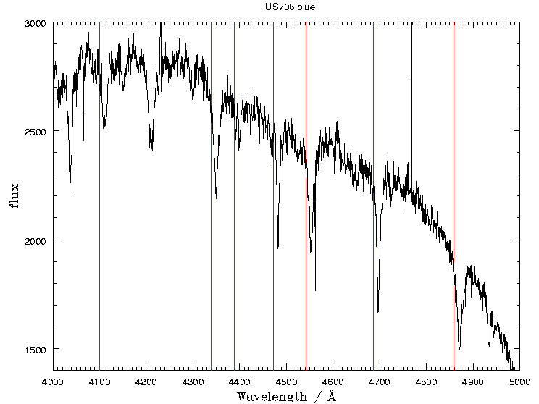
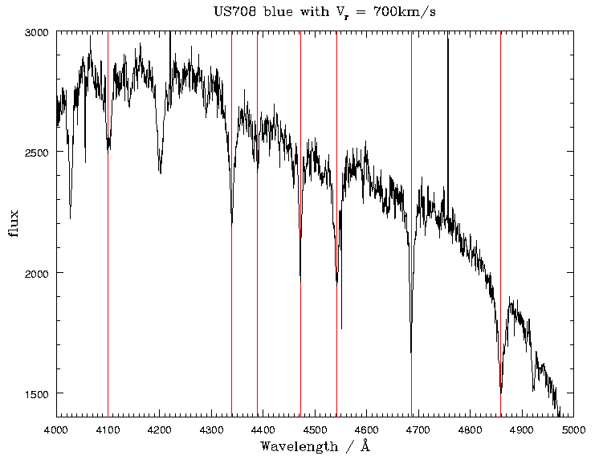
Radial velocities: He-sdO US 708 (Hirsch et al. 2005)
Hypervelocity star
Vgrf=850Km/s

Slide 23
Hypervelocity hot subdwarfs
SN Ia: Single degenerate scenario (Justham et al. 2009):
- Donor is a hot subdwarf
- orbital period: 1h
- WD explodes when reaching Chandrasekhar mass
- sdO is released at orbital velocity
- may get additional kick from SN
(Marietta et al. 2000)

Slide 24
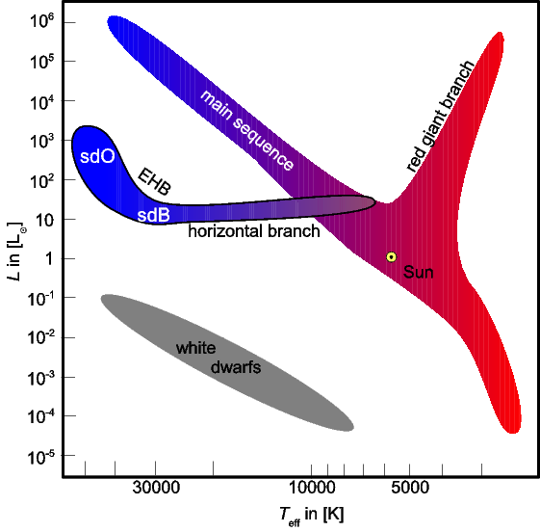
Formation of single sdO stars: Late Hot Flasher
Late Hot Flasher:
delayed He-Flash (Sweigart, 1997,
Miller-Bertolami, 2008)

Slide 25
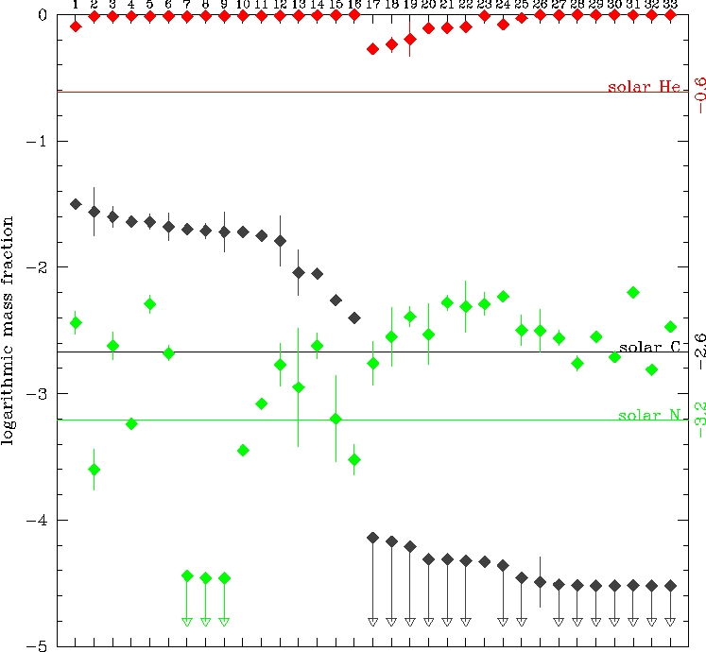
Quantitative NLTE spectral analysis
He-, C and N-abundances: 33 He-sdOs from SPY
He
solar
C solar
N solar
Hirsch (2009)

Slide 26
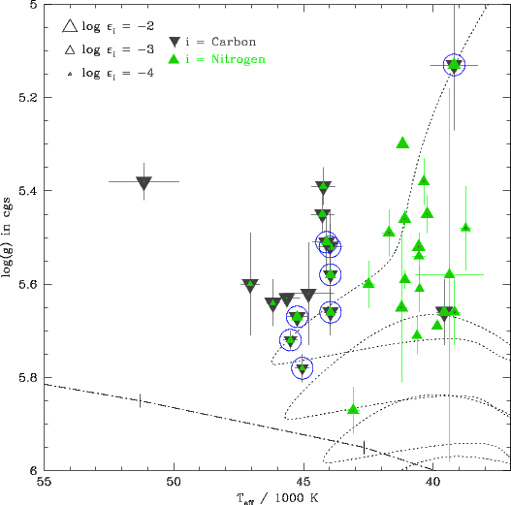
Carbon and Nitrogen in the Teff-log g-plane
- Model predictions:
Simultaneous
burning and mixing
(Miller-Bertolami et al., 2008)

Slide 27
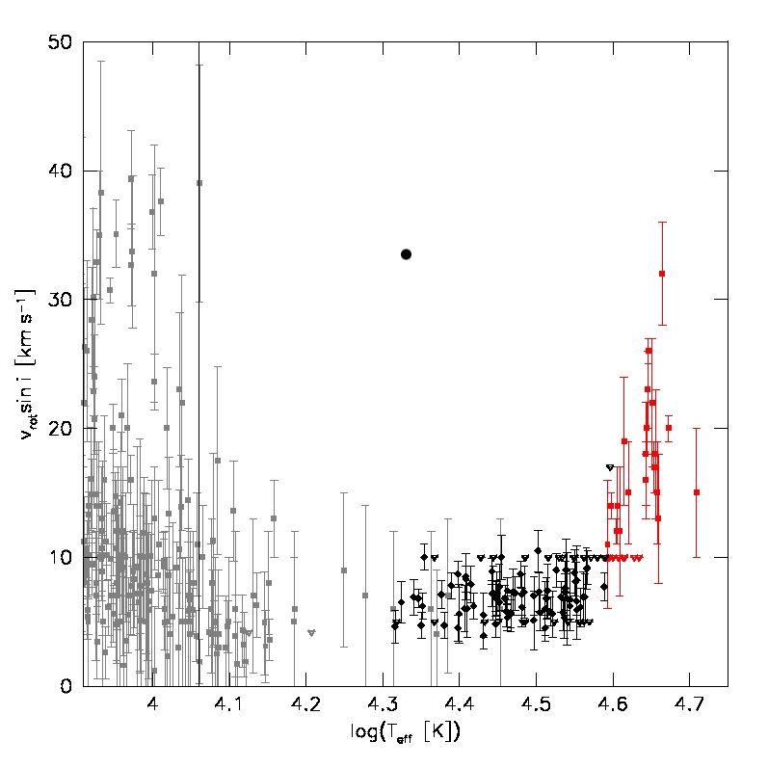
Rotation
He-sdO
Projected rotational
velocities along the
HB:
Break at 11000K:
BHB and sdB low
He-sdO: increase
to 30km/s
sdB

Slide 28
Summary
Formation of close binaries
by common envelope evolution
The role of the Roche lobe overflow channel?
Single sdB stars: Merger or planet engulfment
Single He-sdO: Merger or Late hot flashers
Hypervelocity hot subdwarfs: SN Ia origin
The key: abundances and rotation properties
Wanted: model predictions
- Merger of He-WDs ... vs .... late hot flashers
- Other: SN Ia ejection; .... (Han)

Slide 29
International Meeting
Planetary Systems beyond the Main Sequence
11 - 14 August 2010, Bamberg, Germany
Main topics:
Influence of planets on evolved stars
The fate of planets
The stability and habitability of planetary systems around evolved stars
Debris disks around white dwarfs
Planet formation around evolved stars
Detecting substellar objects around evolved stars
Substellar objects in binary stars

Slide 30
Happy Birthday,
Tony

Slide 31
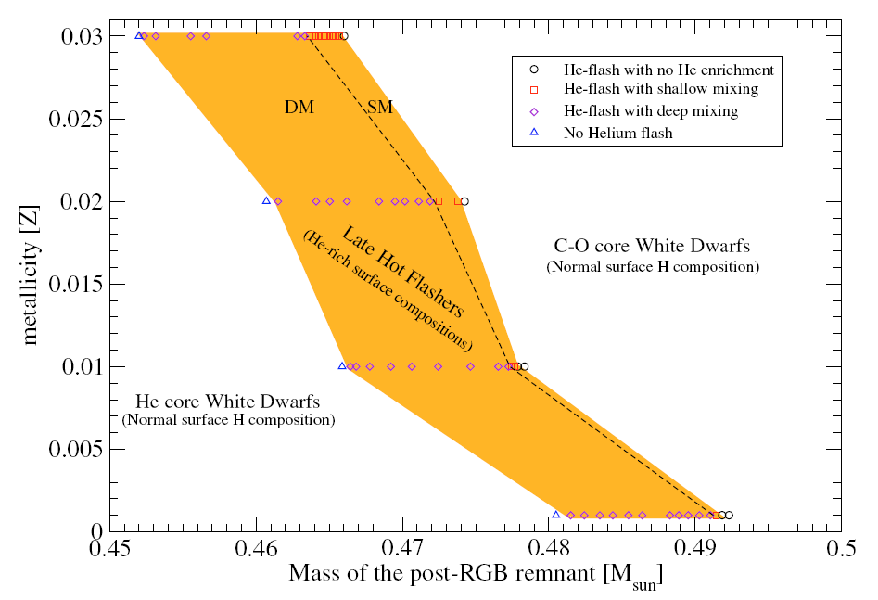

Slide 32
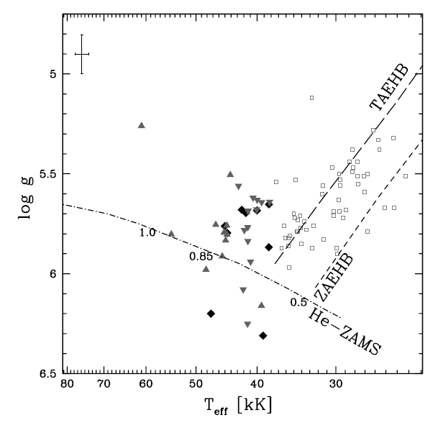
Qantitative NLTE spectral analyses (Stroeer et al., 2007)
He-rich sdO stars

Slide 33
Outline
Introduction
spectral classification
formation: common envelope evolution
apparently single stars: merger vs late hot flasher
a hypervelocity sdO
quantitative spectral analysis of sdO stars
C, N dichotomy
Summary

Slide 34
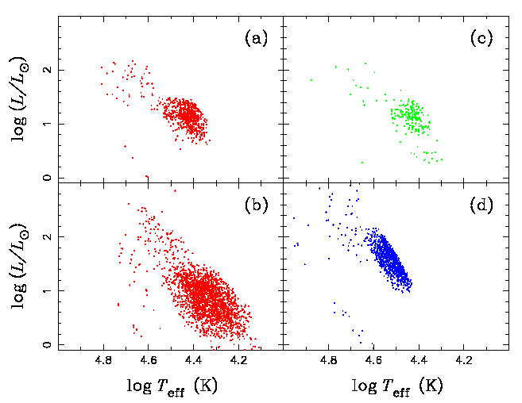
Binary Population Synthesis (BPS)
Han et al. (2003):
a)
b)
c)
d) He+He WD merger
a: 1. CE ejection
b: 1. stable RLOF
c: 2. CE ejection
d: merger

Slide 35
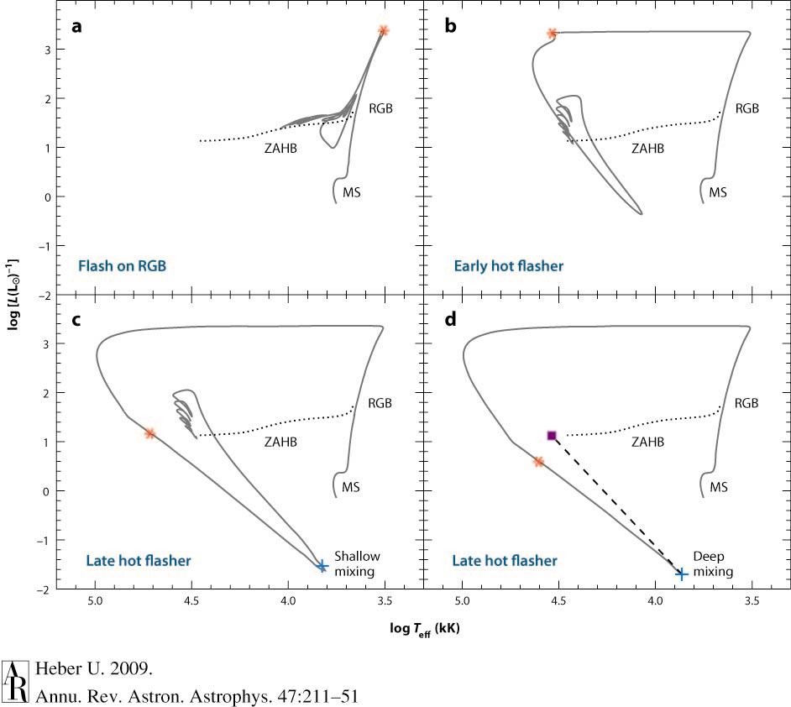

Slide 36
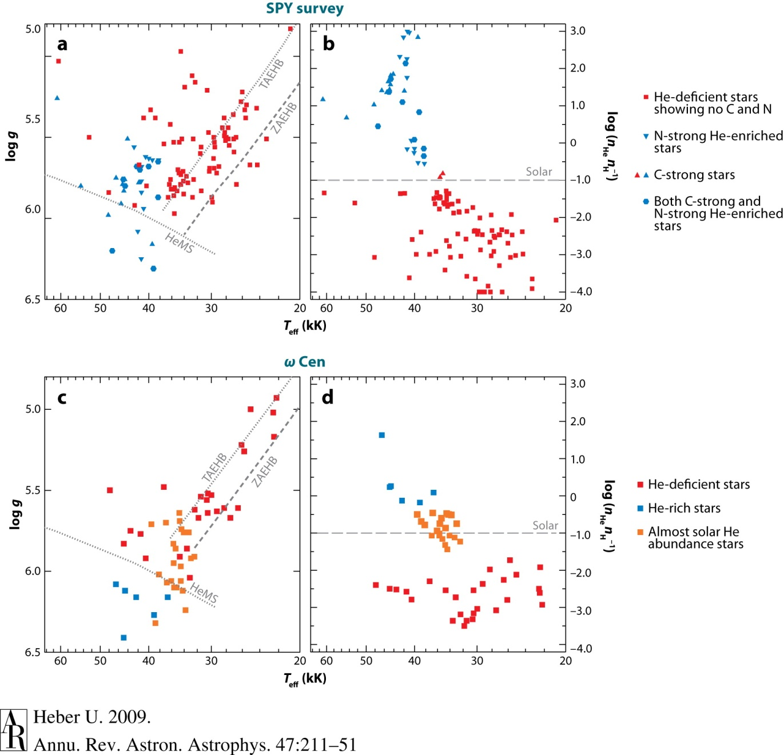

Slide 37
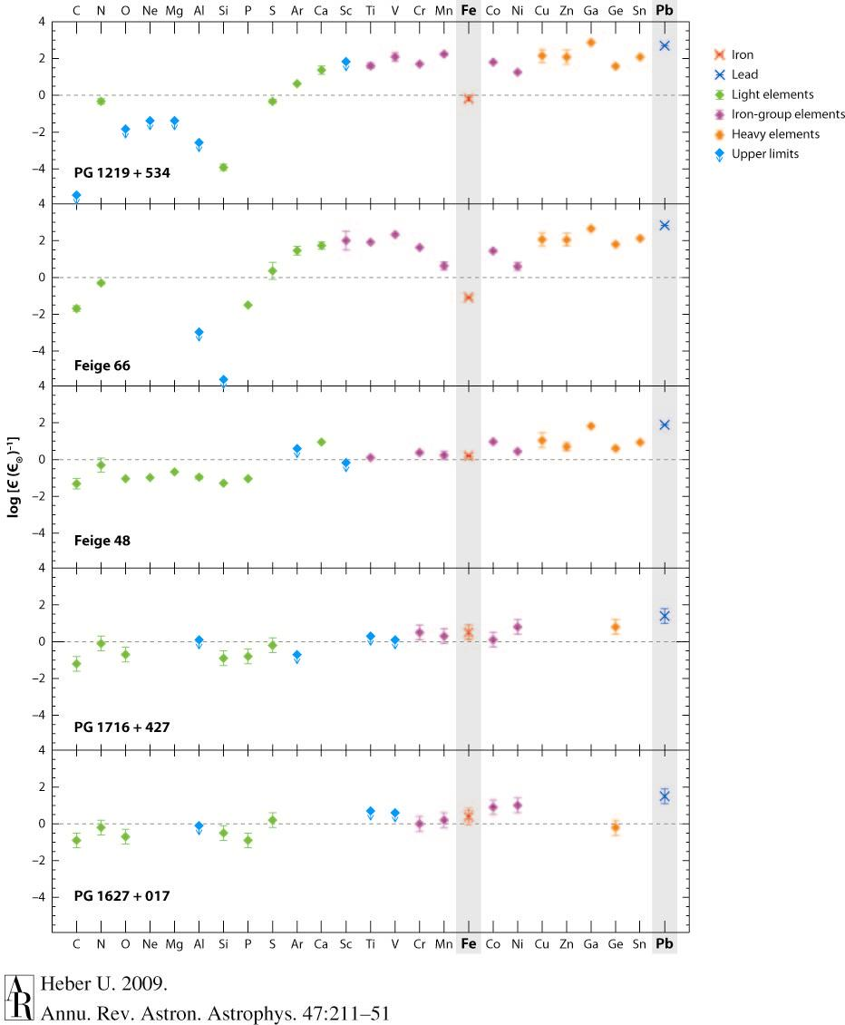

Slide 38
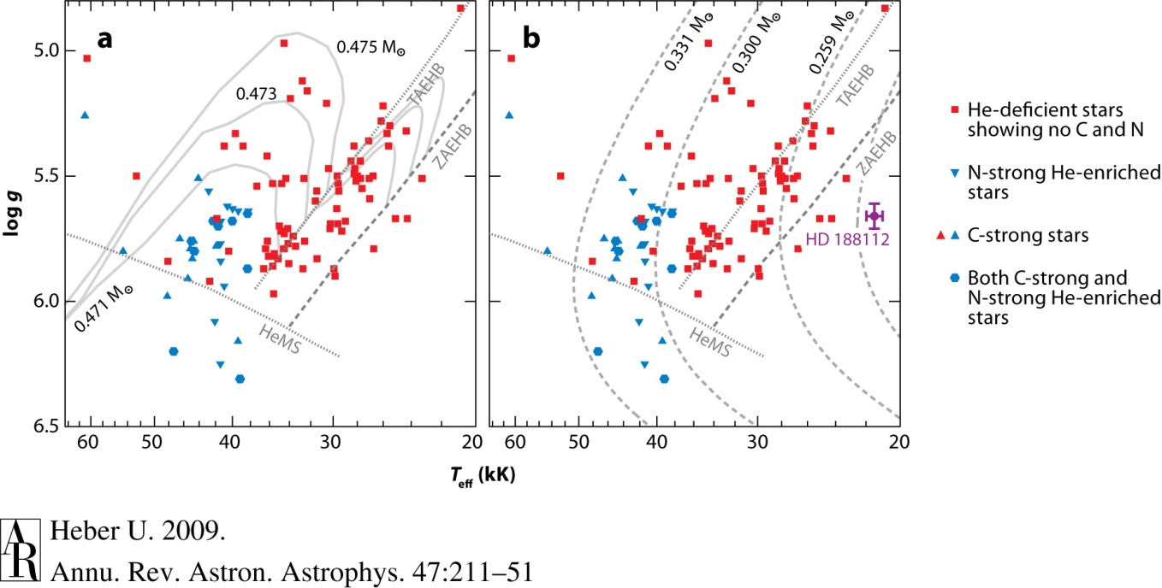

Slide 39
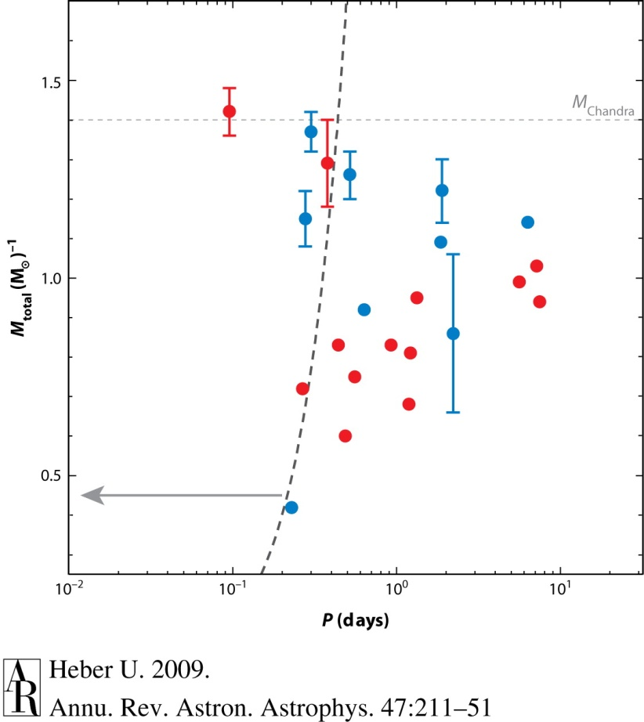

Slide 40
Spectral classification
Hot subdwarf stars
sdO
He
H
sdB

Slide 41
Spectral classification
Hot subdwarf stars
sdO
He
H
He-sdO
H-sdO
sdB

Slide 42
Entstehungsszenarien Late Hot Flasher
“Shallow mixing”
H-Hülle
H→He
Sternradius
He-Hülle
He→C
~12000
Jahre
He-flash
Zeit

Slide 43
Entstehungsszenarien Late Hot Flasher
H-Hülle
Sternradius
He-Hülle
H→He
He→C
He-flash
Zeit

Slide 44
Entstehungsszenarien Binärsysteme
stabiler Massetransfer
“Common Envelope”
MS
MS
MS
MS
MS
RGB
MS
RGB
MS
Kern
common envelope
MS
Kern

Slide 45
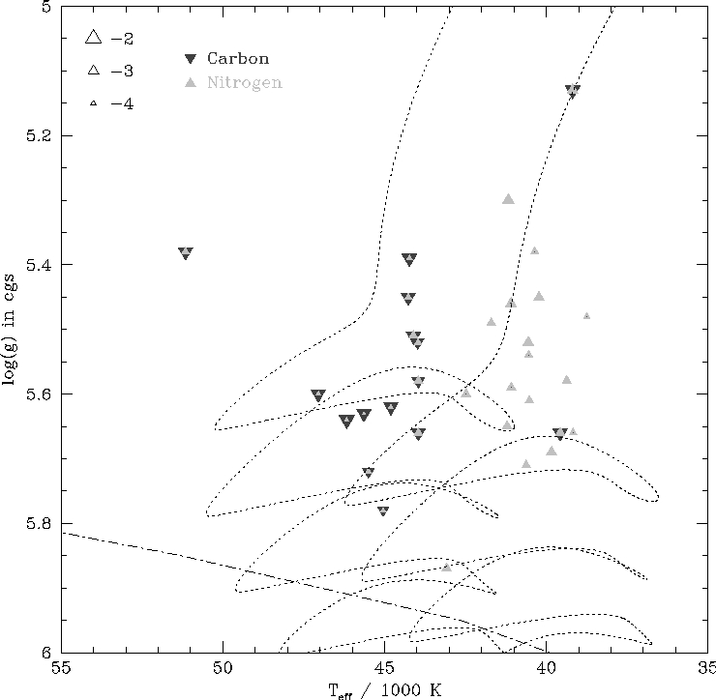

Slide 46
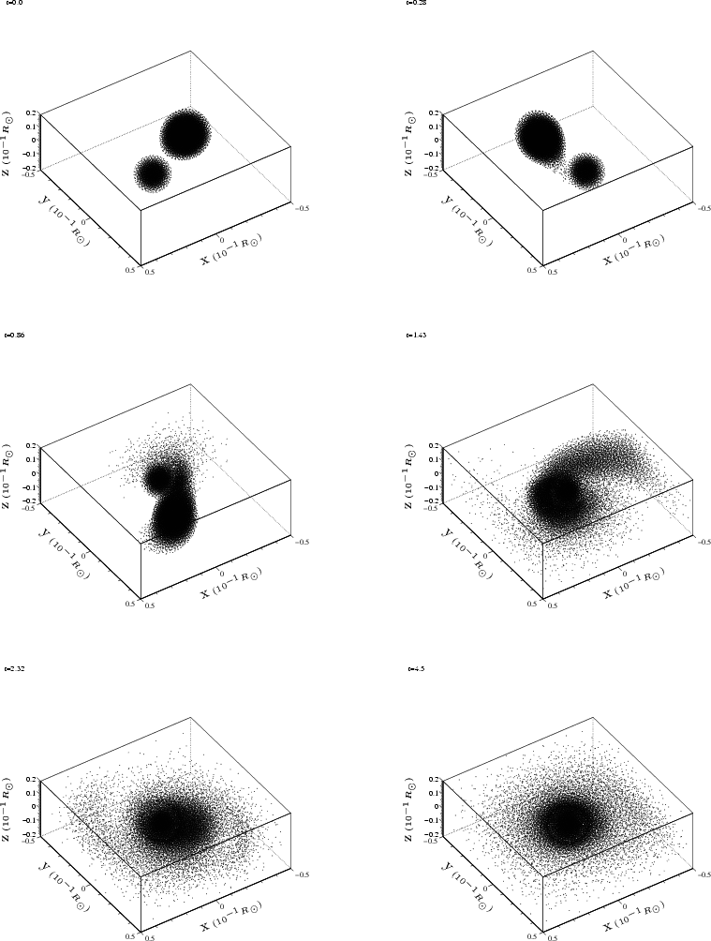
Double Degenerate Scenario
Binary consiting of two WDs
Gravitational waves
⇒ loss of angular momentum
⇒ merger event
SN Ia event
t_{Hubble} > t_{merging}
M_{Chandra} < M_{tot}
SN Ia may be more luminous

Slide 47
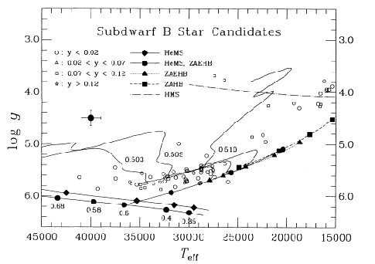
sdB = Extreme HB stars
Post-EHB
EHB
Saffer et al. 1994

Slide 48
Formation: Late hot flasher
Normal:
He-Flash at tip of RGB
HB star
Hertzsprung-Russell Diagramm

Slide 49
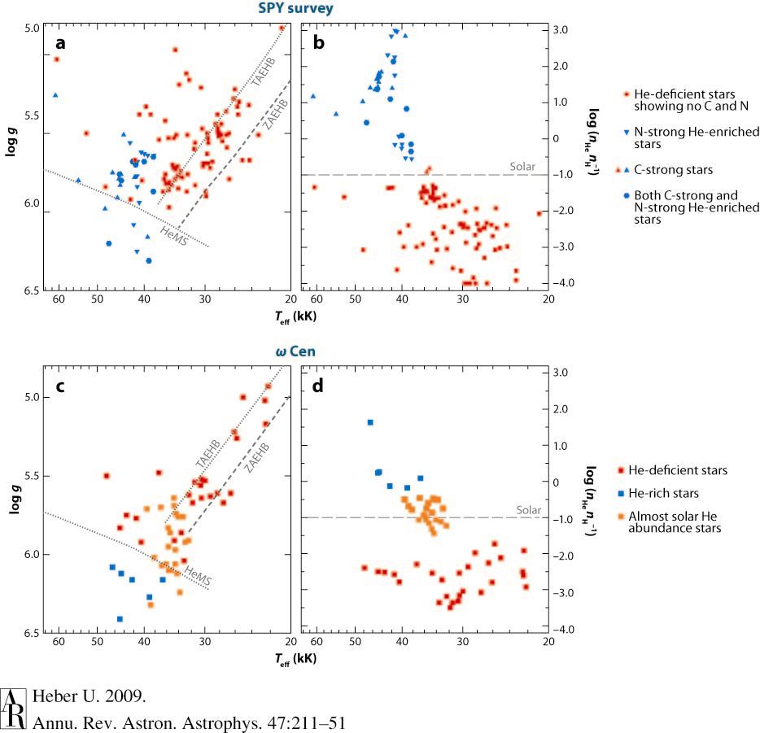

Slide 50
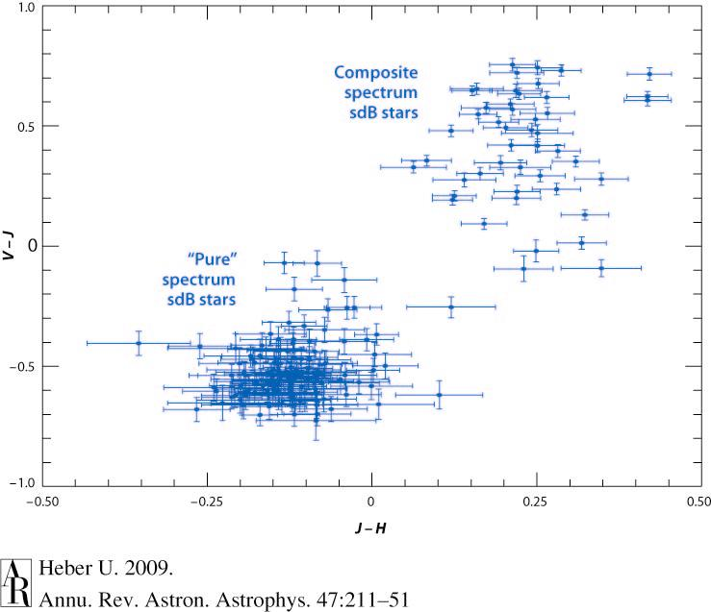

Slide 51
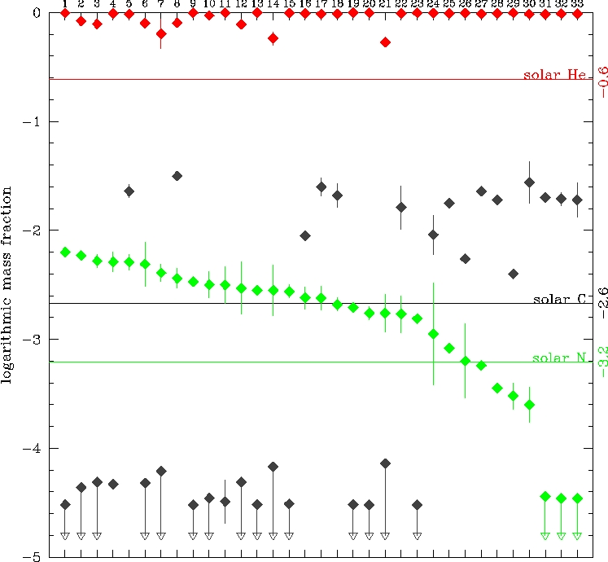
Sorting by N-abundance

