Slide 1
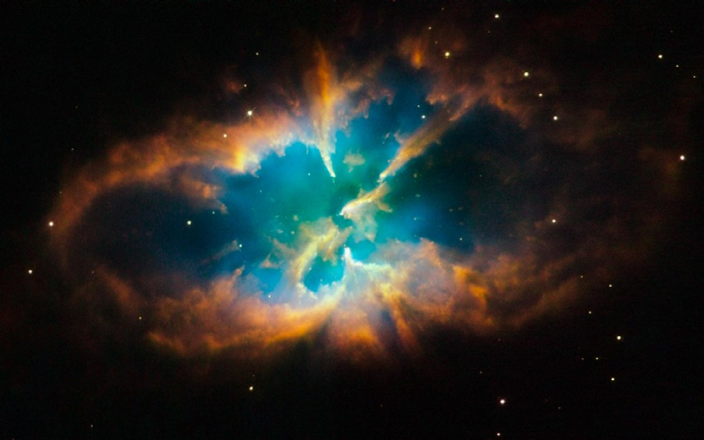

Slide 2
Contents of this chapter
Evolutionary timescales
Evolution of low-mass stars
Evolution of high-mass stars → core-collapse supernovae
Endpoints of stellar evolution
white dwarfs (WD)
neutron stars (NS)
black holes (BH)
Star clusters: observational tests of stellar evolution theory
Binary evolution
29.11.
01.12.

Slide 3
Timescales
Evolution of stars determined by three timescales
1) Nuclear timescale t_{n} = amount of time during which the star can sustain its luminosity by nuclear H fusion. But usually only ~10% of the available mass (H) is processed, i.e., evolutionary timescale t_{E} ≈ 1/10 t_{n}
Example: M = 30 M_{ʘ} L = 1.4·10⁵ L_{ʘ}
t_{E} = 2.1·10⁶ yr
Sun: 10¹⁰ yr
Nuclear timescale determines the overall lifetime of a star

Slide 4
Evolutionary timescale for MS stars with different mass
M/M_{ʘ} t_{E} / yr
----------------------
60 5.5·10⁵ 550 000 yr
18 2.4·10⁶
6 5.2·10⁷
3 3.9·10⁸
1.1 5.1·10⁹
0.8 1.4·10¹⁰ ~ age of Universe
0.2 1.4·10¹¹
→ Massive stars live rather wastefully!

Slide 5
2) Thermal timescale (Helmholtz-Kelvin timescale) t_{HK}
= amount of time during which the star can sustain its luminosity by its thermal energy content (fusion “switched off”).
virial theorem:
Sun: t_{HK} = 2·10⁷ yr = 1/500 t_{E}
HK timescale is relevant, e.g., during changes of the interior structure when nuclear fusion is “off”, e.g., contraction of inert He-core of a star that evolves away from the main sequence (explaining the “Hertzsprung gap” in the HRD, see slide 62).

Slide 6
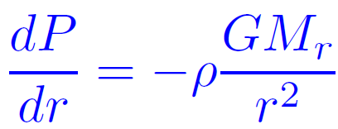
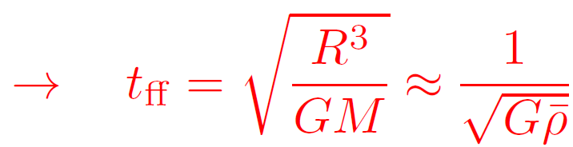
3) Free-fall timescale (dynamical timescale) t_{ff}
Determines star collapse: stabilizing pressure “switched off“
Hydrostatic equation:
↓
≈ ≈
Relevant timescale for, e.g, stellar core collapse, or stellar oscillations
For MS stars (and most of subsequent evolution time) holds t_{n} >> t_{HK} >> t_{ff}

Slide 7
Post-main sequence evolution: case distinction
1. very low masses M/M_{ʘ} = 0.08 … 0.4 (only H burning)
2. low-mass stars < 8 M_{ʘ} (up to He burning)
3. massive stars > 8 M_{ʘ} (fusion through Fe)
Generally:
During their lifetime, stars lose a large fraction of their mass (stellar wind). Stars with initial masses
< 8 M_{ʘ} end as WD with < 1.4 M_{ʘ} (=M_{Ch})*
8 – 50 M_{ʘ} end as NS with ≈ 1.4 – 2.3 M_{ʘ} (=M_{OV})*
50 – 140 M_{ʘ} end as BH with ≈ 2.3 – 15 M_{ʘ}
> 140 M_{ʘ} are completely disrupted by explosive O & Si – burning
*Chandrasekhar and Oppenheimer-Volkoff mass limits
Remark: Stars with M > 140 M_{ʘ} can exist only at low metallicities (i.e., not in our Galaxy, predominantly at earlier epochs → Explosions observed in distant galaxies: so-called pair-instability SNe; see slide 34)

Slide 8
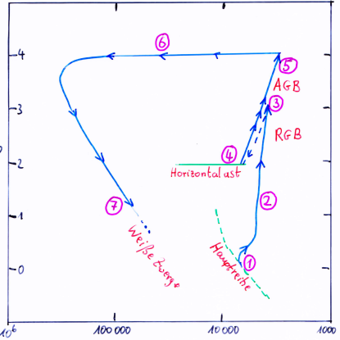
Evolution of a 1 M_{ʘ} star
AGB
RGB
↑
log L/L_{ʘ}
Horizontal branch
White dwarfs
Main sequence
← T_{eff} / K

Slide 9
Evolutionary phases of low-mass stars
1. Main sequence (MS): H core burning
2. Red giant branch (RGB): H shell burning, He core contracts, HK timescale
3. Helium flash: He ignites explosively in core, electrons degenerate (for M < 2.5 M_{ʘ}). Thermal runaway: EOS independent of T (see previous chapter, slide 18), star cannot react on T increase with expansion. T increases until degeneracy is lifted.
4. Horizontal branch (HB): He core burning & H shell burning
5. Asymptotic giant branch (AGB): double shell burning (H+He), strong mass-loss
6. Envelope ejection → planetary nebula (PN) M_{PN} = 0.01…some M_{ʘ}
7. Cooling sequence of WDs; star “dead“ (no more fusion), cooling times several
10⁹ yr. Coolest WDs found: T_{eff} = 4000 K (cooler ones non-existent, because cooling time > age of Galaxy)

Slide 10
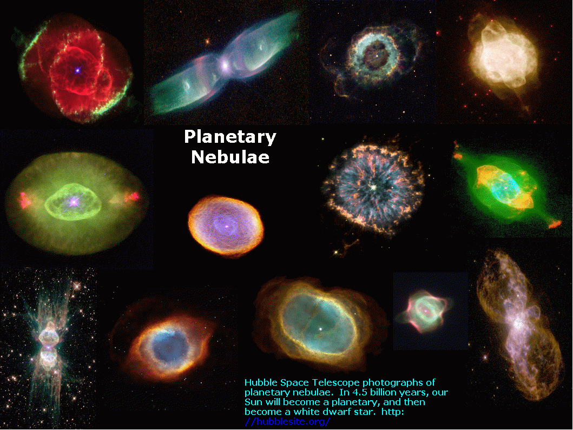

Slide 11
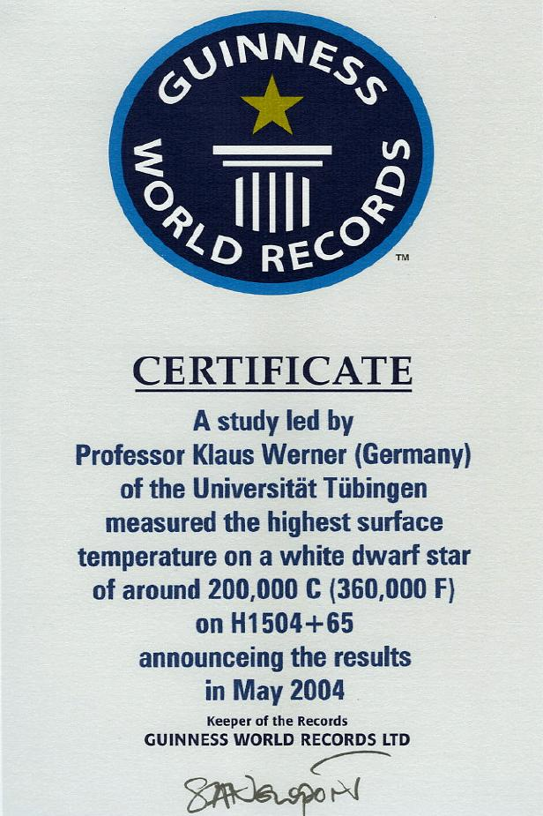

At “birth“, WDs are very hot, T_{eff} > 100 000 K. Record holder for a decade:
H1504+65, T_{eff} = 200 000 K
2004

Slide 12
Current record holder: RXJ0439.8-6809, T_{eff} = 250 000 K
Identification:
van Teeseling et al. 1996

Slide 13
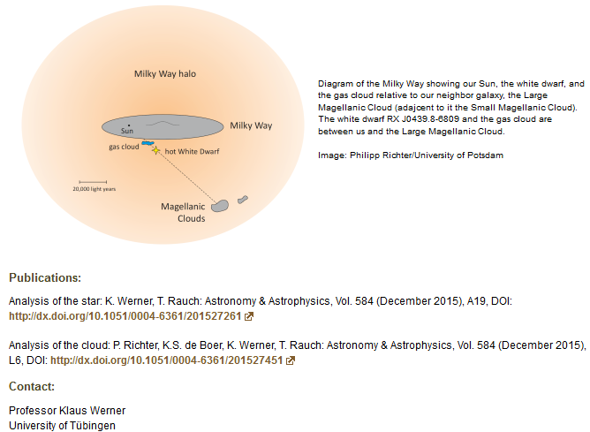

Slide 14
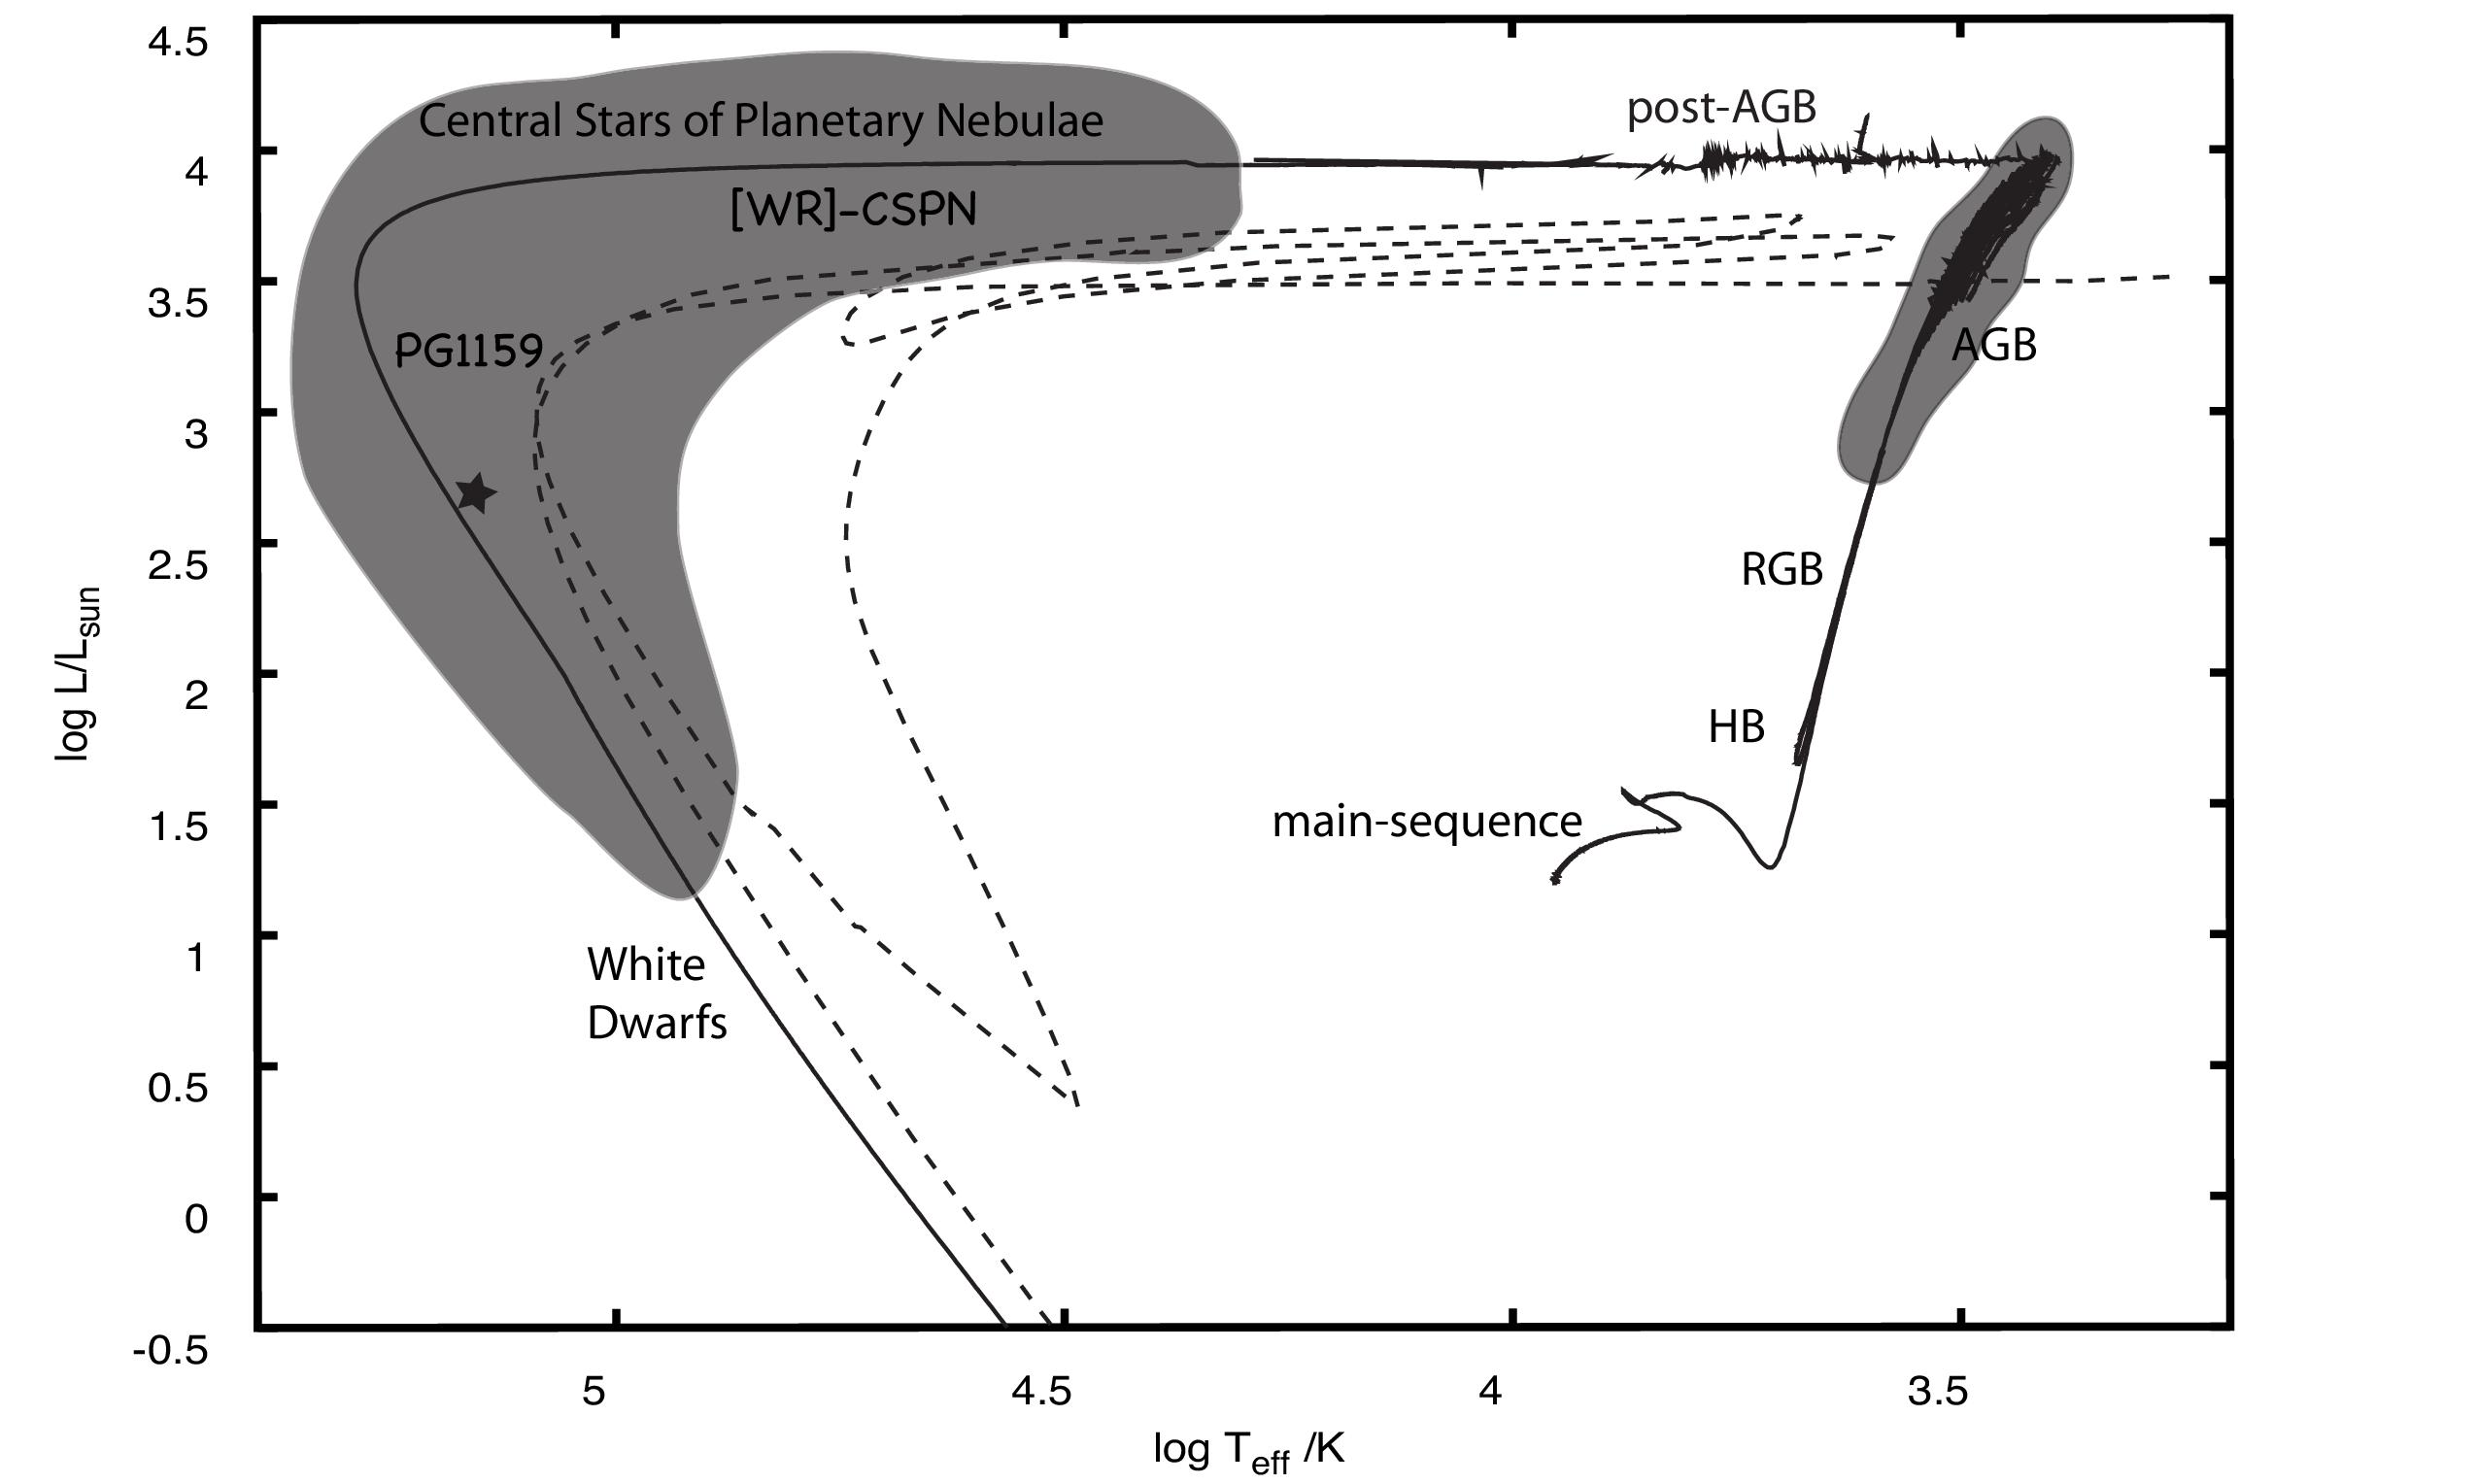
Some WDs re-ignite their He-shell fusion and become born-again stars
late He-shell flash
causes return to AGB
Evolutionary tracks for a 2 M star. Born-again track offset for clarity.
(Werner & Herwig 2006)

Slide 15
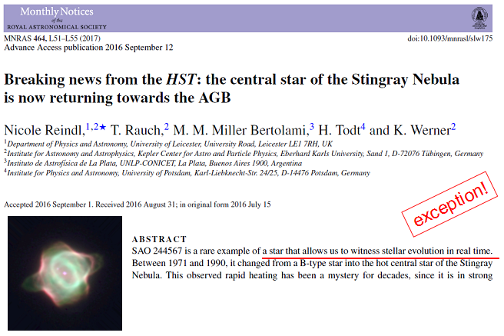
Remember this slide from the previous chapter:
This is a born-again star on its way back to the AGB, quickly moving through the HRD in “real time”!

Slide 16
We identified a born-again star on its way back to the AGB, quickly moving through the HRD in “real time”!

Slide 18
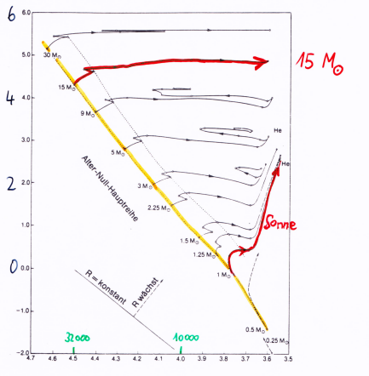
Post-MS evolution up to ignition of central helium burning
15 M_{ʘ}
↑
log L/L_{ʘ}
ZAMS
Sun
32000 K
10000 K
← log T_{eff} / K

Slide 19
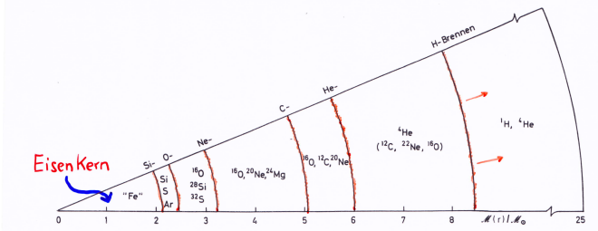
Massive stars (M > 8 M_{ʘ})
C burning ignites, electron gas not degenerate (i.e., no fatal carbon flash)
Duration (20 M_{ʘ} star) 1000 yr
Then: Ne burning 0.6 yr
O burning 1.3 yr
Si burning 12 d
burning
“onion-shell model” of a 25 M_{ʘ} star
Fe core
M_{r}/M_{ʘ}

Slide 20
Then, no more nuclear energy sources available. Fe core contracts.
T_{c} = 10¹⁰ K ρ_{c} = 10¹⁰ g/cm³
Key parameter for further course of events: Mass of built-up Fe core (core mass M_{c}). Since M_{c} > M_{Ch}, core collapses (electrons relativistic degenerate) as soon as γ_{ad} is reduced below 4/3 by:
(adiabatic exponent, =4/3 for rel. deg. electron gas; slide 18 in previous chapter)
electron capture (by Ne, Mg nuclei) (M_{c} < 4 M_{ʘ})
or photo disintegration (⁵⁶Fe → 14 ⁴He) (M_{c} > 4 M_{ʘ})
→ Fe core collapse (implosion, τ_{ff} ≈ 40 ms!)
stops when ρ_{c} ≈ 2·10¹⁴ g/cm³ is reached (nuclear matter density)
→ NS formed in the center, remaining matter “rains down“ on it.
→ shock front (core bounce)
→ reversal of direction of motion
→ SN explosion (~10⁵³ erg, 99% carried away by neutrinos)

Slide 21
How is the gravitational energy that was liberated by the collapsed core transformed into kinetic energy to eject the remaining stellar envelope?
Problem: shock wave first runs through non-collapsed part of stellar Fe core. Most energy lost by spallation of ⁵⁶Fe nuclei.
Solution: neutrinos, that are created during neutronization of matter in the forming NS, diffuse outward and transfer momentum to matter.
p + e⁻ → n + ν_{e}
neutrino burst ~10 sec
Fe
NS

Slide 22
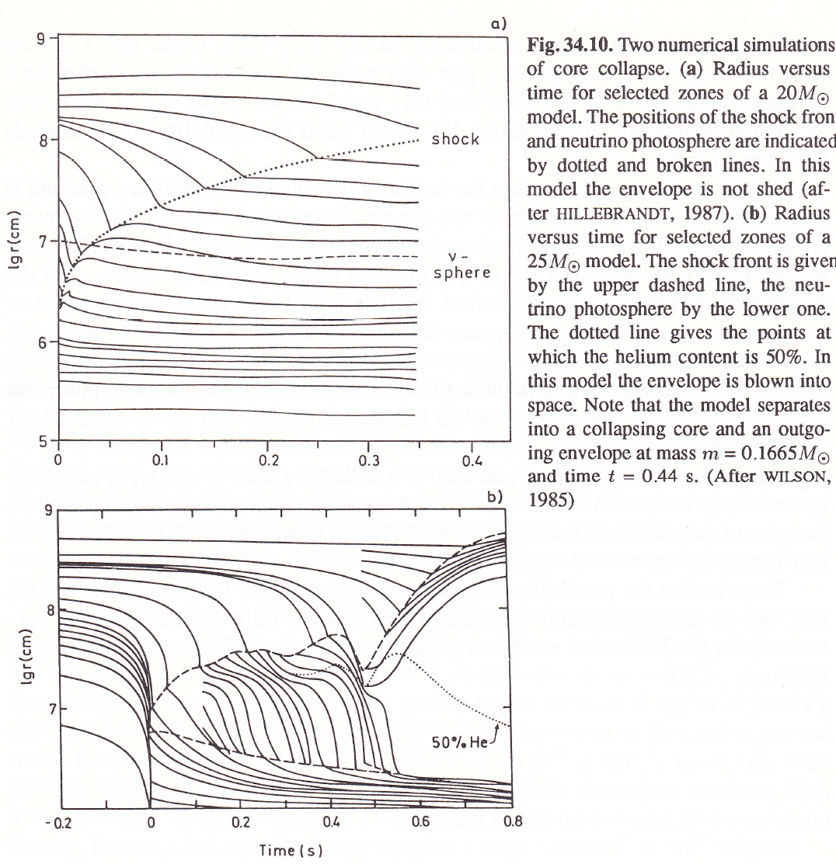
shock
↓
20 M_{ʘ}
neutrino sphere
↓
NS surface →
Radial movement of mass shells during core collapse
shock
↓
25 M_{ʘ}
neutrino sphere
↓
t=0:
core collapse almost stopped, NS “ready“, surface “hard“ → core bounce, outward shock starts
NS surface →

Slide 23
Failed supernovae?
Many SN progenitors could be identified on pre-explosion images (red supergiants). Strange result: up to now, no progenitor found with >17 M_{ʘ}
Speculation: more massive (20–30 M_{ʘ}?) objects become failed SNe
Shock wave stalls in stellar envelope; even with neutrino support not strong enough to cause SN explosion.
→ Star directly collapses to BH, without SN explosion
Observation campaigns to look for supergiants in galaxies which suddenly disappear.
First possible proof in 2015:

Slide 24
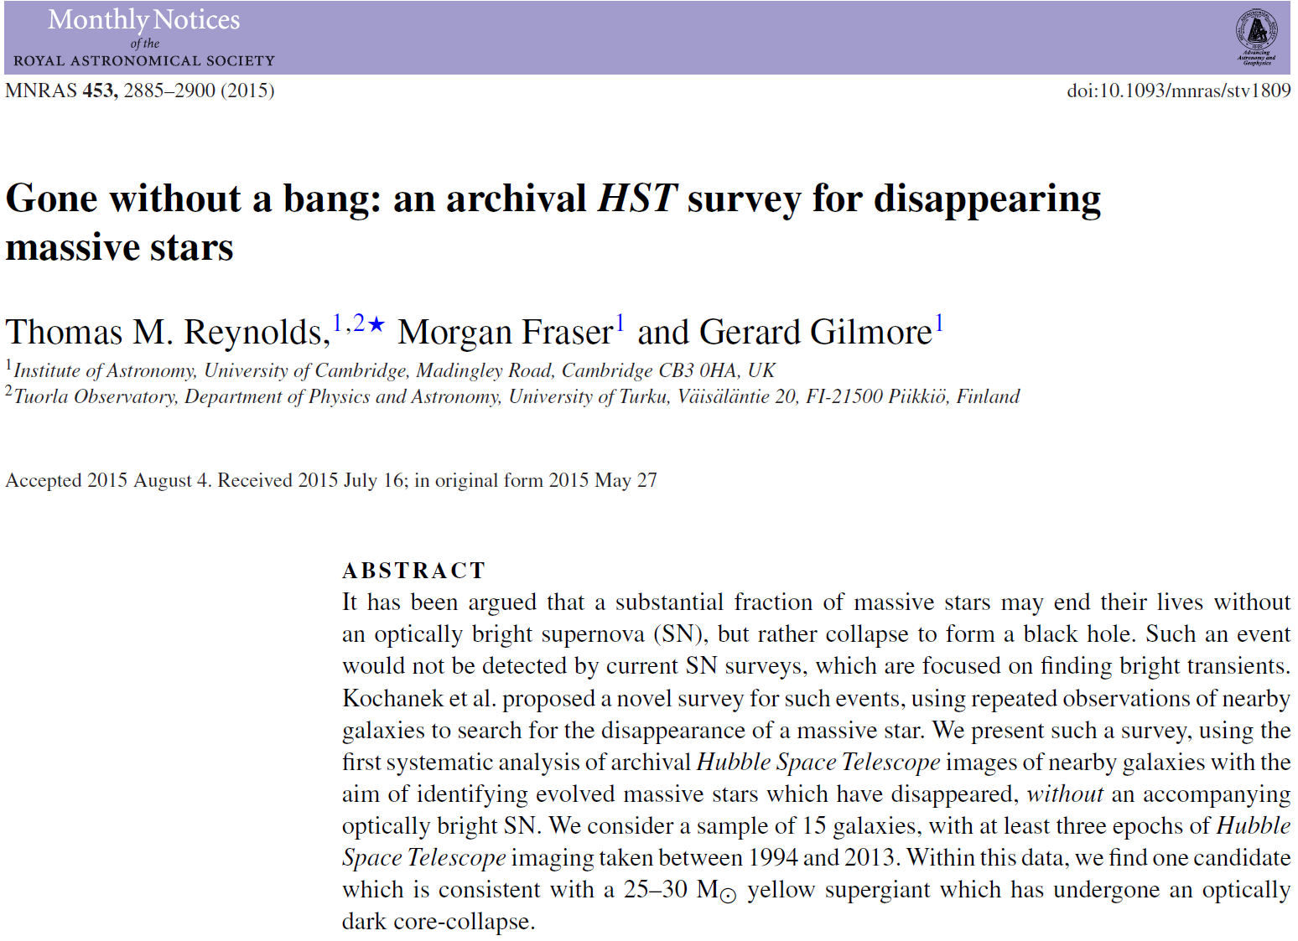

Slide 26
Another case
(2017):
before
after

Slide 27
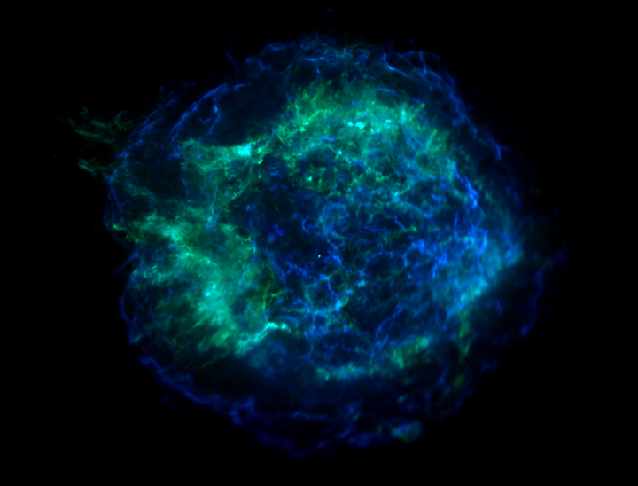
NSs are born very hot, 10¹¹ K, drops to 10⁹ K within 1st day by neutrino emission (Urca process, same as ν cooling in massive stars):
n → p + e⁻ + ν_{e} p + e⁻ → n + ν_{e}
Other ν emission processes dominate cooling during next 1000 yr → 10⁸ K (interior), T=10⁶ at surface. Then photon cooling takes over, L ≈ L_{ʘ}, but flux maximum at X-rays (≈ 30 Å).
-
Supernova remnant (SNR) Cas A with neutron star
(X-ray image, Chandra observatory)
More details about SN phenomenology in the following chapter on variable (eruptive) stars

Slide 28


First discovery of a NS: Bell, Hewish (1967), radio pulsar PSR1919+21, periodic signal P=1.337 s (NS rotation)
Most of the ~3000 known NSs are radio pulsars, only very few identified in other wavelength regions (optical, UV, X-ray)
NS rotation periods 0.01 – 8 s. Even shorter in binaries (1-10 ms, “milli-second pulsars“, spun-up by accretion)
Anthony Hewish
(Nobel prize 1974)
Jocelyn
Bell

Slide 29
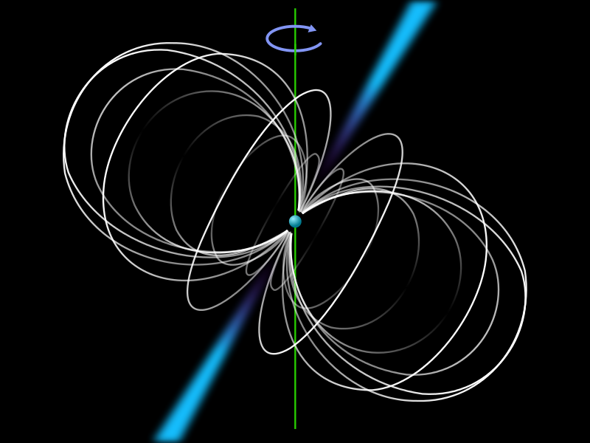
Pulsar model
rapidly rotating NS accelerates plasma with its strong magnetic field
particles approach speed of light, typically after 1000 km
emission of Bremsstrahlung no longer isotropic but beamed → light house effect
Pulsar only visible when beam hits Earth

Slide 30

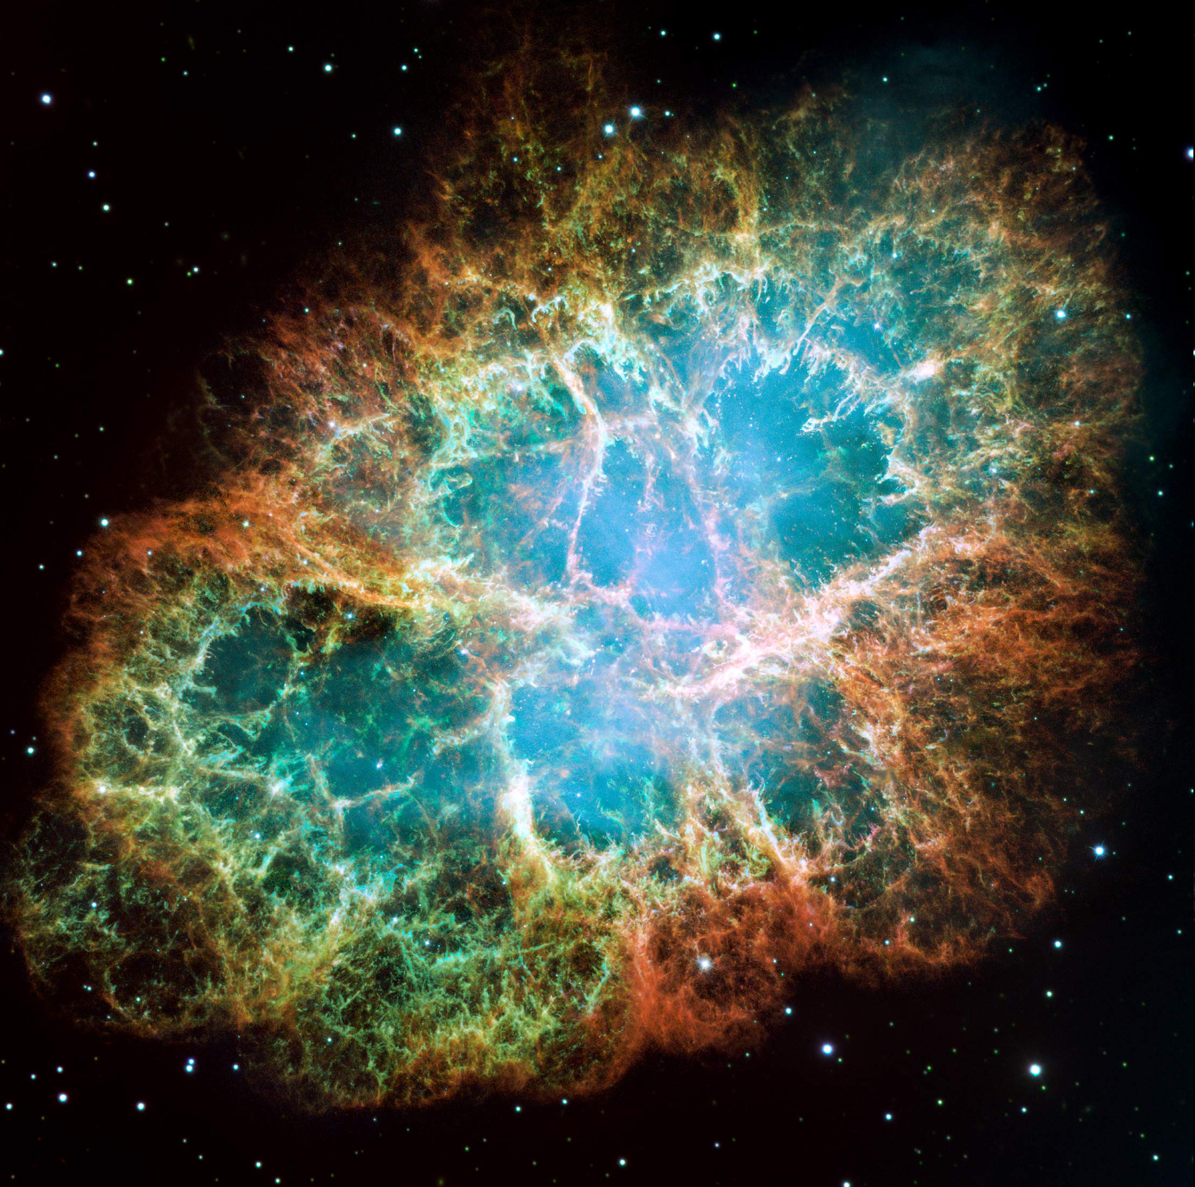
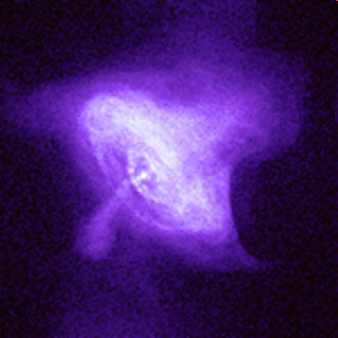
Rotation periods increase: can be measured (rotating dipole → energy loss). Characteristic time scale τ: doubling of period
For most pulsars: τ = 10⁶ … 10⁷ yr
Crab pulsar: τ = 2500 yr age: 967 yr (SN explosion 1054)
→ τ is a measure for the age of the pulsars
Crab SNR (optical) NS at center (X-ray)

Slide 31
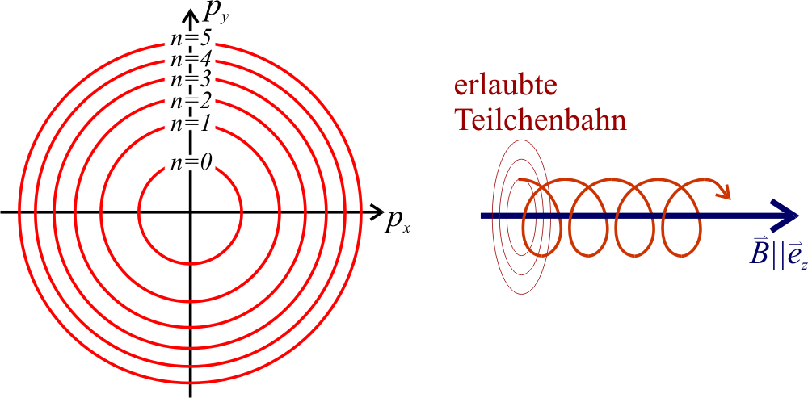
NS magnetic fields
Her X-1 Trümper et al. 1977 (Tübingen):
Emission line in X-ray spectrum at 58 keV. (actually, an absorption line at 38 keV)
= cyclotron absorption of gyrating electrons in very strong magnetic field
gyration movement quantized (discrete, equidistant Landau levels)
ΔE = heB/2πm_{e} → B ≈ 4∙10¹² G
allowed particle
trajectories
wikipedia

Slide 32
Simulation of magnetized NS atmospheres is a challenging task

Slide 33
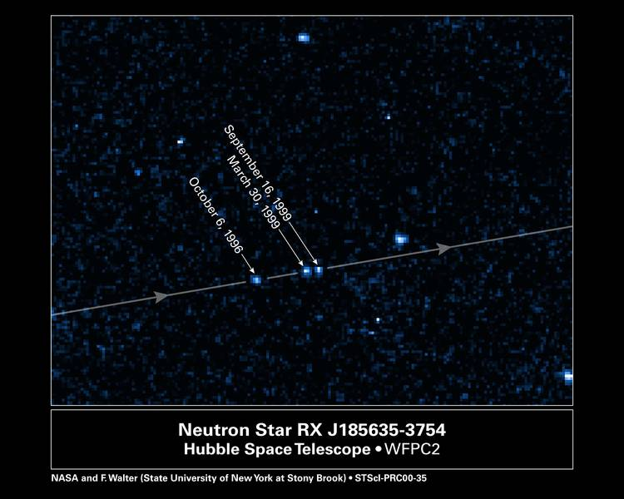
Isolated NS that has left its birth location with high velocity (“SN kick”)

Slide 34
Pair-instability supernova
Occurs in oxygen cores of most massive stars (M > 140 M_{ʘ}), T extremely high → radiation pressure, exerted by γ photons, stabilizes the star
With increasing T, γ photons “disappear“ by electron-positron pair production.
→ radiation pressure falls
→ core contracts, heats up, O & Si burning ignites abruptly
→ very energetic explosion, very bright SN → no remnant
This type of very bright SNe belongs to the group of superluminous SNe, also dubbed hypernovae.
Other scenarios possibly leading to hypernovae are variants of core-collapse SNe (see next chapter on (eruptive) variable stars):
Collapse of a fast-rotating star (so-called “collapsar”, related to γ-ray bursts)
Formation and spin-down of a magnetar (NS with B≈10¹⁵ G)

Slide 35
2009

Slide 36
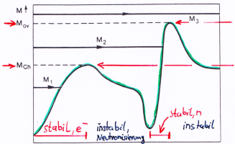
Interior structure of white dwarfs (WD) and neutron stars (NS); black holes (BH)
≈ 2.3 M_{ʘ}
≈ 1.4 M_{ʘ}
↑
Mass
stable, n
stable, e–
unstable
unstable
neutronization
log (mean density) →
M < 1.4 M_{ʘ} Chandrasekhar mass limit
WD, stabilized by degenerate electron gas
M up to ~2.3 M_{ʘ} Oppenheimer-Volkoff mass limit
NS, stabilized by degenerate neutrons

Slide 37
Interior structure of white dwarfs (WD) and neutron stars (NS)
Properties of black holes (BH)
Remember:
M < 1.4 M_{ʘ} Chandrasekhar mass limit
WD, stabilized by degenerate electron gas
M up to ~2.3 M_{ʘ} Oppenheimer-Volkoff mass limit
NS, stabilized by degenerate neutrons
Why are there mass limits?

Slide 38


Mass-radius relation for WDs
hydrostatic equation:
estimation for P:
↓
EOS (non-relativistic degenerate e– gas):
→ radius of WD shrinks (!) with increasing mass!
But: with increasing mass density, the electrons become relativistic
→ beginning from the WD core, the EOS becomes softer: P~ρ^{4/3},
→ WD shrinks even stronger with increasing mass
→ R=0 is reached at Chandrasekhar mass limit M_{Ch} = 1.44 M_{ʘ}

Slide 39
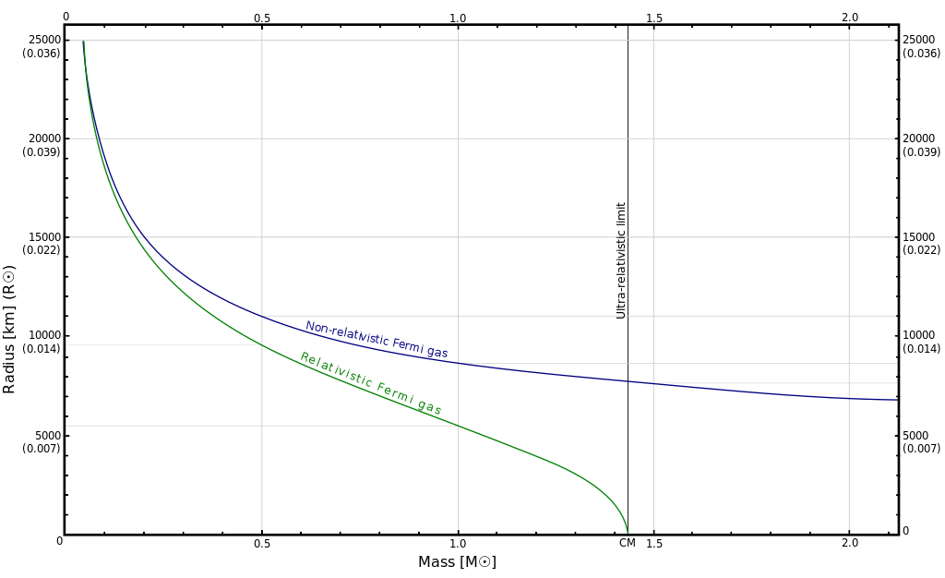
Mass-radius relation for WDs
R~M^{-1/3}
↑ Chandrasekhar limit
In practice: a mass-accreting WD in a binary system ignites explosive C burning when reaching M_{Ch} → thermonuclear SN (type Ia, see next chapter about variable stars)

Slide 40
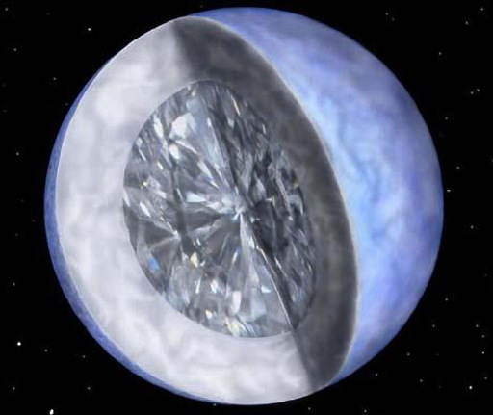
Interior structure of WDs
Thin mantles of He and H (unburned fuel)
Core chemistry dominated by He-burning ash (99% of total WD mass): C and O
A fraction of the WD core is crystallized (C and O atomic lattices). In case of C, this is … diamond!
Remark: The most massive WDs (>1M_{ʘ}) could have O/Ne/Mg cores because progenitor stars might have gone through C burning. In binaries, they can suffer an accretion induced collapse to a NS by electron captures on Ne/Mg nuclei. In contrast to C/O WDs, no explosion. Pathway to NSs, in addition to core-collapse SNe. Debated.

Slide 41
Interior structure of WDs
Thin mantles of He and H (unburned fuel)
Core chemistry dominated by He-burning ash (99% of total WD mass): C and O
Remember from EOS discussion in previous chapter: A fraction of the WD core is crystallized (C and O atomic lattices). In case of C, this is … diamond!
Note: the most massive WDs (>1M_{ʘ}) could have O/Ne cores because progenitor stars might have gone through C burning

Slide 42
Most WDs have masses near 0.6M_{ʘ}. (secondary maximum at 0.8 M_{ʘ} is result of binary WD mergers.) Massive WDs are rare, because
1) massive progenitor stars are rare (see chapter on star formation) and
2) strong mass loss during stellar evolution
WD mass distribution
initial-final mass relation
El-Badry et al. 2018
Kilic et al. 2018
→ Difficult to test observationally the theoretical M-R relation near the Chandrasekhar mass limit

Slide 43
R~M^{-1/3} proportionality for WDs also holds for NSs, but at much smaller scale (essentially because of mass ratio electron/neutron):
P ~ ρ^{5/3} / (m_{N}μ_{N}^{5/3})
μ_{N} = molecular weight per free neutron ( =1, 1 nucleon / fermion)
→ R_{NS} ≈ 1/1000 R_{WD}
In analogy to WDs, NSs also have upper mass limit (Oppenheimer-Volkoff)
Typical values:
WD radius (1 M_{ʘ}) ≈ 1/100 R_{ʘ} (≈ Earth radius)
NS radius (2 M_{ʘ}) ≈ 15 km

Slide 44
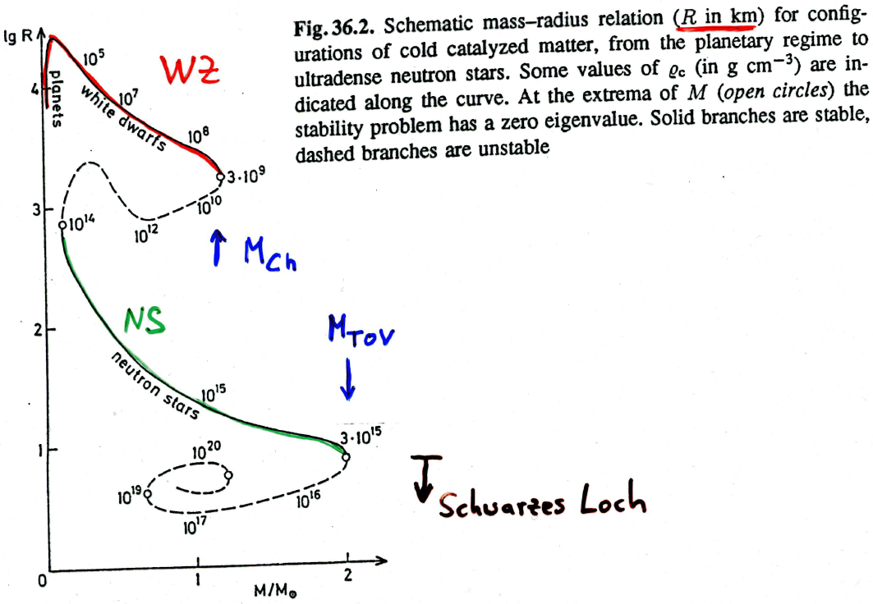
WD
↑ M_{Ch}
NS
↓ M_{OV}
↓ black hole

Slide 45
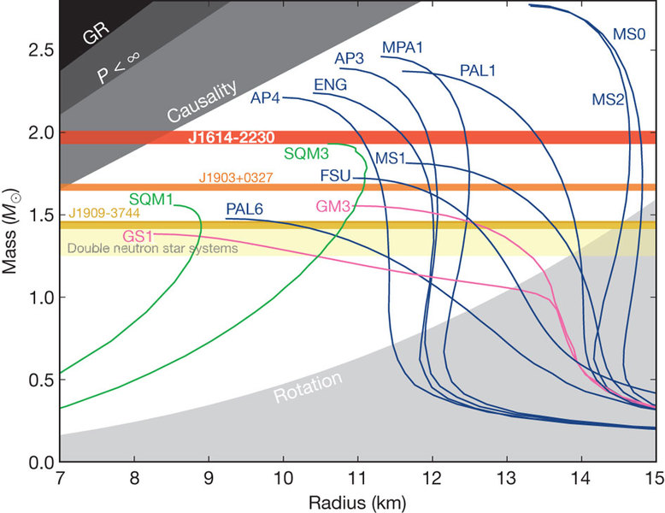
Mass-radius relation for NSs
highly uncertain because EOS of core matter unknown
→ presently hot topic: constrain EOS by observed NS masses and radii.
Theoretical mass-radius relations of NS models computed with different EOSs.
E.g.: depending on the EOS, a NS with 1.5 M_{ʘ} has a radius between 8-15 km. A “stiff” EOS gives a large radius.
The highest NS mass found to date (2.14 M_{ʘ}) excludes the softer EOSs (they cannot resist gravity; NS would collapse to BH)
There’s not even room enough to be anywhere. It’s not dark yet, but it’s gettin’ there. – Bob Dylan

Slide 46
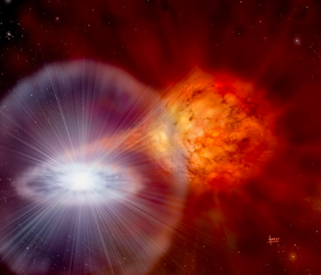
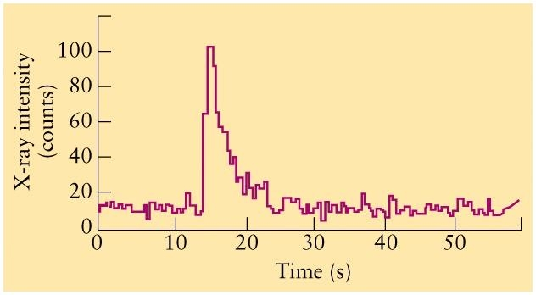
NS masses can be accurately determined in binaries. Problem: radius.
One possibility: from L=4πR²σT_{eff}⁴ , necessary:
a) distance (to determine L)
b) T_{eff}, from spectral energy distribution (SED). Simplest assumption: NS radiates like a blackbody. In practice: NS atmospheres must be modeled.
Several other possibilities, e.g., X-ray bursters (see next chapter).
Burst: Thermonuclear explosion of accreted matter (He or C) on NS surface
← Artist impression
X-ray luminosity →
Change of SED during NS cooling after explosion depends on M and R.

Slide 48
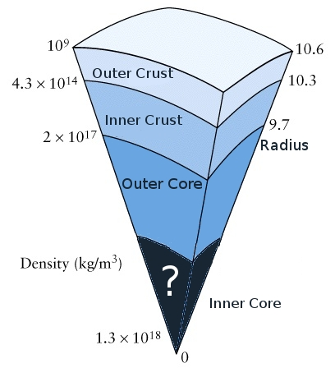
Interior structure
of neutron stars
Top: photosphere, ideal gas, like in “usual stars” but much denser (pressure scale height: ~cm) and possibly composed of Fe (partially ionized).
Outer crust: solid lattice of ⁵⁶Fe nuclei plus rel.deg. e⁻. Towards bottom, increasing neutronisation of nuclei (cf. EOS discussion in previous chapter) produces n-rich, heavy nuclei like ⁸⁶Kr … ¹¹⁸Kr (solid lattice).
Inner crust: neutron-drip starts → mixture of nuclei (lattice), free n and e⁻
Outer core: at top, nuclear density is reached, nuclei dissolve → mixture of primarily n (superfluid), smaller number of p (superfluid, superconducting) and e⁻ (rel.deg.)
Inner core: uncertain (~5 times nuclear density), maybe solid, consisting of pions (from n→p+π⁻)
(km)
NSs can have extremely strong magnetic fields (up to 10¹⁵ G, magnetars). Related phenomena (pulsars etc.) will be discussed in the next chapter on variable (eruptive) stars.

Slide 49
Quark stars
… are hypothetical objects, even more compact than NS. Existence debated (lack of knowledge of EOS of a quark-gluon plasma).
2002
R = 3.8 – 8.2 km → too small for a NS.
Later interpretation: emitting area is hot spot on a NS

Slide 50
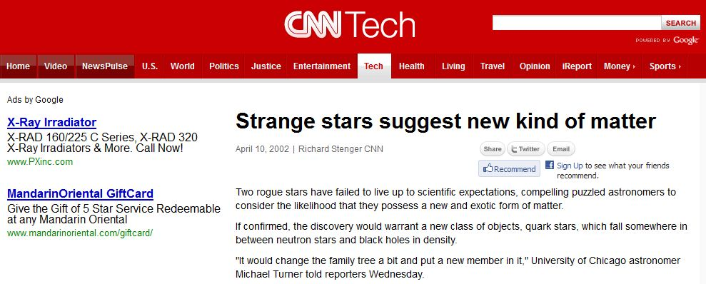
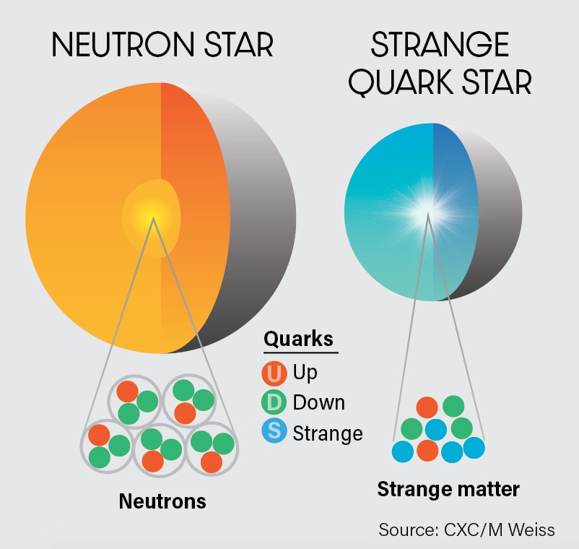
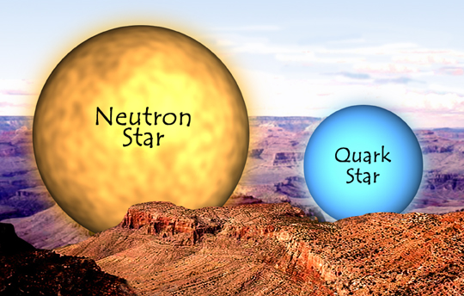

Slide 51
Black holes
Are formed in a core-collapse SN when collapsing core exceeds Oppenheimer-Volkoff limit (≈ 2.3 M_{ʘ}).
Relativistic degenerate neutrons cannot resist gravity.
Even light is not able to escape from the BH:
escape velocity (classical mechanics):
v_{e} = (2GM/R)^{1/2}
exceeds speed of light at critical radius
R_{S} = 2 GM/c² Schwarzschild radius
(same result follows from General Relativity)
e.g., Sun: R_{S} = 3 km

Slide 52
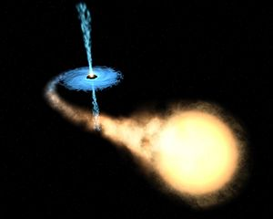
Beyond event horizon (given by R_{S}) any information about structure of matter disappears
BH has only three properties: Mass, angular momentum, (electric charge)
Detection possibilities: in binary systems
a) motion of visible companion around center-of-gravity
b) radiation spectrum of infalling matter (X-ray emission, X-ray binary)
Example: Cygnus X-1, 40 M_{ʘ} supergiant + 15 M_{ʘ} BH
Presently, ~15 BHs known (all in our Galaxy), M = 4 - 15 M_{ʘ}
artist conception

Slide 53
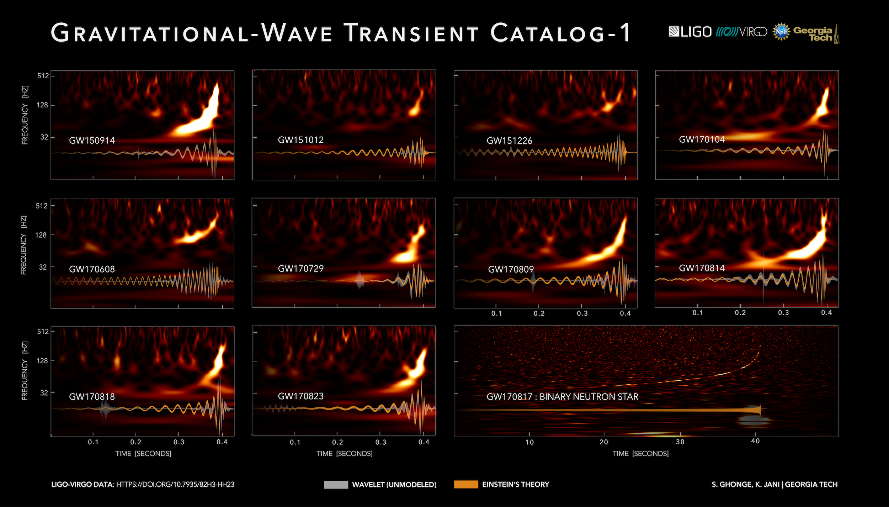
Binary BH merger detected by gravitational waves (10 first confirmed events see below) occurred in other galaxies (see chapter on Astronomical Instruments). Remarkable high masses were found; range M = 8 - ~80 M_{ʘ}

Slide 54
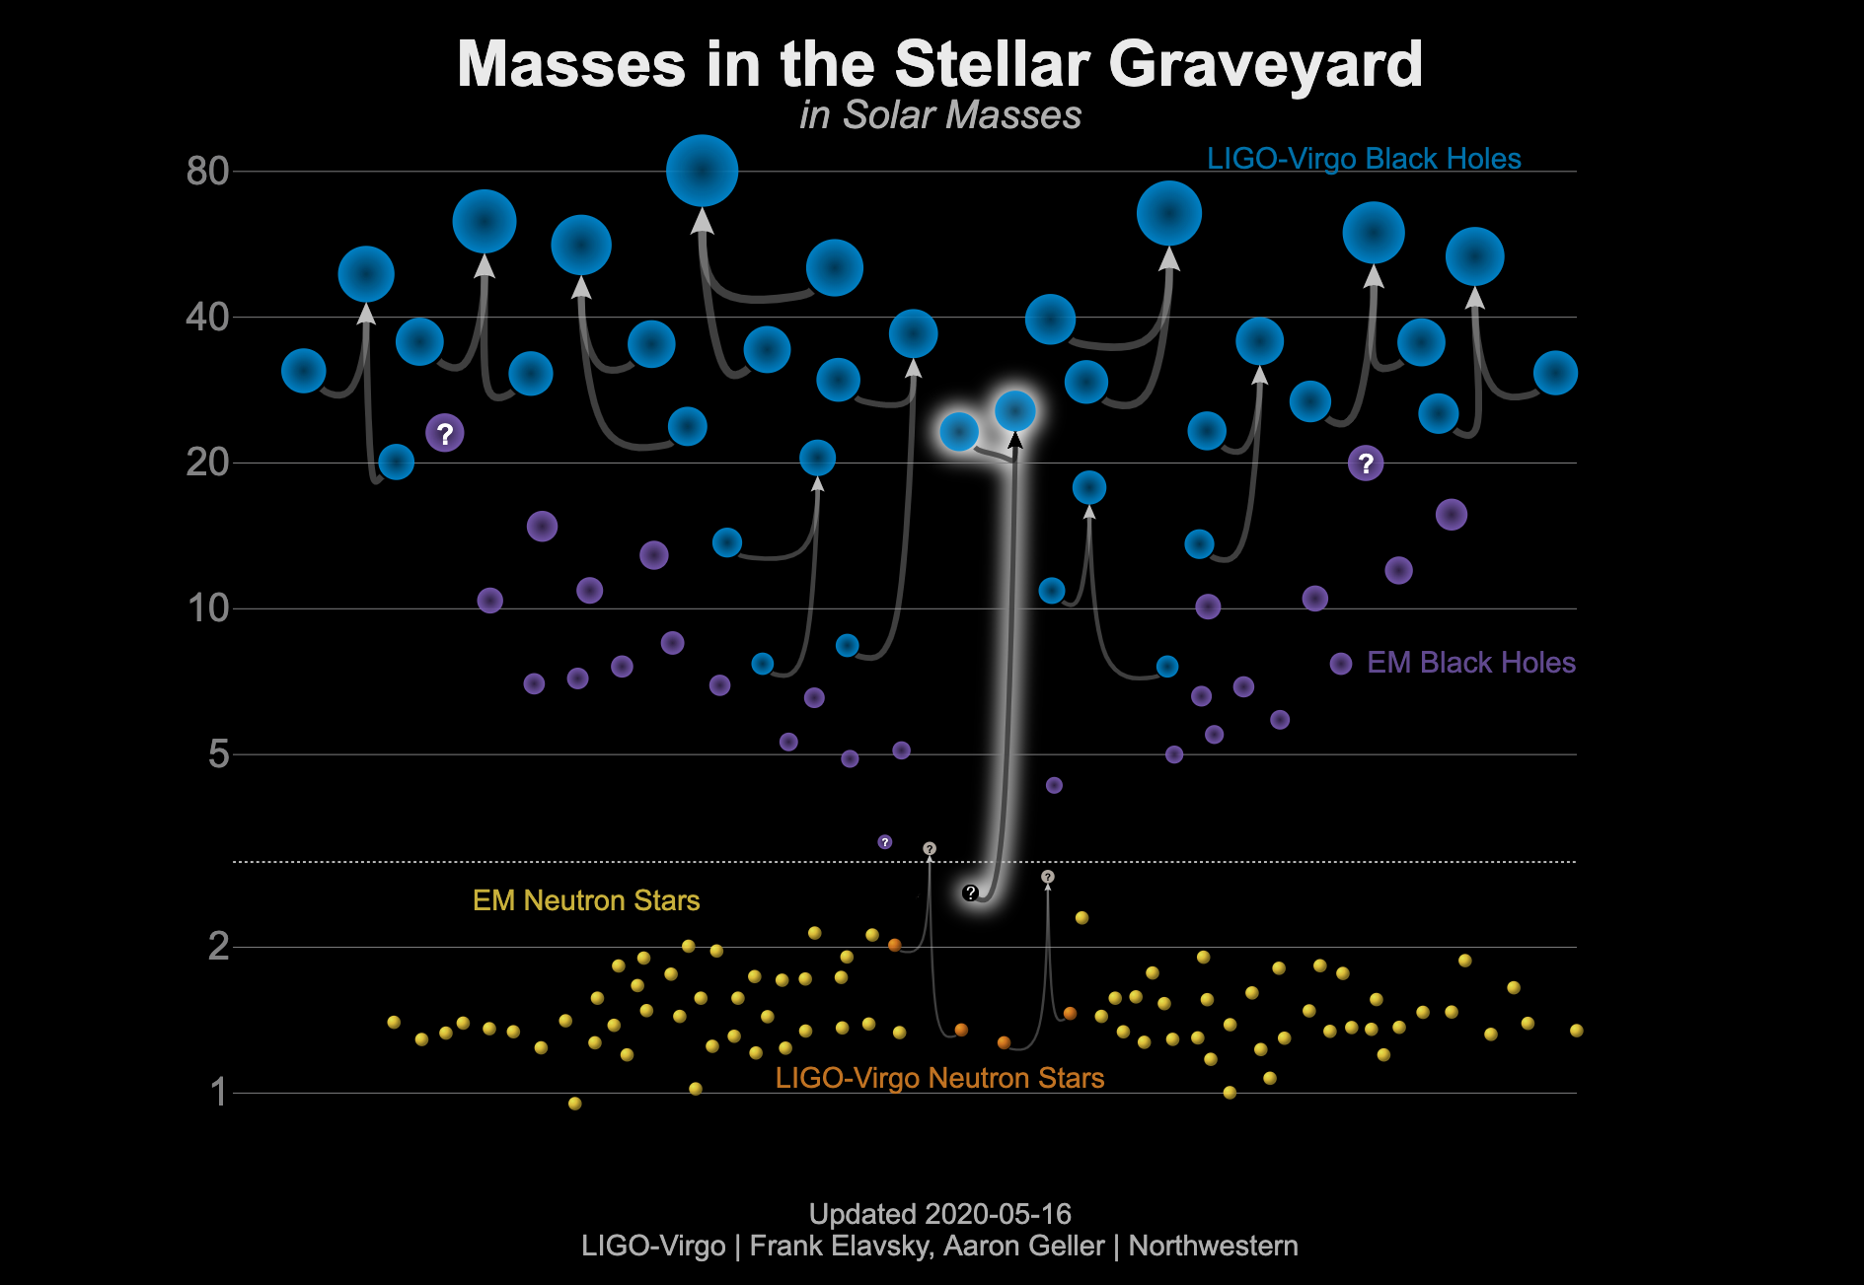
EM = electromagnetic

Slide 55
New detection (press release June 23, 2020): extreme mass ratio
EM = electromagnetic

Slide 56
Stellar clusters: Test beds for stellar evolution theory
Assumption:
All stars in a cluster have the same age and distance
→ Stellar clusters are ideal laboratories for the empirical study of stellar evolution.
differential study possible (distance-independent); i.e. color-magnitude diagram is equivalent to Hertzsprung-Russell diagram
Distance to cluster can often be measured more accurately than distance to single stars
Note: “all stars have same age“ not always true. Clear evidence for multiple star formation episodes in several clusters
Notes:
56

Slide 57
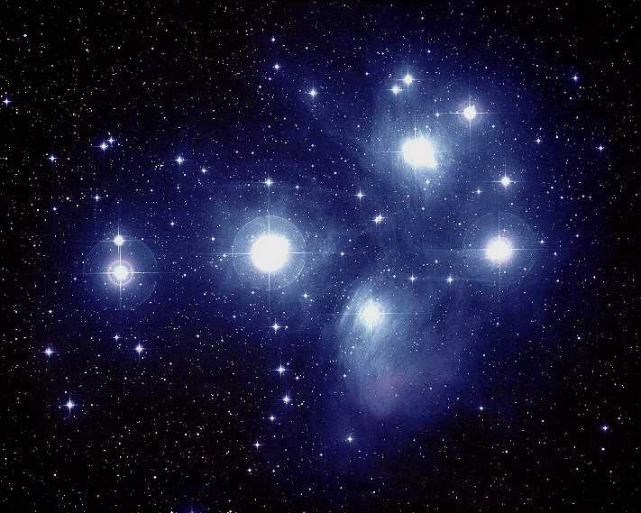
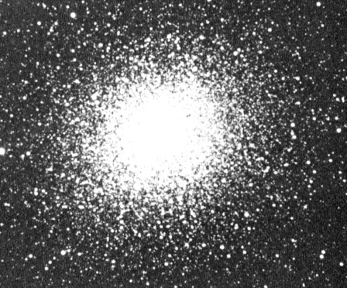
Open clusters
- located in Galaxy‘s spiral arms (i.e., young)
- comprise few dozen to several hundred stars
Globular clusters
- located in Galactic halo (i.e., old)
- about 100,000 stars
- low metallicity (about 1-10% solar)
Pleiades
M13

Slide 58
Evolution of a 1 M_{ʘ} star
AGB
RGB
↑
log L/L_{ʘ}
Horizontal branch
White dwarfs
Main sequence
← T_{eff} / K

Slide 59
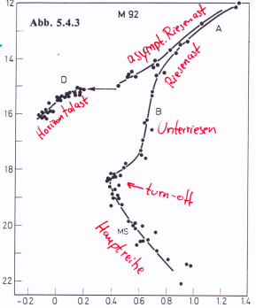
Color-magnitude diagram (CMD): globular clusters
asympt. giant branch
giant branch
Interpretation of cluster CMDs
CMD = HRD with M_{V} = m_{V} + const
high-mass stars further evolved than low-mass stars
horizontal branch
subgiants
V
← turn-off
main sequence
Example: M92
B-V

Slide 60
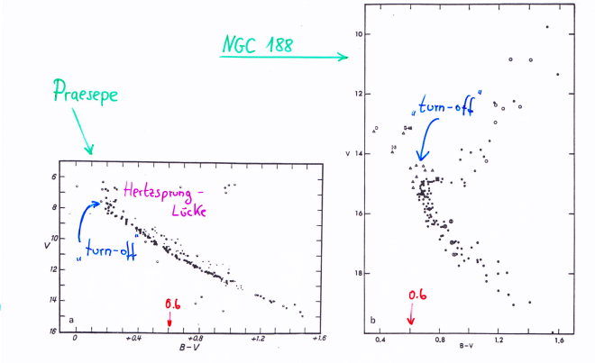
Color-Magnitude diagram: open clusters
NGC 188
Praesepe
turn - off
↑
V
Hertzsprung
gap
turn - off
0.6
↓
0.6
↓
B – V →

Slide 61
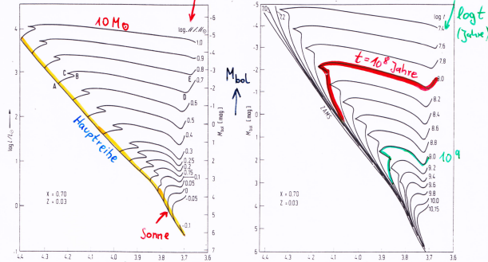
evolutionary tracks
log M/M_{ʘ}
isochrones (lines of equal age)
10 M_{ʘ}
log t
(years)
M_{bol}
t=10⁸ years
log
L/L_{ʘ}
main sequence
10⁹
Sun
← log T_{eff} ← log T_{eff}
comparison of isochrones with observed CMDs allows age determination
(by fixing turn-off point from main sequence)

Slide 62
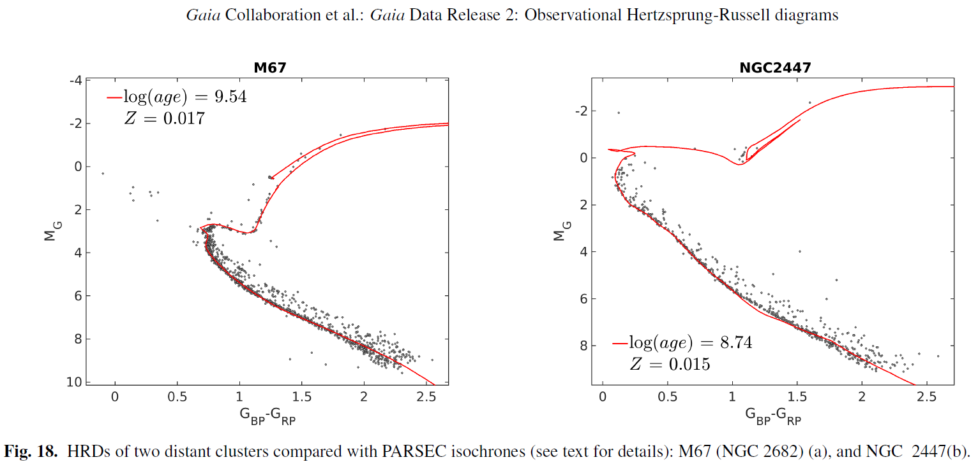
2018
Hertzsprung
gap
Isochrone fits for two open clusters (Gaia data).
Derived ages: 3.5·10⁹ and 5.5·10⁸ yr, respectively

Slide 63
Binary star evolution
Components of a close binary system mutually affect their evolution by mass transfer.
Essential point: more massive star evolves faster
Qualitative description of two examples:
a) two massive stars with 8 and 20 M_{ʘ}
b) two low-mass stars with 2 and 1 M_{ʘ}

Slide 64
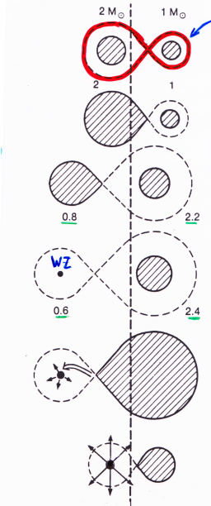
Roche lobe (equipotential surface)
MS phase, detached system
2 M_{ʘ} star expands: mass transfer starts
Low-mass subgiant + massive main sequence star
WD + main sequence star
2nd main sequence star evolves
→ mass transfer onto WD → nova outbursts
Continuing mass transfer onto WD
→ when M>M_{Ch}: C detonation → SN Ia explosion
WD

Slide 65
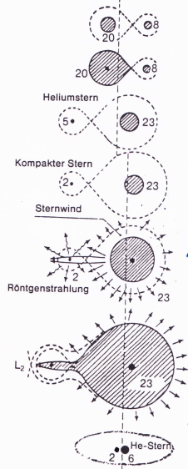
MS phase
1st mass transfer (Roche lobe overflow)
Termination of 1st transfer
Helium star exploded as SN,
compact remnant (NS or BH)
Accretion of matter from stellar wind → strong
X-ray source (high-mass X-ray binary) Cyg X-1
2nd mass transfer → system loses mass
Helium star, then → SN II
Finally: 2 compact objects (NS or BH)

Slide 66
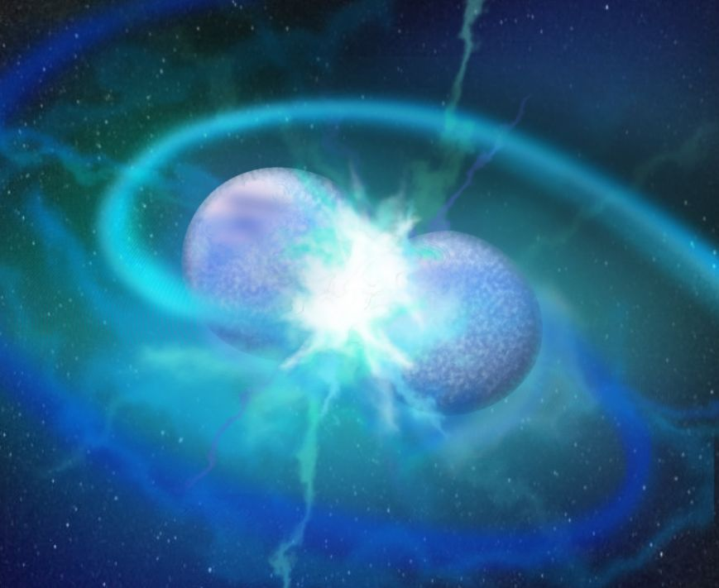
So-called helium rich hot subdwarfs are hot He-burning stars (T_{eff} ~ 50,000 K) below the main sequence, i.e., they are less luminous than usual hydrogen-burning stars of same temperature.
They are probably the outcome of the merger of two helium-core white dwarfs.
We know such close binary WD systems, with orbital periods down to some minutes. They will merge due to gravitational-wave emission.

Slide 68
We have recently discovered hot subdwarfs, that are covered by He-burning ash (C and O rich)
A He-core white dwarf as accreted a CO-core white dwarf
Very strange, because CO-WDs are more massive than He-WDs. Therefore, vice versa, the CO WD should have shredded and accreted the He-WD.
Spectrum and model-atmosphere fit reveals high amounts of C and O from 3α-burning

Slide 69
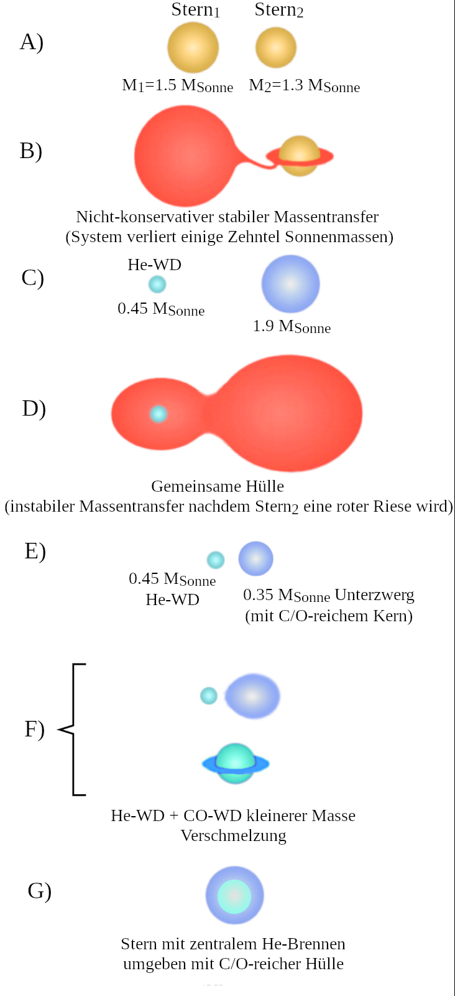
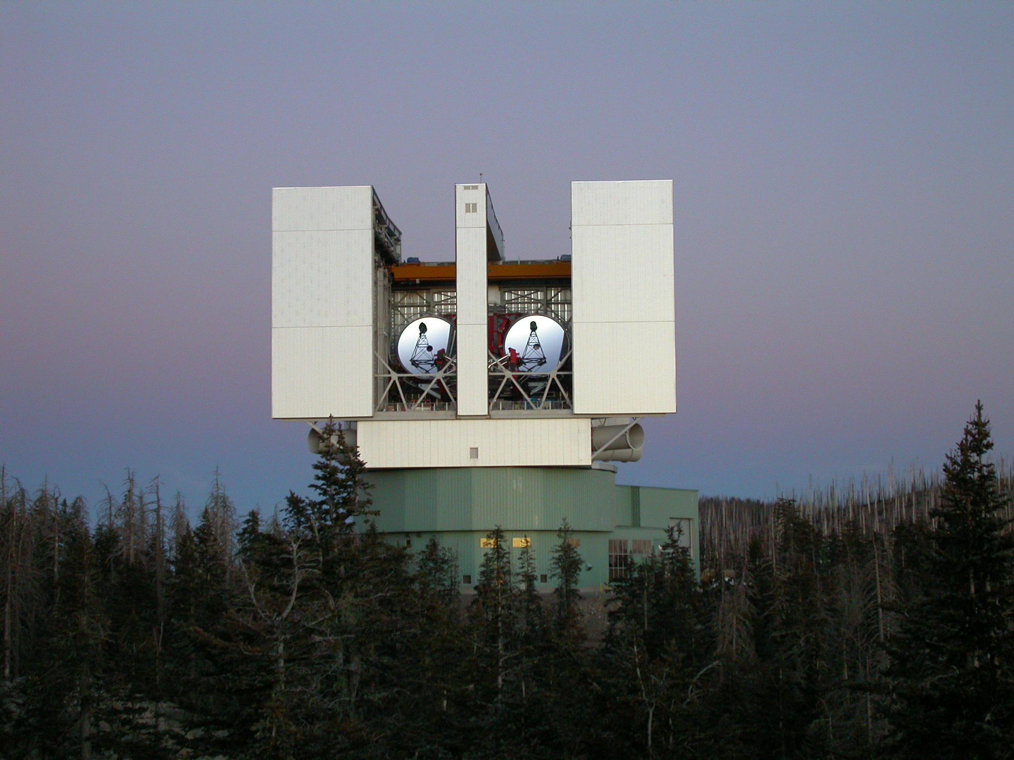
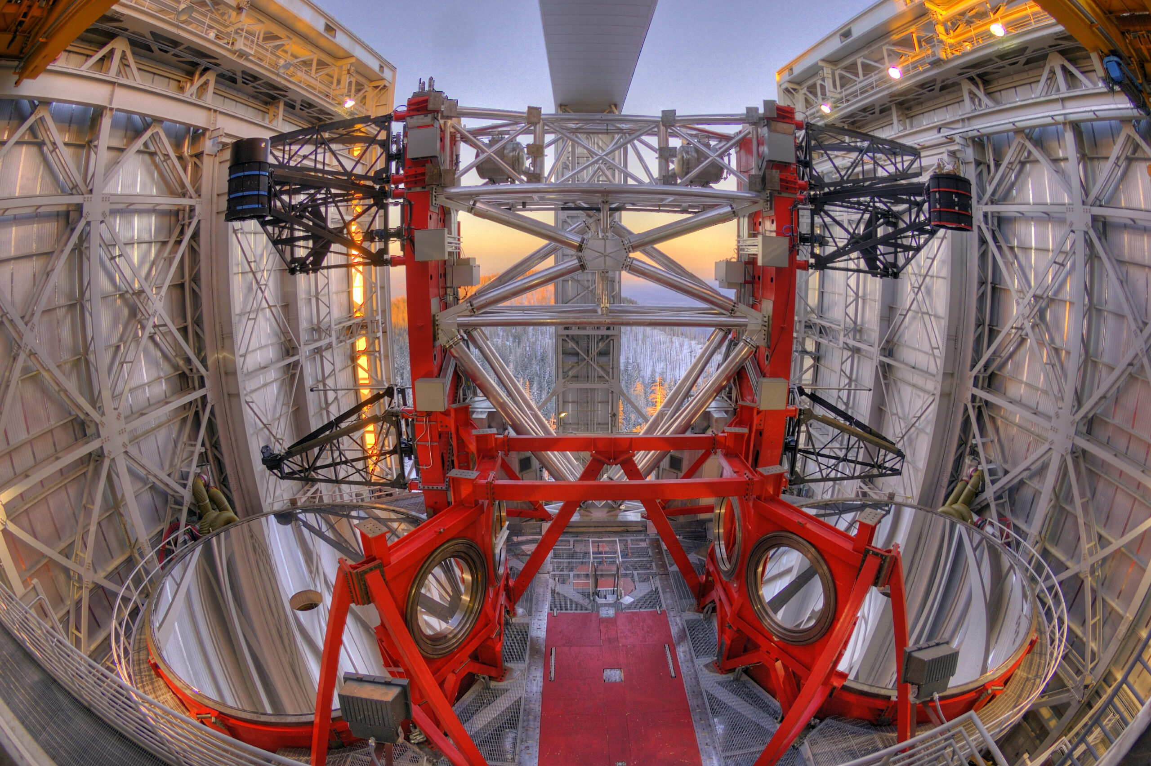
Large Binocular Telescope (LBT, Mt. Graham, Arizona)

Slide 71
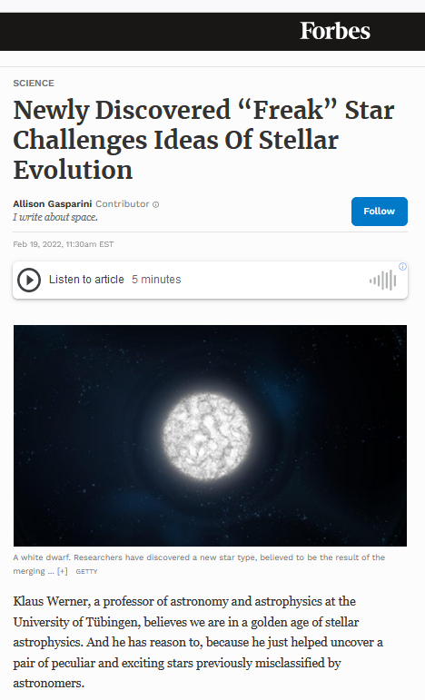
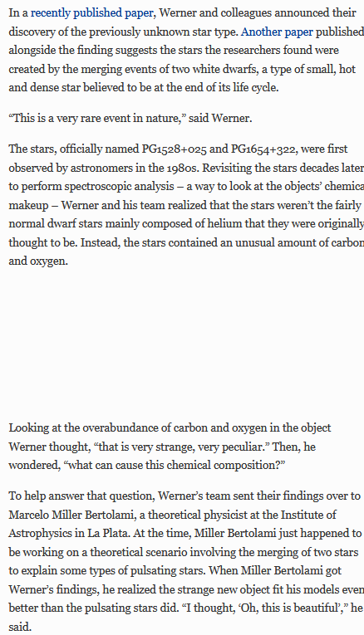

Slide 72

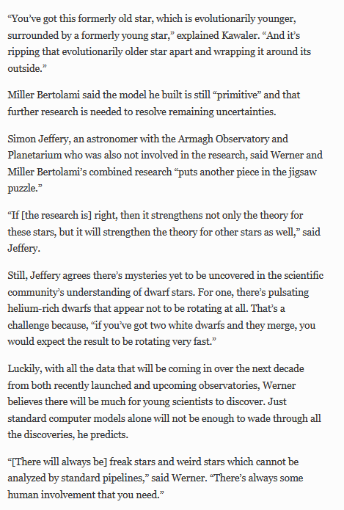

Slide 73
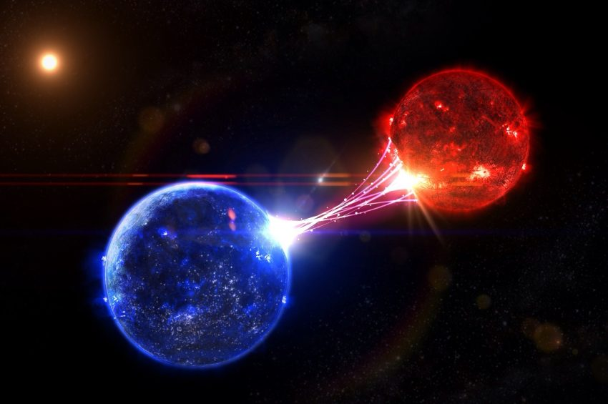
Interesting explosive phenomena occur during binary evolution.
More details on this and other stellar variability mechanisms follow now, in the upcoming chapter on “Variable Stars” on Dec. 6! Don’t miss out!!!
Artist impression of a close binary system

